Slide 1
LO: I can interpret line graphs accurately
While you wait arithmetic challenge:
What is the mean average of these 4 numbers:
4325 1346 9495 3466

Slide 2
I can interpret line graphs accurately
SC:
Define and recognise perpendicular lines (ruler skills)
Recap on key learning on ‘time’
Estimate/identify position on a timeline (60 minutes….)
Read scales and identify divisions
Read horizontally and vertically.

Slide 3
Right angles….. What are they?
Perpendicular lines – when 2 lines intersect at a right angle.

Slide 6
True or false? These numbers are important in time… why are they?
45
15
8
30
100
1000
60
24
300

Slide 7
60 minutes

Slide 8
60 minutes
10:00
11:00
This is 10:50 because it is half way
And ½ is equivalent to 50 - true or false

Slide 9
60 minutes
4:00
5:00
This is 4:25 because it is ¼ of the way along – true or false?

Slide 10
60 minutes
15, 30 and 45

Slide 11
60 minutes
1:00
2:00
What time is this?
How do you know?

Slide 12
60 minutes
5:00
6:00
What time is this?
How do you know?

Slide 13
60 minutes
2:00
1:00
What time is this?
How do you know?

Slide 14
3:00
4:00
7:00
8:00
2:00
3:00
4:00
5:00
11:00
12:00
9:00

Slide 15
Line graphs
What are they?

Slide 16
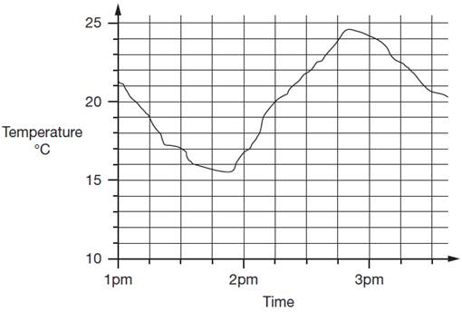

Slide 17
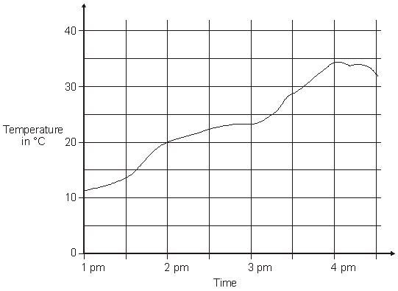

Slide 18
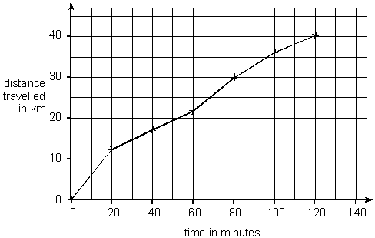

Slide 19
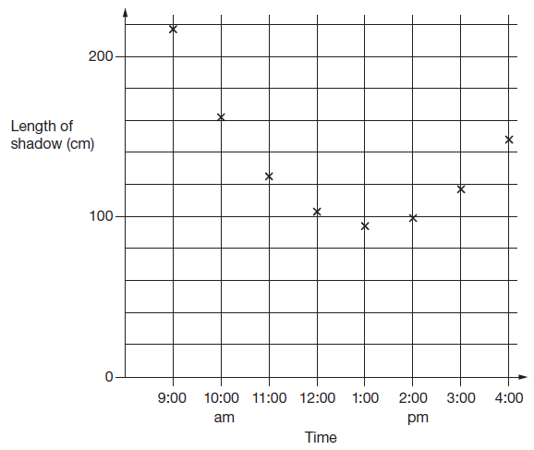

Slide 20
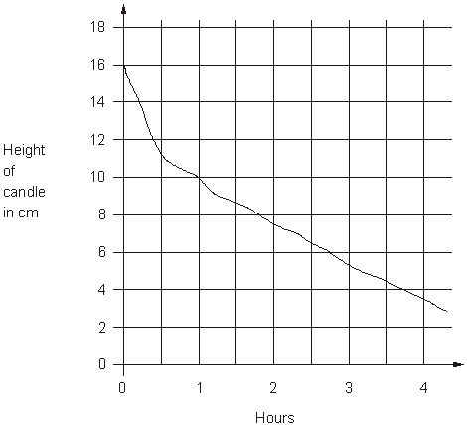

Slide 21
Line graphs – what do they show?
A line graph is a graph that uses line segments to connect data points and shows changes in data over time.

Slide 22
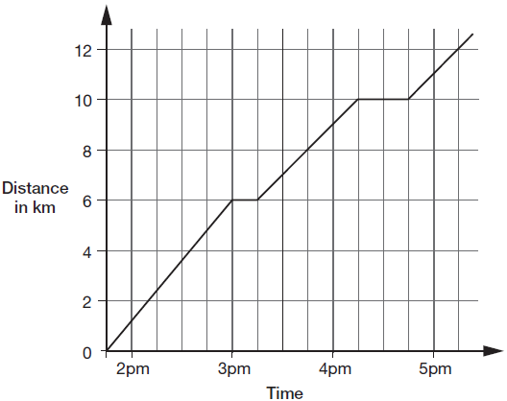
This graph shows the distance Alfie and Chen walked in an afternoon. They started at 1:45pm and had two breaks.
1) What are the scales going in?
2)Horizontal and vertical reading

Slide 23
This graph shows the distance Alfie and Chen walked in an afternoon. They started at 1:45pm and had two breaks.
What was the time after they had walked 7km?

Slide 24
This graph shows the distance Alfie and Chen walked in an afternoon. They started at 1:45pm and had two breaks.
What was the time after they had walked 6 km?

Slide 25
What was the time at 25 degrees?

Slide 26
At 27 degrees the time was 3:56
True or false?

