Slide 1
Describing a rotation
KS3 Mastery PD Materials: Exemplified Key Ideas
Materials for use in the classroom or to support professional development discussions
(from 6.3 Transforming shapes)
Summer 2021

Slide 2
About this resource
These slides are designed to complement the 6.3 Transforming shapes Core Concept document and its associated Theme Overview document 6 Geometry, both found in the Secondary Mastery Professional Development pages.
These slides re-present the key examples from the Core Concept document so that the examples can be used either directly in the classroom or with a group of teachers. There are prompt questions alongside the examples, and further clarification in the notes.
These slides do not fully replicate the Core Concept document, so should be used alongside it. Reference to specific page numbers, and to other useful NCETM resources, can be found in the notes for each slide.
This slide deck is not designed to be a complete PD session, rather it is a selection of resources that you can adapt and use as needed when planning a session with a group of teachers.

Slide 3
About this resource
The slides are structured as follows:
The big picture:
Where does this fit in?
What do students need to understand?
Why is this key idea important?
Prior learning
Misconceptions
Exemplified key ideas
Reflection questions
Appendices:
Key vocabulary
Representations and structure
Previous and Future learning
Useful links
The exemplified key idea slides have the following symbols to indicate how they have been designed to be used:
Into the classroom
The examples are presented on these slides so that they could be used in PD, but also directly in the classroom. The notes feature suggested questions and things teachers might consider when using with students.
PD discussion prompts
These slides look at the examples in more detail, with question prompts to promote discussion among maths teachers. The notes feature reference to further information and guidance within the Core Concepts document.

Slide 4
Where does this fit in?
The NCETM has identified a set of six ‘mathematical themes’ within Key Stage 3 mathematics that bring together a group of ‘core concepts’.
The sixth of these themes is Geometry, which covers the following interconnected core concepts:
6.1 Geometrical properties
6.2 Perimeter, area and volume
6.3 Transforming shapes
6.4 Constructions
Notes:
Linked on this slide is the Theme Overview document of Geometry. This document includes why it is important, the key underpinning knowledge and links to prior and future learning. There is also guidance about how the five big ideas of Teaching for Mastery relate specifically to this theme.

Slide 5
Where does this fit in?
Within this core concept, 6.3 Transforming shapes, there are four statements of knowledge, skills and understanding.
These, in turn, are broken down into twelve key ideas. The highlighted key idea is exemplified in this slide deck.
Notes:
For key ideas marked with an asterisk, we exemplified the common difficulties and misconceptions that students might have and included elements of what teaching for mastery may look like. We have provided examples of possible student tasks and teaching approaches.
Within these slides are ‘classroom-ready’ versions of the examples for the key idea that has been highlighted. There are also slides that may be useful for discussion in a professional development session

Slide 6
What do students need to understand?
6.3.2.2 Understand the minimum information required to describe a rotation (centre of rotation, size and direction of rotation)
Understand that three pieces of information are required to fully describe a rotation.
Use geometrical reasoning and/or equipment, such as angle measurers, to fully describe a rotation.
Understand that the position of the centre of rotation has an effect on the image’s position relative to the object.
Recognise and fully describe a given rotation
What prior knowledge might your students already have?
What language might they use to describe this key idea?
What questions might you want to ask to assess their prior learning?

Slide 7
Why is this key idea important?
Geometry is a central part of mathematics. Geometrical thinking is a fundamental and often intuitive and accessible way to engage students in mathematical activity. The study of geometry helps to develop students’ spatial awareness, intuition and visualisation
Encouraging students to draw diagrams and to see problems in a visual and geometrical form can help them gain insights and hence solve many types of problems.
Transformations allow students to explore the key mathematical ideas of variance and invariance, considering what’s the same and what’s different when looking at objects and their images. This also allows for discussion about congruence and similarity.
Notes:
A more detailed overview of the core concept of rotations can be found on page 6 of the 6.3 Core Concept document.
The background to each key idea is also explored in more detail on the following pages:
6.3.1 Understand and use translations – page 5
6.3.2 Understand and use rotations – page 5
6.3.3 Understand and use reflections – page 6
6.3.4 Understand and use enlargements – page 6

Slide 8
Prior learning
Upper Key Stage 2 Learning Outcome
Identify, describe and represent the position of a shape following a reflection or translation, using the appropriate language, and know that the shape has not changed
Draw and translate simple shapes on the coordinate plane, and reflect them in the axes
Solve problems involving similar shapes where the scale factor is known or can be found
What prior knowledge might your students already have?
What language might they use to describe this key idea?
What questions might you want to ask to assess their prior learning?
Notes:
You may find it useful to speak to your partner schools to see how the above has been covered and the language used.
You can find further details regarding prior learning in the following segments of the NCETM primary mastery professional development materials (linked on final slide):
Year 4: 2.17 Structures: using measures and comparison to understand scaling
Year 6: 2.27 Scale factors, ratio and proportional reasoning
Within the Geometry Theme Overview document, you can also find a broader description of students’ potential previous learning (page 3).

Slide 9
Checking prior learning
The following slides contain questions for checking prior learning.
What representations might students use to support their understanding of these questions?
What variation might you put in place for these questions to fully assess students’ understanding of the concept?
How might changing the language of each question change the difficulty?
Why are these such crucial pre-requisites for this key idea?

Slide 10
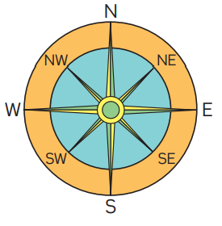
Checking prior learning
a) In the questions below, all of Harry’s movement is in a clockwise direction.
If Harry is facing North and turns through 180 degrees, in which direction will he be facing?
If Harry is facing South and turns through 180 degrees, in which direction will he be facing?
What do you notice?
If Harry is facing North and wants to face SW how many degrees must he turn?
From this position how many degrees must he travel through to face North again?
Notes:
References to the questions (links on final slide):
a) NCETM Primary mastery assessment materials: Year 5, page 26

Slide 11
Common difficulties and misconceptions
What aspects of this key idea might students find challenging?
What misconceptions might students have?
When teaching this topic, you may find students encounter difficulties with…
Describing and recording a rotation
More information, and some suggestions for overcoming these challenges, can be found on the following slides.

Slide 12
Common difficulties and misconceptions (1)
Describing and recording a rotation can prove challenging for students, since it draws on their understanding of angle as a measure of turn.
Research suggests that this understanding of angle is not common in students in early KS3; rather, an angle is often viewed only as a static measure of the relationship between two lines (i.e. a measure of ‘pointedness’).
Rotating several key points or elements of an object to obtain the image may help to establish a better understanding. The use of dynamic geometry software enables the exploration of a range of examples.
Notes:
More detail can be found on page 9 of the 6.3 Core Concept document.
A rotation is arguably one of the more challenging transformations for students to visualise. You can support students in learning about rotations by giving them plenty of opportunities to experiment and become familiar with the behaviour of rotations; for example, through the use of dynamic geometry software and hands-on activities using cut-out shapes or tracing paper.

Slide 13
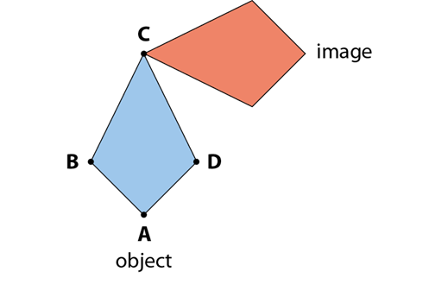
Understand that three pieces of information are required to fully describe a rotation
Example 1
The image is a 90° anticlockwise rotation of the object about point C.
Describe another rotation that also transforms the object to this image.
Notes:
Suggested questioning:
What has stayed the same? What has changed?
Which points haven’t moved under this rotation?
Can you describe all rotations in two different ways?
Things for you to think about:
Rotations require three pieces of information to be fully described: a centre of rotation, a size of rotation and a direction of rotation.
Example 1 is designed to prompt students to think about each of these pieces of information in order to find another way of describing the rotation.

Slide 14
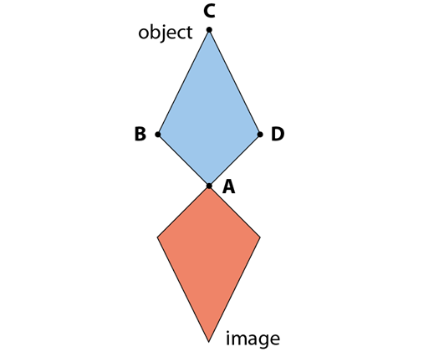
Understand that three pieces of information are required to fully describe a rotation
Example 2
The image is a rotation of the object about point A.
What other information is required to fully describe this rotation?
Notes:
Suggested questioning:
What has stayed the same? What has changed?
Which points haven’t moved under this rotation?
How do you know if you have turned CW or ACW? Does it matter?
Things for you to think about:
In Example 2, students are encouraged to think about each of the key pieces of information needed to specify a rotation.

Slide 15
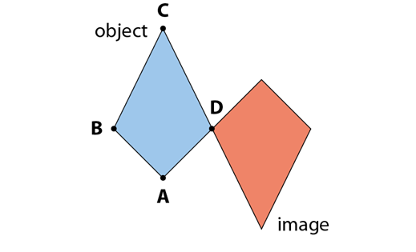
Understand that three pieces of information are required to fully describe a rotation
Example 3
The image is a rotation of the object.
Describe two possible rotations that transform the object to this image.
Notes:
Suggested questioning:
What has stayed the same? What has changed?
Which points haven’t moved under this rotation?
How do you know if you have turned CW or ACW? Does it matter?
What does it mean to describe a rotation?
Things for you to think about:
The ability to visualise different rotations is an important skill.
In Example 3, students are invited to imagine rotating the object around the point D.
Whole-class discussion may reveal that some students rotated the object clockwise, while others rotated it anticlockwise.
D You could encourage students to consider the reverse transformation. That is, how would the description of the rotation differ if the object and the image were exchanged?

Slide 16
Understand that three pieces of information are required to fully describe a rotation
Example 1
Example 2
Example 3
.
The image is a 90° anticlockwise rotation of the object about point C. Describe another rotation that also transforms the object to this image
The image is a rotation of the object about point A. What other information is required to fully describe this rotation?
The image is a rotation of the object. Describe two possible rotations that transform the object to this image.
What mathematical language would you expect students to use when describing rotations?
What features would you draw attention to when designing a follow up task?
Notes:
These examples can be found on pages 7-9 of the 6.3 Core Concept document.

Slide 17
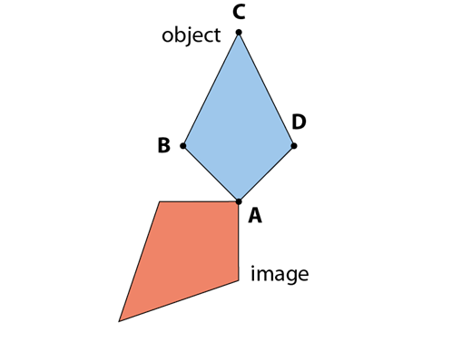
Use geometrical reasoning and/or equipment, such as angle measurers, to fully describe a rotation
Example 4
Describe two possible rotations (specifying the number of degrees turned) that transform the object to the image.
Notes:
Suggested questioning:
What has stayed the same? What has changed?
Which points haven’t moved under this rotation?
What does it mean to describe a rotation?
Things for you to think about:
Students may describe rotations as fractions of whole turns.
Example 4 encourages them to make connections with their knowledge of angles measured in degrees.

Slide 18
Use geometrical reasoning and/or equipment, such as angle measurers, to fully describe a rotation
Example 4
When would you expect pupils to use an angle measurer to describe a rotation?
What mistakes do students make using protractors?
How can you support students to overcome these challenges?
Describe two possible rotations (specifying the number of degrees turned) that transform the object to the image.
Notes:
These examples can be found on pages 7-9 of the 6.3 Core Concept document.

Slide 19
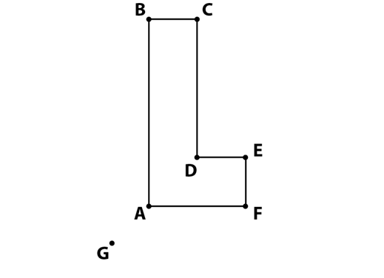
Understand that the position of the centre of rotation has an effect on the image’s position relative to the object
Example 5
a) Using tracing paper, find the position of the image if this object is rotated 90° clockwise about:
(i) A (ii) D (iii) F (iv) G
b) What’s the same and what’s different about these four images?
Notes:
Suggested questioning:
Which point is it easiest to rotate around? Why?
Which is the most difficult? Why?
What would happen if the centre of rotation was a point inside the shape?
Things for you to think about:
In Example 5, the centre of rotation is varied, but all other features of the rotation are the same.
This should draw students’ attention to the following key points:
The orientation of the image is the same wherever the centre of rotation is.
Once one point and one line have been identified on the image, all other points and lines can be determined (because the object and the image are congruent).
If the centre of rotation is a point on the shape, then that point does not move under the transformation.

Slide 20
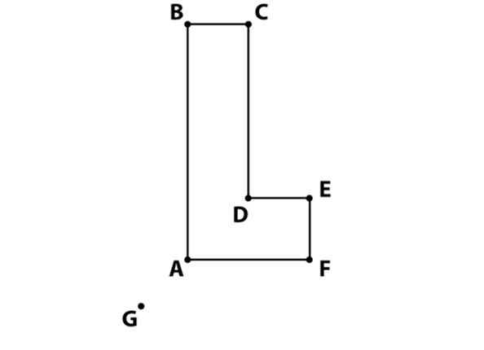
Understand that the position of the centre of rotation has an effect on the image’s position relative to the object
Example 5
a) Using tracing paper, find the position of the image if this object is rotated 90° clockwise about:
(i) A (ii) D (iii) F (iv) G
b) What’s the same and what’s different about these four images?
How can you encourage students to perform the transformation if the scaffold of using tracing paper is removed?
How does this activity support the bigger idea of invariance?
Notes:
This example can be found on page 9 of the 6.3 Core Concept document.

Slide 21
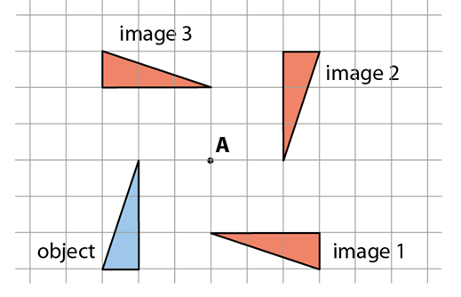
Understand that the position of the centre of rotation has an effect on the image’s position relative to the object
Example 6
What’s the same and what’s different about the three rotations which transform the object to images 1, 2 and 3?
Describe in full each of the rotations.
Notes:
Suggested questioning:
How do you know it is a rotation and not a reflection/translation?
What does it mean to describe in full?
Things for you to think about:
In Example 6, the centre and direction of rotation have been kept the same while varying the angle. This is to direct students’ attention to the size of the turn.

Slide 22
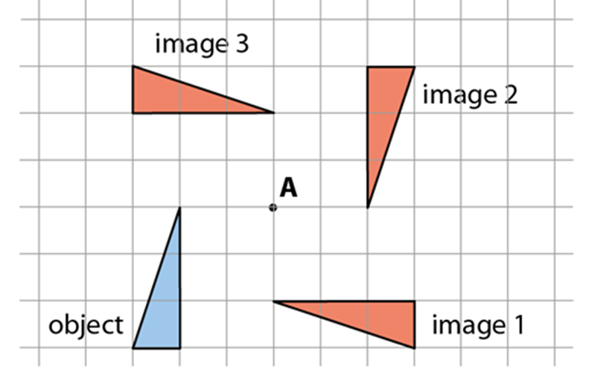
Understand that the position of the centre of rotation has an effect on the image’s position relative to the object
Example 6
What’s the same and what’s different about the three rotations which transform the object to images 1, 2 and 3?
Describe in full each of the rotations.
How could you demonstrate the locus of each vertex when rotating a full 360° degrees?
Why might you do this?
Notes:
This example can be found on page 10 of the 6.3 Core Concept document.

Slide 23
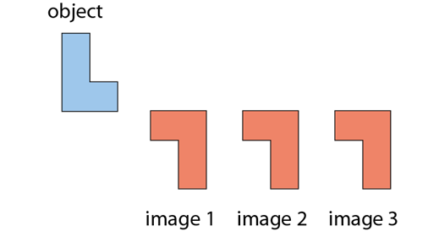
Understand that the position of the centre of rotation has an effect on the image’s position relative to the object
Example 7
What’s the same and what’s different about the three rotations which transform the object to images 1, 2 and 3?
Describe in full each of the rotations.
Notes:
Suggested questioning:
How do you know it is a rotation and not a reflection/translation?
Is the angle of rotation the same in each case?
Things for you to think about:
What might students notice from keeping the size of the turn and direction of rotation constant, but varying the position of the centre of rotation?

Slide 24
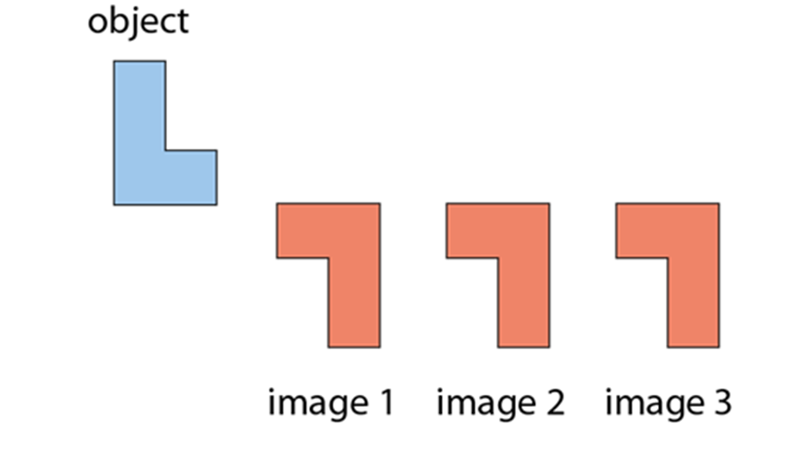
Understand that the position of the centre of rotation has an effect on the image’s position relative to the object
Example 7
What’s the same and what’s different about the three rotations which transform the object to images 1, 2 and 3?
Describe in full each of the rotations.
What might students notice from keeping the size of the turn and direction of rotation constant, but varying the position of the centre of rotation?
Students will be required to use their knowledge of coordinates to describe transformations. What foundations can be built to support this later learning?
Notes:
This example can be found on page 10 of the 6.3 Core Concept document.

Slide 25
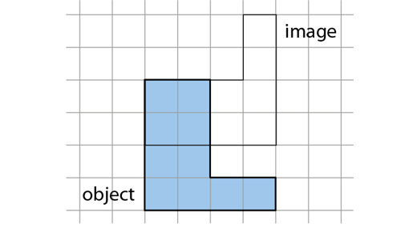
Understand that the position of the centre of rotation has an effect on the image’s position relative to the object
Example 8
The object has been rotated 90° anticlockwise.
Where is the centre of rotation?
Notes:
Suggested questioning:
Imagine putting the centre of rotation on each vertex, where would the image be in each case after a 90 degree anticlockwise rotation?
How does this help you think about where the centre of rotation might be?
Things for you to think about:
You could encourage students to vary, for themselves, the centre of rotation and explore what happens to the position of the image. Discussion could draw out the important point that the orientation of the image will be the same for different centres if the direction and size of rotation remains the same.

Slide 26
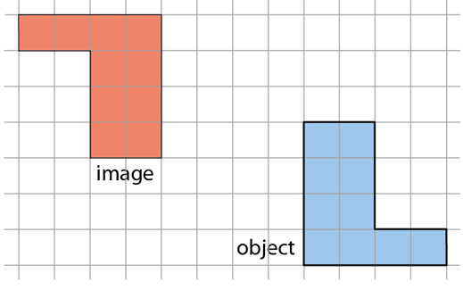
Understand that the position of the centre of rotation has an effect on the image’s position relative to the object
Example 9
The object has been rotated by 180°.
Where is the centre of rotation?
Notes:
Suggested questioning:
Is the centre of rotation on the shape / inside the shape / outside the shape?
How do you know?
Can you predict where the centre is? How would you check?
Things for you to think about:
Example 9 provides an opportunity for students to deepen their understanding of using constructions to find the centre of rotation. By joining points on the object to corresponding points on the image, and identifying where the lines cross, the centre of rotation can be found accurately.

Slide 27
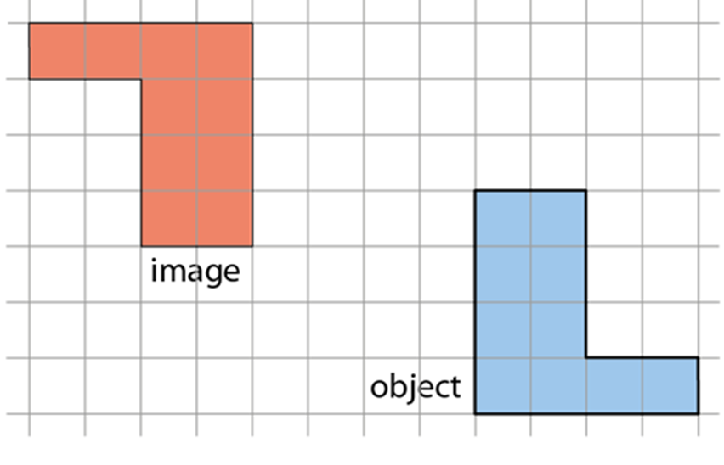
Understand that the position of the centre of rotation has an effect on the image’s position relative to the object
Example 8
Example 9
The object has been rotated 90° anticlockwise.
Where is the centre of rotation?
The object has been rotated by 180°.
Where is the centre of rotation?
Which of these questions do you think students will find the most challenging? Why?
In Example 9 students can find the centre by joining points on the object to corresponding points on the image, and identifying where the lines cross. Does this strategy work for all angles of rotation?
Notes:
These examples can be found on page 11 of the 6.3 Core Concept document.

Slide 28
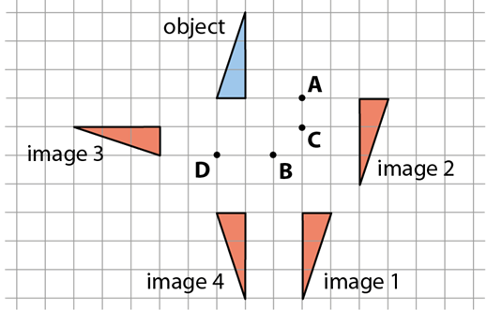
Recognise and fully describe a given rotation
Example 10
Four transformations of the blue object are shown here.
a) Which image is not a rotation of the object?
b) Fully describe the transformation of the object to each image.
Notes:
Suggested questioning:
What stays the same under a rotation?
Which image is the odd one out and why?
Things for you to think about:
The first part of Example 10 draws students’ attention to what a rotation is not by the inclusion of image 4, which is a reflection of the object in the line DB. You could challenge students to create their own example collections of transformations, some of which are correct and others that are not, to swap with a desk partner to solve.
Encourage students to use precise language to describe a rotation. For example: ‘Object A is rotated 90 degrees anticlockwise around the point B.’

Slide 29
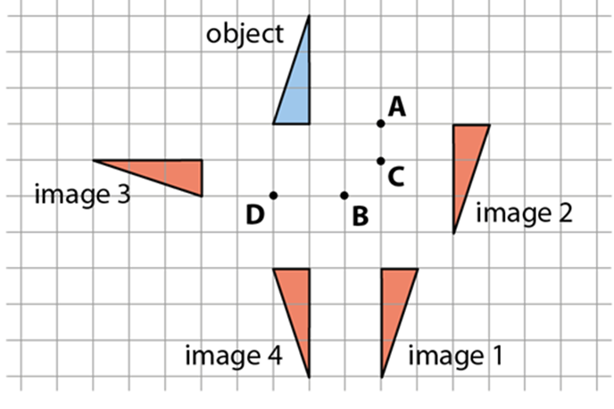
Recognise and fully describe a given rotation
Example 10
Four transformations of the blue object are shown here.
a) Which image is not a rotation of the object?
b) Fully describe the transformation of the object to each image.
By having a question about which image is not a rotation, what properties is it drawing attention to?
What strategies do you think students will use to identify which centre has been used for each image?
Notes:
This example can be found on page 12 of the 6.3 Core Concept document.

Slide 30
Reflection questions
What other mathematical concepts will be supported by students’ stronger understanding of this key idea?
What mathematical language will you continue to use to support pupils to make connections with other areas?
Which representations might you continue to use to further develop students’ understanding?

Slide 32
Appendices
You may choose to use the following slides when planning or delivering a PD session. They cover:
Key vocabulary
Representations and structure
Previous learning
Future learning
Library of links

Slide 33
Key vocabulary
Term | Definition
centre of rotation | Mentioned in definition for rotation: in 2-dimensions, a transformation of the whole plane, which maps each point to another by rotating it by a specified angle (the angle of rotation) about a fixed point (the centre of rotation).
congruent (figures) | Two or more geometric figures are said to be congruent when they are the same in every way except their position in space.
image | When a transformation is applied to a shape, the transformed shape is called the ‘image’. The original shape is called the ‘object’.
object | When a transformation is applied to a shape, the original shape is called the ‘object’. The transformed shape is called the ‘image’.

Slide 34
Representations and structure
There are a number of different representations that you may wish to use to support students’ understanding of this key idea. These might include:
Dynamic geometry software
The guided use of dynamic geometry software can provide an environment in which students are able to make and test conjectures. By dragging and changing features, they are able to identify variant and invariant properties, leading to a deeper understanding of generalisations.
Mental imagery
All concrete and pictorial representations have their limitations in the way they are able to represent the abstract world of mathematics. The ultimate purpose of all representations is to support students’ mental construct of an idea or concept. Students do not use the representation to do the mathematics; rather, the representation supports the student in making a mental representation of the idea.
Notes:
More information about the representations and structure involved in this key idea can be found:
On page 6 of the Theme Overview document
Links to all of these can be found on the final slide.

Slide 35
Previous learning
From Upper Key Stage 2, students will bring experience of:
drawing 2D shapes using given dimensions and angles
recognising, describing and building simple 3D shapes, including making nets
comparing and classifying geometric shapes based on their properties and sizes, and finding unknown angles in any triangles, quadrilaterals and regular polygons
illustrating and naming parts of circles, including radius, diameter and circumference, and knowing that the diameter is twice the radius
recognising angles where they meet at a point, are on a straight line or are vertically opposite, and finding missing angles
drawing and translating simple shapes on the coordinate plane and reflecting them in the axes.
Notes:
Theme 6 Geometry

Slide 36
Future learning (1)
In KS4, students will build on the core concepts in this mathematical theme to:
interpret and use fractional {and negative} scale factors for enlargements
{describe the changes and invariance achieved by combinations of rotations, reflections and translations}
identify and apply circle definitions and properties, including: centre, radius, chord, diameter, circumference, tangent, arc, sector and segment
{apply and prove the standard circle theorems concerning angles, radii, tangents and chords, and use them to prove related results}
construct and interpret plans and elevations of 3D shapes
interpret and use bearings
calculate arc lengths, angles and areas of sectors of circles
calculate surface areas and volumes of spheres, pyramids, cones and composite solids
Please note: Braces { } indicate additional mathematical content to be taught to more highly attaining students.

Slide 37
Future learning (2)
In KS4, students will build on the core concepts in this mathematical theme to:
apply the concepts of congruence and similarity, including the relationships between lengths, {areas and volumes} in similar figures
apply Pythagoras’ theorem and trigonometric ratios to find angles and lengths in right-angled triangles {and, where possible, general triangles} in two {and three} dimensional figures
know the exact values of sin θ and cos θ for θ = 30°, 45°, 60° and 90°; know the exact value of tan θ for θ = 30°, 45°, 60°
{know and apply the sine rule, $\frac{a}{SinA}=\frac{b}{SinB}=\frac{c}{SinC}$ , and cosine rule, $a^{2}=b^{2}+c^{2}– 2bc cos⁡A$, to find unknown lengths and angles}
{know and apply Area =$\frac{1}{2}ab\sin{C}$ to calculate the area, sides or angles of any triangle}
describe translations as 2D vectors
apply addition and subtraction of vectors, multiplication of vectors by a scalar, and diagrammatic and column representations of vectors; {use vectors to construct geometric arguments and proofs}.
Please note: Braces { } indicate additional mathematical content to be taught to more highly attaining students.
Notes:
Theme 6 Geometry

Slide 38
Library of links
The following resources from the NCETM website have been referred to within this slide deck:
NCETM Secondary Mastery Professional Development
6 Geometry Theme Overview Document
6.1 Geometrical properties Core Concept Document
NCETM primary mastery professional development materials
NCETM primary assessment materials

