Slide 1
Algebra Key Stage 2
Video 2.4
Using algebra to solve problems

Slide 2
2.4 Using algebra to solve problems
Consider the boy’s reasoning when he says:
“There’s two pears and a lemon and there’s two pears and an orange – that means a lemon is seven greater than an orange.”
Work through the problem on the following slide and consider the strategies you would use to solve the problem.

Slide 3
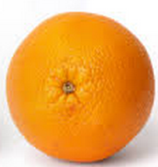
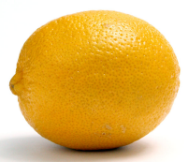
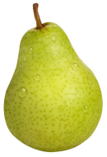
The Problem
46
35
42
Can you find the value of an orange, a lemon and a pear from the information you have been given?

Slide 4
Linking to the new curriculum
find pairs of numbers that satisfy an equation with two unknowns (NC p42)
Consider how the activity addresses this programme of study statement and enables higher attaining children to develop depth of reasoning.

