Slide 1
Recognising place value in decimals
KS3 Mastery PD Materials: Exemplified Key Ideas
Materials for use in the classroom or to support professional development discussions
(From 1.1 Place value, estimation and rounding)
Summer 2021

Slide 2
About this resource
These slides are designed to complement the 1.1 Place value, estimation and rounding Core Concept document and its associated Theme Overview document 1 The Structure of the number system, both found in the Secondary Mastery Professional Development pages.
These slides re-present the key examples from the Core Concept document so that the examples can be used either directly in the classroom or with a group of teachers. There are prompt questions alongside the examples, and further clarification in the notes.
These slides do not fully replicate the Core Concept document, so should be used alongside it. Reference to specific page numbers, and to other useful NCETM resources, can be found in the notes for each slide.
This slide deck is not designed to be a complete PD session, rather it is a selection of resources that you can adapt and use as needed when planning a session with a group of teachers.

Slide 3


About this resource
The slides are structured as follows:
  The big picture:
    Where does this fit in?
    What do students need to understand?
    Why is this key idea important?
  Prior learning
  Misconceptions
  Exemplified key ideas
  Reflection questions
  Appendices:
    Key vocabulary
    Representations and structure
    Previous and Future learning
    Useful links
The exemplified key idea slides have the following symbols to indicate how they have been designed to be used:
Into the classroom
The examples are presented on these slides so that they could be used in PD, but also directly in the classroom. The notes feature suggested questions and things teachers might consider when using with students.
PD discussion prompts
These slides look at the examples in more detail, with question prompts to promote discussion among maths teachers. The notes feature reference to further information and guidance within the Core Concepts document.

Slide 4
Where does this fit in?
The NCETM has identified a set of six ‘mathematical themes’ within Key Stage 3 mathematics that bring together a group of ‘core concepts’.
The first of these themes is The structure of the number system, which covers the following interconnected core concepts:
    1.1 Place value, estimation and rounding
    1.2 Properties of number
    1.3 Ordering and comparing
    1.4 Simplifying and manipulating expressions, equations and formulae
Notes:
Linked on this slide is the Theme Overview document of The structure of the number system. This document includes why it is important, the key underpinning knowledge and links to prior and future learning. There is also guidance about how the five big ideas of Teaching for Mastery relate specifically to this theme.

Slide 5
Where does this fit in?
Within this core concept, 1.1 Place value, estimation and rounding, there are four statements of knowledge, skills and understanding.
These, in turn, are broken down into fifteen key ideas. The highlighted key idea is exemplified in this slide deck.
Notes:
For key ideas marked with an asterisk, we exemplified the common difficulties and misconceptions that students might have and included elements of what teaching for mastery may look like. We have provided examples of possible student tasks and teaching approaches.
Within these slides are ‘classroom-ready’ versions of the examples for the key idea that has been highlighted. There are also slides that may be useful for discussion in a professional development session.

Slide 6
What do students need to understand?
1.1.1.2 Understand place value in decimals, including recognising exponent and fractional representations of the column headings
Know and understand powers of ten
Interpret powers of ten written using index notation
Connect different representations of column headings
Understand the multiplicative relationships between columns in the place value structure
  What prior knowledge might your students already have?
  What language might they use to describe this key idea?
  What questions might you want to ask to assess their prior learning?

Slide 7
Why is this key idea important?
Understanding place value is a fundamental skill and at the heart of a strong sense of number. Students need to be able to correctly say any number and understand where it fits in the number system (i.e. in an ordered list of numbers and on a number line).
It is important that students are aware of the general structure of the place-value system as based on powers of ten and begin to see how this naturally extends to decimals. Students need to progress beyond recalling place-value column headings when answering questions such as ‘What does the 8 represent in 43 872?’ and appreciate that 43 872 has 438 hundreds and, later, that 43 872 is, in fact, 438.72 hundreds or 438.72 × 100.
The focus in this set of key ideas is understanding the structure of the system (that each column value is a power of ten and that multiplying or dividing by ten shifts digits from one column to the adjacent one).
This learning will support students’ work on significant figures and standard form, as students who can express numbers (including very large and very small numbers) in these different ways are more likely to have a feel for the size of such numbers and where they fit in the number system.
Notes:
A more detailed overview of the core concept of Place value, estimation and rounding can be found on page 2 of the 1.1 Core Concept document.
The background to each key idea is also explored in more detail on the following pages:
1.1.1 Understand the value of digits in decimals, measures and integers – page 4
1.1.2 Round numbers to a required number of decimal places – page 5
1.1.3 Round numbers to a required number of significant figures – page 5
1.1.4 Estimate calculations by rounding – page 6

Slide 8
Prior learning
  What prior knowledge might your students already have?
  What language might they use to describe this key idea?
  What questions might you want to ask to assess their prior learning?
Upper Key Stage 2 Learning Outcome
Read, write, order and compare numbers up to 10 000 000 and determine the value of each digit
Round any whole number to a required degree of accuracy
Identify the value of each digit in numbers given to three decimal places and multiply and divide numbers by 10, 100 and 1 000 giving answers up to three decimal places
Notes:
You may find it useful to speak to your partner schools to see how the above has been covered and the language used.
You can find further details regarding prior learning in the following segments of the NCETM primary mastery professional development materials (linked on final slide):
Year 4: 2.13 Calculation: multiplying and dividing by 10 or 100
Year 5: 1.26 Composition and calculation: multiples of 1 000 up to 1 000 000
Year 6: 1.30 Composition and calculation: numbers up to 10 000 000
Within the Theme Overview document, you can also find a broader description of students’ potential previous learning (page 4), alongside further information about key underpinning knowledge (page 2).

Slide 9
Checking prior learning
The following slides contain questions for checking prior learning.
  What representations might students use to support their understanding of these questions?
  What variation might you put in place for these questions to fully assess students’ understanding of the concept?
  How might changing the language of each question change the difficulty?
  Why are these such crucial pre-requisites for this key idea?

Slide 10
Checking prior learning
a) Complete the sentences.
  500 made 1,000 times the size is ________.
  0.7 made 100 times the size is ________.
  800,000 made 10 times the size is ________.
  4,000,000 made one-thousandth times the size is ________.
  9,000 made one-hundredth times the size is ________.
  3 made one-tenth times the size is ________.
b) Fill in the missing numbers.
0.01 x ___ = 1 0.1 x ___ = 1 0.01 x ___ = 0.1
Notes:
References to the questions (links on final slide):
Mathematics guidance: key stages 1 and 2 (DfE and NCETM, 2020), page 285
Mathematics guidance: key stages 1 and 2 (DfE and NCETM, 2020), page 215

Slide 11
Common difficulties and misconceptions
What aspects of this key idea might students find challenging?
What misconceptions might students have?
When teaching this topic, you may find students encounter difficulties with…
Interpreting column headings written as fractions or exponents
More information, and some suggestions for overcoming these challenges, can be found on the following slides
Notes:
More information can be found on page 6 of the 1.1 Core Concept document.

Slide 12
Common difficulties and misconceptions
Students are likely be familiar with place value charts and the column headings in both words (tens, ones, tenths, hundredths…) and as decimals (10s, 1s, 0.1s, 0.01s…) (for example, in Year 4 of the Primary PD Materials, Topic 1.24) but may need to revisit column headings written as fractions and exponents.
Understanding that a mathematical object can have the ‘same value but a different appearance’ is a key understanding in maths, and students may find it challenging to recognise that a column headed as tenths, 1/10, 0.01 or 10⁻¹ will represent digits of equal value.
A focus for this Key Idea is the structure of the place value system and the connections within it. This builds on the understanding that students developed at KS2 and moves to a more general appreciation of the multiplicative relationships between columns.
Notes:
More detail can be found on page 6 of the 1.1 Core Concept document.

Slide 13
Know and understand powers of ten
Example 1
Write down as many three-digit powers of ten as you can.
Notes:
Suggested questioning:
What makes a number a power of ten?
Is 010 an example? Is 0.10 an example? Is 0.01 an example? Why or why not?
What power of ten is __?
Things for you to think about:
Example 1 invites students to think about what makes a number a power of ten, considering what it is, what it also is, and what it’s not. By working with student generated examples the teacher is able to gather ‘boundary cases’ while also assessing the students’ current understanding. For example, a student might offer 010 as a three-digit power of ten and, in discussing the validity of this, the key features of powers of ten can be discussed. If not forthcoming from students, the teacher might offer 0.10, or 0.01 and so the task offers an opportunity to expand the range of examples that students are able to draw on.

Slide 14
Know and understand powers of ten
Example 1
  What are the potential benefits of considering what something “is, also is, and is not”?
  How might a ‘boundary case’ help you to assess students’ understanding?
  What suggestions might your students offer here? What suggestions might you want to offer here?
Write down as many three-digit powers of ten as you can.
Notes:
This example can be found on page 6 of the 1.1 Core Concept document.

Slide 15
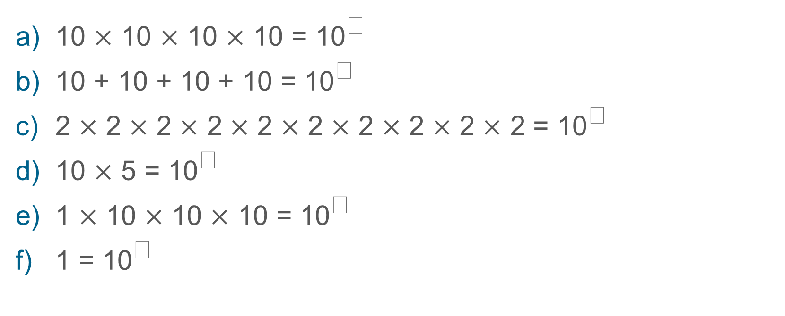
Interpret powers of ten written using index notation
Example 2
Which of these calculations cannot be answered by placing a single digit in the box?
10 $×$ 10 $×$ 10 $×$ 10 = 10
10 + 10 + 10 + 10 = 10
2 $×$ 2 $×$ 2 $×$ 2 $×$ 2 $×$ 2 $×$ 2 $×$ 2 $×$ 2 $×$ 2 = 10
10 $×$ 5 = 10
1 $×$ 10 $×$ 10 $×$ 10 = 10
1 = 10
Notes:
Suggested questioning:
What does ‘to the power of’ mean? How is this different to ‘multiply’?
How could you rewrite the ones that cannot be answered?
What is the difference between 2¹⁰ and 10²?
What is the same/different between parts _ and _?
Things for you to think about:
While example 1 focuses on understanding the exponential nature of the powers of ten, here we focus on understanding the notation. Example 2 offers an opportunity for students to think about what is, and what is not a power of ten, and to use correct notation to record this.
Part b allows attention to be drawn to the multiplicative nature of exponentiation.
Part c offers an opportunity to discuss the role of the base and the exponent in the notation (drawing a distinction between 2¹⁰ and 10²).
Parts e and f introduce a 1 to the beginning of the expansion. The inclusion of the multiplicative identity may help students make sense of the fact that m⁰ = 1. By describing part e as “one multiplied by ten three times, part a could then be described as “one multiplied by ten four times” and so part f is described as “one multiplied by ten zero times”.

Slide 16
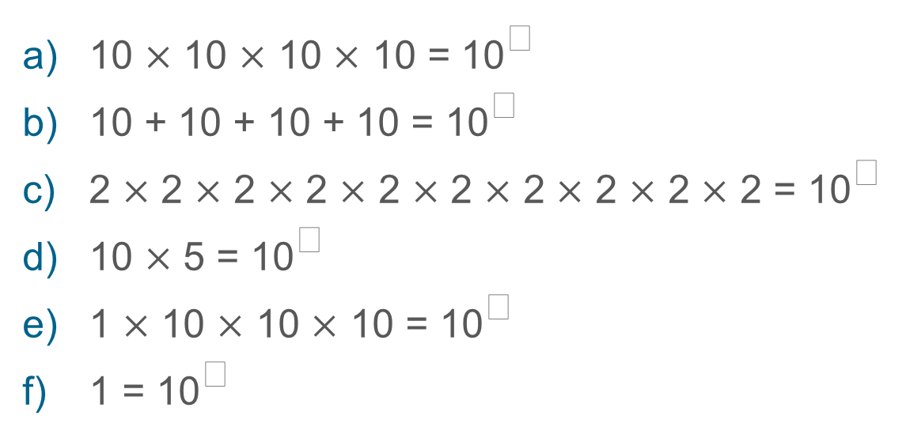
Interpret powers of ten written using index notation
Example 2
Which of these calculations cannot be answered by placing a single digit in the box?
  It is common to describe a number such as 10³ as “ten multiplied by itself three times.” What are the advantages and limitations of this description?
  Do you think that the description of “1 multiplied by ten three times” offers a greater insight for students, muddies the water further, or makes little difference?
10 $×$ 10 $×$ 10 $×$ 10 = 10
10 + 10 + 10 + 10 = 10
2 $×$ 2 $×$ 2 $×$ 2 $×$ 2 $×$ 2 $×$ 2 $×$ 2 $×$ 2 $×$ 2 = 10
10 $×$ 5 = 10
1 $×$ 10 $×$ 10 $×$ 10 = 10
1 = 10
Notes:
This example can be found on pages 6-7 of the 1.1 Core Concept document.

Slide 17
Interpret powers of ten written using index notation
Example 3
10⁹ is a power of ten.
How would you find the next power of ten (and what is it)?
How would you find the previous power of ten (and what is it)?
Notes:
Suggested questioning:
What is the relationship between consecutive powers of ten? How do you ‘move’ from one to another?
How would you find the ‘next but one’ power of ten?
Things for you to think about:
This task gives an opportunity to explore the structure of powers of ten, drawing attention to the multiplication that underpins them. Moving from one power of ten to the next is a key idea when working with place value.

Slide 18
Interpret powers of ten written using index notation
Example 3
  “Always Sometimes Never” questions can be useful when exploring mathematical structure with students. For example, students might be asked, “Is it always, sometimes or never true that multiplying two powers of ten together will generate another power of ten?”
  Do this “Always Sometimes Never” question and Example 2 draw attention to the same mathematical structure?
  When might you ask one question and when would you choose the other?
10⁹ is a power of ten.
How would you find the next power of ten (and what is it)?
How would you find the previous power of ten (and what is it)?
Notes:
Due to space constraints, the image on this PD discussion slide is very small. PD Leads might like to use or print the ‘in the classroom’ version of this slide for teachers to access during discussions.
This example can be found on page 7 of the 1.1 Core Concept document.

Slide 19
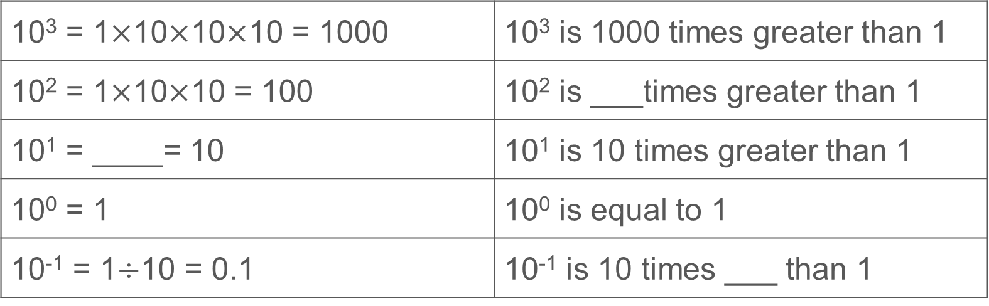
Interpret powers of ten written using index notation
Example 4
Fill in the gaps:
10³ = 1$×$10$×$10$×$10 = 1000 | 10³ is 1000 times greater than 1
10² = 1$×$10$×$10 = 100 | 10² is ___times greater than 1
10¹ = ____= 10 | 10¹ is 10 times greater than 1
10⁰ = 1 | 10⁰ is equal to 1
10⁻¹ = 1$÷$10 = 0.1 | 10⁻¹ is 10 times ___ than 1
If the pattern continues, what would the next row be?
Notes:
Suggested questioning:
Is there another way of phrasing each sentence?
What do you notice about the pattern?
What is the same/different about each row?
What is the relationship between each power of 10 and 1?
Things for you to think about:
In example 4, students are able to continue the pattern to notice the way that the powers of ten extend to negative numbers. The use of a written description is intended to make explicit to students the structure underpinning that pattern. Consider carefully the language you will use and expect students to use.

Slide 20
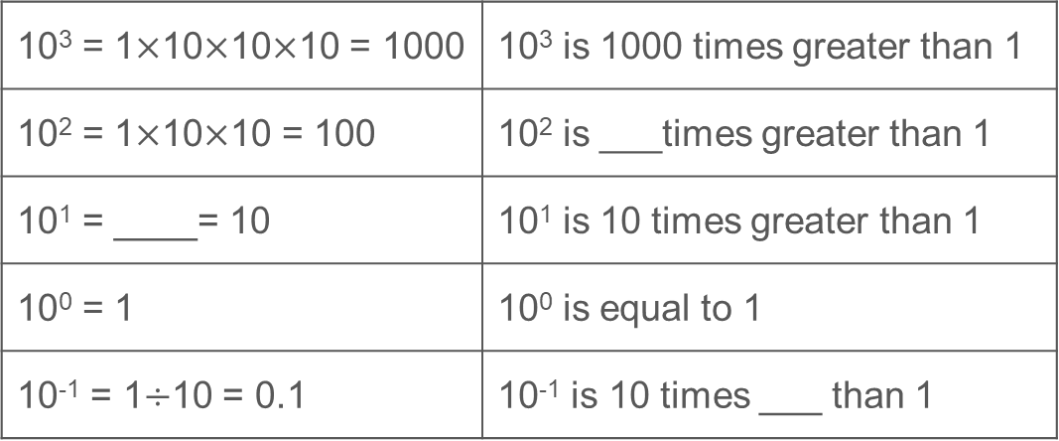
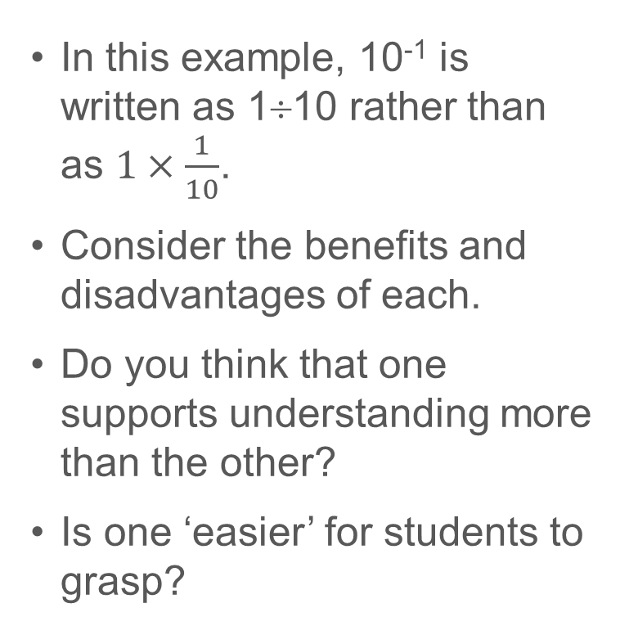
Interpret powers of ten written using index notation
Example 4
  In this example, 10⁻¹ is written as 1÷10 rather than as $1×\frac{1}{10}$.
  Consider the benefits and disadvantages of each.
  Do you think that one supports understanding more than the other?
  Is one ‘easier’ for students to grasp?
Fill in the gaps:
10³ = 1$×$10$×$10$×$10 = 1000 | 10³ is 1000 times greater than 1
10² = 1$×$10$×$10 = 100 | 10² is ___times greater than 1
10¹ = ____= 10 | 10¹ is 10 times greater than 1
10⁰ = 1 | 10⁰ is equal to 1
10⁻¹ = 1$÷$10 = 0.1 | 10⁻¹ is 10 times ___ than 1
If the pattern continues, what would the next row be?
Notes:
Due to space constraints, the image on this PD discussion slide is very small. PD Leads might like to use or print the ‘in the classroom’ version of this slide for teachers to access during discussions.
This example can be found on page 7 of the 1.1 Core Concept document.

Slide 21
Interpret powers of ten written using index notation
Example 5
Fill in the gaps:
10³ = 1000 | 10³ is 10 times greater than 10²
10² = 100 | 10² is ___ times greater than 10¹
10¹ = 10 | 10¹ is 10 times greater than 10
10⁰ = 1 | 10⁰ is 10 times greater than ___
10⁻¹ = 0.1 | 10⁻¹ is 10 times ___ than 10⁻²
Notes:
Suggested questioning:
How is the language different to example 4?
What is the relationship between consecutive powers?
Is there another way of phrasing each sentence?
What do you notice about the pattern?
What is the same/different about each row?
Things for you to think about:
Example 5 builds on example 4 but this time the language is used to draw attention to the relationship between consecutive powers of ten when represented using index notation. This understanding is key when working with column headings in place value charts.

Slide 22
Interpret powers of ten written using index notation
Example 5
Fill in the gaps:
  Why is this understanding so crucial for students’ conception of place value?
  What representations might you want to refer to when discussing this task with students?
10³ = 1000 | 10³ is 10 times greater than 10²
10² = 100 | 10² is ___ times greater than 10¹
10¹ = 10 | 10¹ is 10 times greater than 10
10⁰ = 1 | 10⁰ is 10 times greater than ___
10⁻¹ = 0.1 | 10⁻¹ is 10 times ___ than 10⁻²
Notes:
This example can be found on page 8 of the 1.1 Core Concept document.

Slide 23
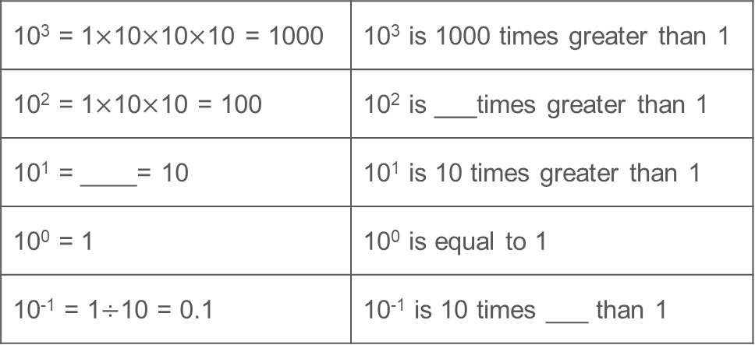
Interpret powers of ten written using index notation
Example 4
Example 5
10³ = 1$×$10$×$10$×$10 = 1000 | 10³ is 1000 times greater than 1
10² = 1$×$10$×$10 = 100 | 10² is ___times greater than 1
10¹ = ____= 10 | 10¹ is 10 times greater than 1
10⁰ = 1 | 10⁰ is equal to 1
10⁻¹ = 1$÷$10 = 0.1 | 10⁻¹ is 10 times ___ than 1
10³ = 1000 | 10³ is 10 times greater than 10²
10² = 100 | 10² is ___ times greater than 10¹
10¹ = 10 | 10¹ is 10 times greater than 10
10⁰ = 1 | 10⁰ is 10 times greater than ___
10⁻¹ = 0.1 | 10⁻¹ is 10 times ___ than 10⁻²
  Consider what is the same and different about examples 4 and 5. How does the difference in language emphasise different aspects of mathematical structure?
  How might each example contribute towards students’ understanding of place value?
Notes:
Due to space constraints, the image on this PD discussion slide is very small. PD Leads might like to use or print the ‘in the classroom’ version of this slide for teachers to access during discussions.
These examples can be found on pages 7 and 8 of the 1.1 Core Concept document.

Slide 24
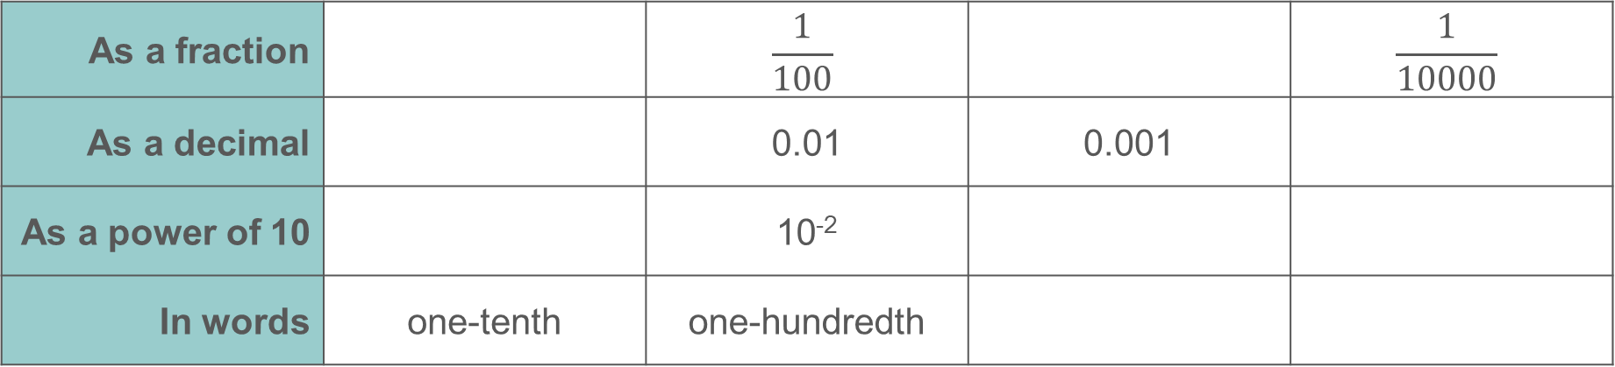
Connect different representations of column headings
Example 6
Fill in the gaps so that each column shows a different way of writing the same value.
As a fraction |  | $$\frac{1}{100}$$ |  | $$\frac{1}{10000}$$
As a decimal |  | 0.01 | 0.001
As a power of 10 |  | 10⁻²
In words | one-tenth | one-hundredth
Notes:
Suggested questioning:
What is the same? What is different?
Do you normally think of one row more than another? Why or why not?
Things for you to think about:
Although not made explicit in the wording of the task, Example 6 shows the first four columns of a place value chart and the different ways in which the column headings might be represented. It is important that students understand that although the representations shown in the columns look different, they represent the same value.

Slide 25
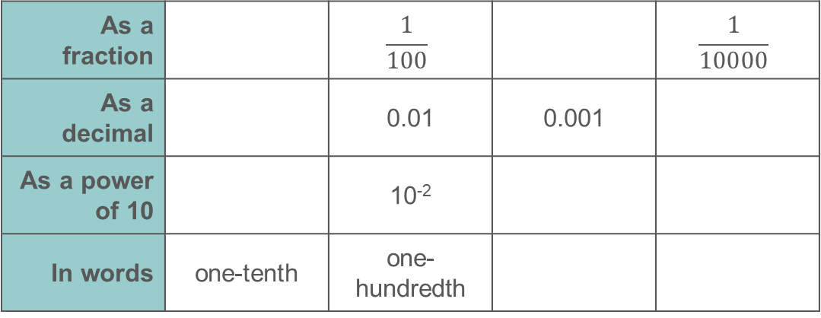
Connect different representations of column headings
Example 6
  Which of these are you (and your students) most likely to use when labelling a place value chart? Why might this be?
  Each column can be described as having the “same value, different appearance” – where else in the curriculum is this an important idea?
Fill in the gaps so that each column shows a different way of writing the same value.
As a fraction |  | $$\frac{1}{100}$$ |  | $$\frac{1}{10000}$$
As a decimal |  | 0.01 | 0.001
As a power of 10 |  | 10⁻²
In words | one-tenth | one-hundredth
Notes:
This example can be found on page 8 of the 1.1 Core Concept document.

Slide 26
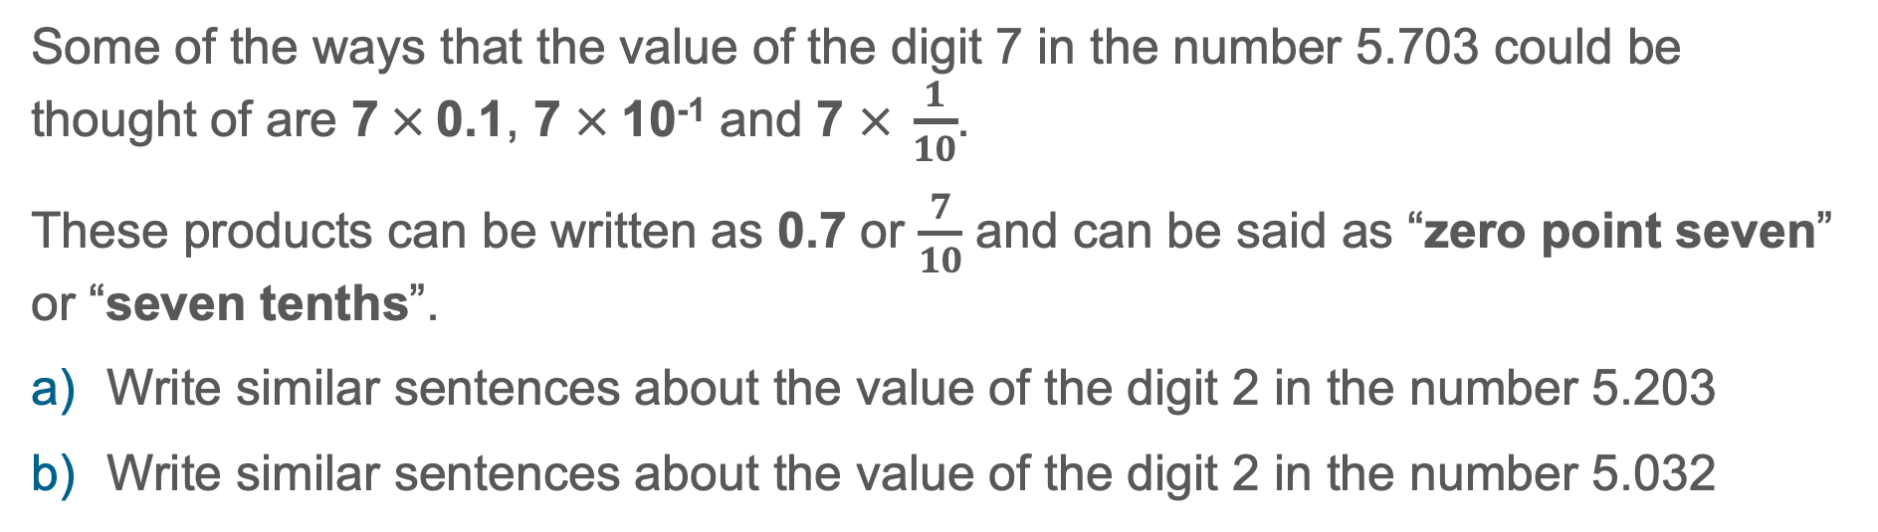
Connect different representations of column headings
Example 7
Some of the ways that the value of the digit 7 in the number 5.703 could be thought of are 7$×$0.1, 7 $×$10⁻¹ and 7 $× \frac{1}{10}$.
These products can be written as 0.7 or $\frac{7}{10}$ and can be said as “zero point seven” or “seven tenths”.
Write similar sentences about the value of the digit 2 in the number 5.203
Write similar sentences about the value of the digit 2 in the number 5.032
Notes:
Suggested questioning:
How many different ways can you think about the value of the digit 2 each time?
Do you prefer to think about a digit’s value in one way more than another?
Things for you to think about:
Students should be aware that the value of a number depends on both the digits that represent the number and the position of those digits.
In part a of this example the value of the digit has been changed while part b changes the position of that digit.

Slide 27

Connect different representations of column headings
Example 7
Some of the ways that the value of the digit 7 in the number 5.703 could be thought of are 7$×$0.1, 7 $×$10⁻¹ and 7 $× \frac{1}{10}$.
These products can be written as 0.7 or $\frac{7}{10}$ and can be said as “zero point seven” or “seven tenths”.
Write similar sentences about the value of the digit 2 in the number 5.203
Write similar sentences about the value of the digit 2 in the number 5.032
  Which of these ways of thinking, if any, are your students most likely to be familiar with?
  Why might it be helpful for students to be able to think flexibly about the value of a digit, and describe it in different ways?
Notes:
Due to space constraints, the image on this PD discussion slide is very small. PD Leads might like to use or print the ‘in the classroom’ version of this slide for teachers to access during discussions.
This example can be found on page 8 of the 1.1 Core Concept document.

Slide 28
Understand the multiplicative relationships between columns in the place value structure
Example 8
The value of the bold red digit in the number 17.405 is 4 tenths.
In each of the following, how many times the size of 4 tenths is the value of the bold blue digit?
  47.105
  14.705
  17.504
Notes:
Suggested questioning:
How many times greater is __ than 4 tenths? Can you describe this another way?
What is the same/different between parts _ and _?
Things for you to think about:
Example 8 asks students to work multiplicatively between place value columns. Although not used here, presenting the task in a place value chart may be useful to support students in making connections between the position and the value of the digit.
Parts a and b give a chance to explore the multiplicative connections moving to the left.
Part c involves a multiplicative connection in which the product is smaller and so may raise additional challenges for students which might provoke fruitful discussion.

Slide 29
Understand the multiplicative relationships between columns in the place value structure
Example 8
  What representations might you use to support discussions of this example?
  What alternatives might students offer for describing the relationship between 4 tenths and the 4 digit in part c?
The value of the bold red digit in the number 17.405 is 4 tenths.
In each of the following, how many times the size of 4 tenths is the value of the bold blue digit?
  47.105
  14.705
  17.504
Notes:
This example can be found on page 8 of the 1.1 Core Concept document.

Slide 30
Understand the multiplicative relationships between columns in the place value structure
Example 9
The value of the bold red digit in the number 17.405 is 4 tenths.
In each of the following, how many times the size of 4 tenths is the value of the bold blue digit?
  17.805
  18.705
  17.245
  17.485
  17.482
  17.405
Notes:
Suggested questioning:
How many times greater is __ than 8 tenths? How about 4 tenths? Can you describe this another way?
What is the same/different between parts _ and _?
Things for you to think about:
Example 9 builds on example 8 and challenges students to work multiplicatively within and between place value columns.
Part a offers students an opportunity to work within a place value column then part b additionally moves across columns.
This pattern is reversed in parts c and d.
In parts e and f, the digit is smaller than 4; what language would you expect students to use to describe this multiplicative relationship?
The intention of the task is to make explicit the connections between place value and multiplication, and to support students in building a deeper and rounded understanding of the multiplicative connections that exist.

Slide 31
Understand the multiplicative relationships between columns in the place value structure
Example 9
  How might you model this to students? What language or representations would you lean on?
  Have you ever asked students to explicitly consider relationships such as these before? What are the benefits and barriers to an example like this?
The value of the bold red digit in the number 17.405 is 4 tenths.
In each of the following, how many times the size of 4 tenths is the value of the bold blue digit?
  17.805
  18.705
  17.245
  17.485
  17.482
  17.405
Notes:
This example can be found on page 9 of the 1.1 Core Concept document.

Slide 32
Understand the multiplicative relationships between columns in the place value structure
Example 8
Example 9
The value of the bold red digit in the number 17.405 is 4 tenths.
In each of the following, how many times the size of 4 tenths is the value of the bold blue digit?
  47.105
  14.705
  17.504
The value of the bold red digit in the number 17.405 is 4 tenths.
In each of the following, how many times the size of 4 tenths is the value of the bold blue digit?
  17.805
  18.705
  17.245
  17.485
  17.482
  17.405
  Compare examples 8 and 9. Do you think there is value in multiplicatively changing the digits within a column and across columns (as in example 9), or does it detract from the focus on place value that keeping the same digit (as in example 8) offers?
Notes:
Due to space constraints, the image on this PD discussion slide is very small. PD Leads might like to use or print the ‘in the classroom’ version of this slide for teachers to access during discussions.
These examples can be found on pages 8 and 9 of the 1.1 Core Concept document.

Slide 33
Reflection questions
What other mathematical concepts will be supported by students’ stronger understanding of this key idea?
What mathematical language will you continue to use to support pupils to make connections with other areas?
Which representations might you continue to use to further develop students’ understanding?

Slide 35
Appendices
You may choose to use the following slides when planning or delivering a PD session. They cover:
  Key vocabulary
  Representations and structure
  Previous learning
  Future learning
  Library of links

Slide 36
Key vocabulary
Term | Definition
decimal | Relating to the base ten. Most commonly used synonymously with decimal fractions where the number of tenths, hundredths, thousandths, etc. are represented as digits following a decimal point. The decimal point is placed at the right of the ones column. Each column after the decimal point is a decimal place. Example: The decimal fraction 0.275 is said to have three decimal places. The system of recording with a decimal point is decimal notation. Where a number is rounded to a required number of decimal places, to 2 decimal places for example, this may be recorded as 2 d.p.
significant figures | The run of digits in a number that are needed to specify the number to a required degree of accuracy. Additional zero digits may also be needed to indicate the number’s magnitude. Examples: To the nearest thousand, the numbers 125 000, 2 376 000 and 22 000 have 3, 4 and 2 significant figures respectively; to 3 significant figures 98.765 is written 98.8

Slide 37
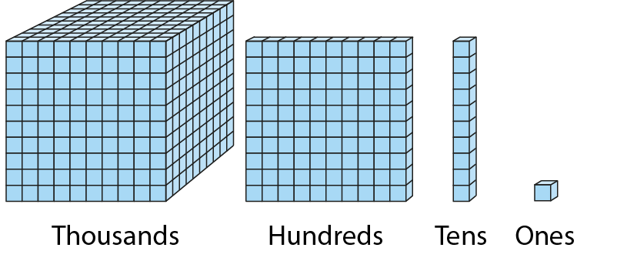
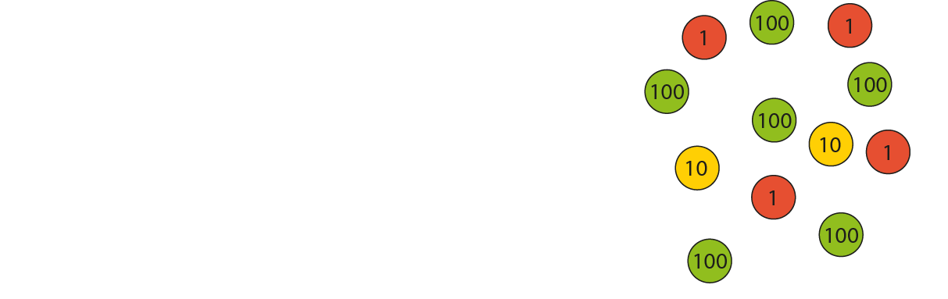
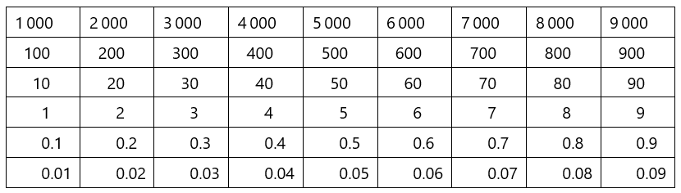
Representations and structure
There are a number of different representations that you may wish to use to support students’ understanding of this key idea. These might include:
Dienes base-ten blocks and Place value counters
  The use of Dienes blocks and, particularly, place-value counters can support students’ understanding of certain algorithms and procedures when they are used alongside the more symbolic representations of the calculations.
Gattegno chart
  Moving (up or down) from one row to another to represent multiplying and dividing by powers of ten helps students to understand these operations and their results.
Notes:
More information about the representations and structure involved in this key idea can be found:
From page 6 of the 1 The structure of the number system Theme Overview document
Within the Using representations at KS3 document
In Spine 1 of the Primary mastery professional development materials
Links to all of these can be found on the final slide.

Slide 38
Previous learning
From Upper Key Stage 2, students will bring experience of:
reading, writing, ordering and comparing numbers up to 10 000 000 and determining the value of each digit
rounding any whole number to a required degree of accuracy
using negative numbers in context
identifying the value of each digit in numbers given to three decimal places and multiplying and dividing numbers by 10, 100 and 1 000, giving answers up to three decimal places
using, reading, writing and converting between standard units, converting measurements of length, mass, volume and time from a smaller unit of measure to a larger unit and vice versa, using decimal notation up to three decimal places
using symbols and letters to represent variables and unknowns in mathematical situations that they already understand, such as:
  missing numbers, lengths, coordinates and angles
  formulae in mathematics and science
Notes:
Theme 1 The structure of the number system

Slide 39
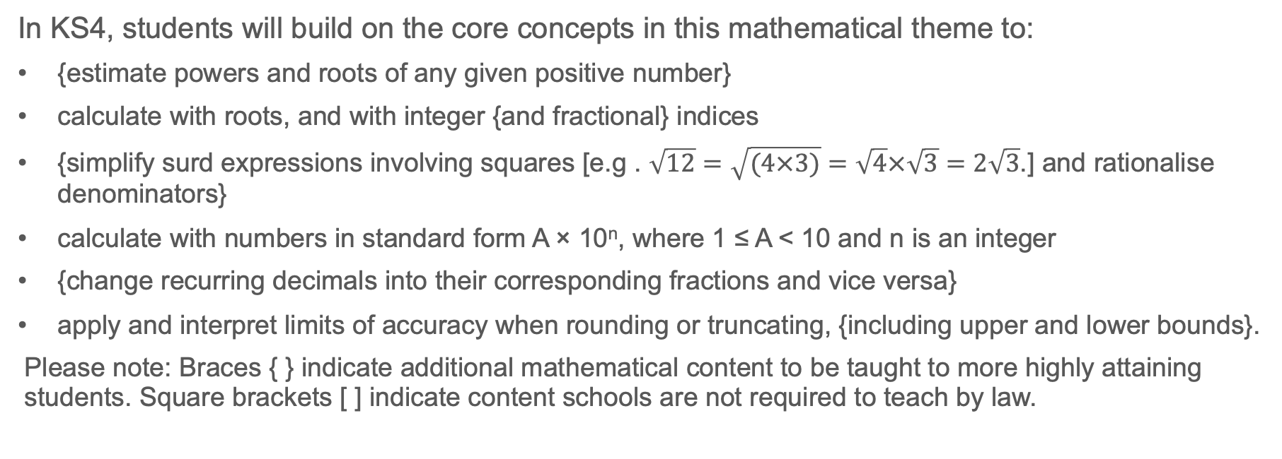
Future learning
In KS4, students will build on the core concepts in this mathematical theme to:
{estimate powers and roots of any given positive number}
calculate with roots, and with integer {and fractional} indices
{simplify surd expressions involving squares [e.g . $\sqrt{12}=\sqrt{(4×3)}=\sqrt{4}×\sqrt{3}=2\sqrt{3}$.] and rationalise denominators}
calculate with numbers in standard form A × 10^{n}, where 1 ≤ A < 10 and n is an integer
{change recurring decimals into their corresponding fractions and vice versa}
apply and interpret limits of accuracy when rounding or truncating, {including upper and lower bounds}.
Please note: Braces { } indicate additional mathematical content to be taught to more highly attaining students. Square brackets [ ] indicate content schools are not required to teach by law.
Notes:
Theme 1 The structure of the number system

Slide 40
Library of links
The following resources from the NCETM website have been referred to within this slide deck:
  NCETM Secondary Mastery Professional Development
    1 The Structure of the number system Theme Overview Document
    1.1 Place value, estimation and rounding Core Concept Document
  Using mathematical representations at KS3 | NCETM
  Insights from experienced teachers | NCETM
  NCETM primary mastery professional development materials
  NCETM primary assessment materials
There are also references to:
  Maths_guidance_KS_1_and_2.pdf (publishing.service.gov.uk)

