Slide 1
2.1 Counting, unitising and coins
Representations | Year 1
Multiplication and Division

Slide 2
How to use this presentation
You can find the teacher guide 2.1 Counting, unitising and coins by following the link below.

Slide 3
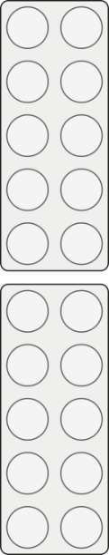



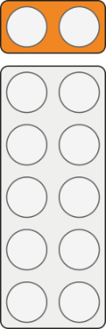
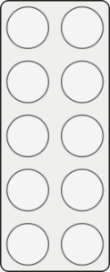




2.1 Counting and unitising Step 1:1
zero
two
four
six
eight
ten
twelve
fourteen
sixteen
eighteen
twenty
0
2
4
6
8
10
12
14
16
18
20

Slide 4
2.1 Counting and unitising Step 1:1
zero
two
four
six
eight
ten
twelve
fourteen
sixteen
eighteen
twenty
0
2
4
6
8
10
12
14
16
18
20

Slide 5
2.1 Counting and unitising Step 1:1
0
1
2
3
4
5
6
7
8
9
10
11
12
13
14
15
16
17
18
19
20

Slide 6
2.1 Counting and unitising Step 1:1
0
1
2
3
4
5
6
7
8
9
10
11
12
13
14
15
16
17
18
19
20

Slide 7
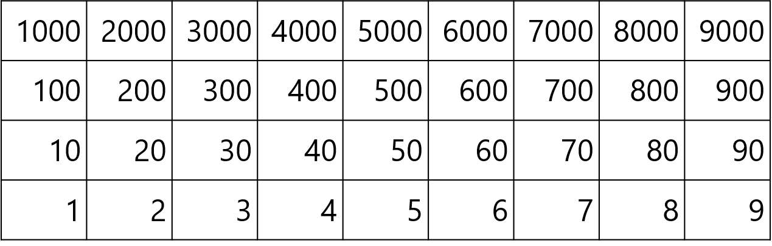
2.1 Counting and unitising Step 1:1

Slide 8
2.1 Counting and unitising Step 1:1

Slide 9

2.1 Counting and unitising Step 1:2
How many wheels are there?
Count in groups of two.
fourteen
sixteen
twelve
eight
four
two
ten
six
14
12
10
16
8
6
4
2

Slide 10
2.1 Counting and unitising Step 1:2
How many wheels are there?
Count in groups of two.

Slide 11

2.1 Counting and unitising Step 1:2
How many shoes are there?
Count in groups of two.
eighteen
fourteen
sixteen
twenty
twelve
eight
four
two
ten
six
14
12
10
16
18
20
8
6
4
2

Slide 12
2.1 Counting and unitising Step 1:2
How many shoes are there?
Count in groups of two.

Slide 13

2.1 Counting and unitising Step 1:2
How many dots are there?
Count in groups of two.
twelve
eight
four
two
ten
six
12
10
8
6
4
2

Slide 14
2.1 Counting and unitising Step 1:2
How many dots are there?
Count in groups of two.

Slide 15

2.1 Counting and unitising Step 1:2
How many hedgehogs are there?
Count in groups of two.
fourteen
twelve
eight
four
two
ten
six
14
12
10
8
6
4
2

Slide 16
2.1 Counting and unitising Step 1:2
How many hedgehogs are there?
Count in groups of two.

Slide 17

2.1 Counting and unitising Step 1:3
How many children are there?

Slide 18
2.1 Counting and unitising Step 1:3
How many children are there?
Count in groups of two.

Slide 19

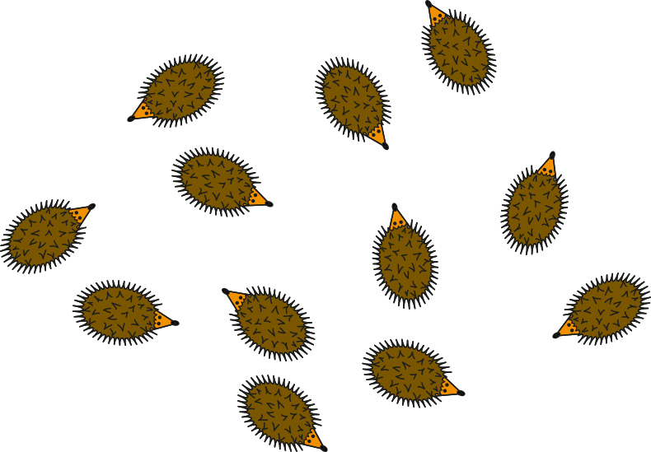





2.1 Counting and unitising Step 1:4
How many hedgehogs are there?

Slide 20
2.1 Counting and unitising Step 1:5
‘Two groups of two.’
‘Three groups of two.’
‘Four groups of two.’
‘Seven groups of two.’
‘Eight groups of two.’
‘Five groups of two.’
‘Six groups of two.’

Slide 21
2.1 Counting and unitising Step 1:5
Notes:
Now ask children to count in twos from this new starting point, without on-screen prompts.

Slide 22
2.1 Counting and unitising Step 1:5
‘Four groups of two.’
‘Seven groups of two.’
‘Eight groups of two.’
‘Nine groups of two.’
‘Five groups of two.’
‘Ten groups of two.’
‘Six groups of two.’

Slide 23
2.1 Counting and unitising Step 1:5
Notes:
Now ask children to count in twos from this new starting point, without on-screen prompts.

Slide 24
2.1 Counting and unitising Step 1:5
‘Three groups of two.’
‘Four groups of two.’
‘Seven groups of two.’
‘Five groups of two.’
‘Six groups of two.’

Slide 25
2.1 Counting and unitising Step 1:5
Notes:
Now ask children to count in twos from this new starting point, without on-screen prompts.

Slide 26
2.1 Counting and unitising Step 1:5
‘Two groups of two.’
‘Three groups of two.’
‘Four groups of two.’
‘Seven groups of two.’
‘Five groups of two.’
‘Six groups of two.’

Slide 27
2.1 Counting and unitising Step 1:5
Notes:
Now ask children to count in twos from this new starting point, without on-screen prompts.

Slide 28
2.1 Counting and unitising Step 2:1
0
10
20
30
40
50
60
70
80
90
100

Slide 29
2.1 Counting and unitising Step 2:1

Slide 30
2.1 Counting and unitising Step 2:1

Slide 31




2.1 Counting and unitising Step 2:2
How many fingers (and thumbs) are there?
Count in groups of ten.
seventy
twenty
thirty
forty
sixty
fifty
ten
70
60
50
40
30
20
10

Slide 32
2.1 Counting and unitising Step 2:2
How many fingers (and thumbs) are there?
Count in groups of ten.

Slide 33

2.1 Counting and unitising Step 2:2
How many dots are there?
Count in groups of ten.
twenty
thirty
forty
sixty
fifty
ten
60
50
40
30
10
20

Slide 34
2.1 Counting and unitising Step 2:2
How many dots are there?
Count in groups of ten.

Slide 35

2.1 Counting and unitising Step 2:2
How many pencils are there?
Count in groups of ten.
seventy
twenty
eighty
ninety
thirty
forty
sixty
fifty
ten
70
60
50
80
90
40
30
20
10

Slide 36
2.1 Counting and unitising Step 2:2
How many pencils are there?
Count in groups of ten.

Slide 37


2.1 Counting and unitising Step 2:3
How many counters are there?

Slide 38


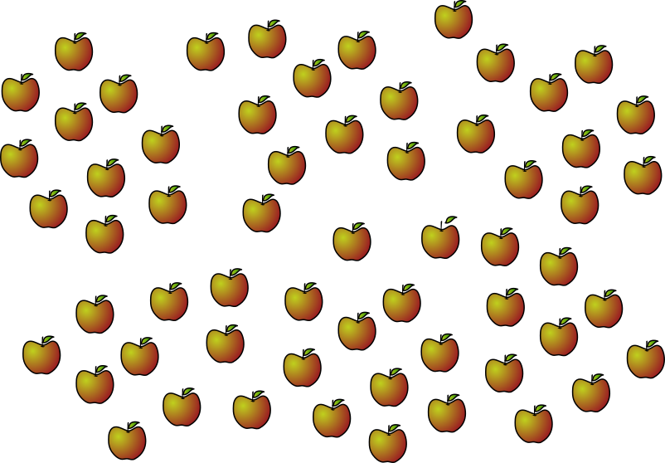




2.1 Counting and unitising Step 2:4
How many apples are there?

Slide 39
2.1 Counting and unitising Step 2:5
‘Four groups of ten.’
‘Seven groups of ten.’
‘Five groups of ten.’
‘Six groups of ten.’

Slide 40
2.1 Counting and unitising Step 2:5
Notes:
Now ask children to count in tens without on-screen prompts.

Slide 41
2.1 Counting and unitising Step 2:5
‘Three groups of ten.’
‘Four groups of ten.’
‘Seven groups of ten.’
‘Five groups of ten.’
‘Six groups of ten.’

Slide 42
2.1 Counting and unitising Step 2:5
Notes:
Now ask children to count in tens without on-screen prompts.

Slide 43
2.1 Counting and unitising Step 2:5
‘Two groups of ten.’
‘Three groups of ten.’
‘Four groups of ten.’
‘Seven groups of ten.’
‘Eight groups of ten.’
‘Nine groups of ten.’
‘Five groups of ten.’
‘Six groups of ten.’

Slide 44
2.1 Counting and unitising Step 2:5
Notes:
Now ask children to count in tens without on-screen prompts.

Slide 45
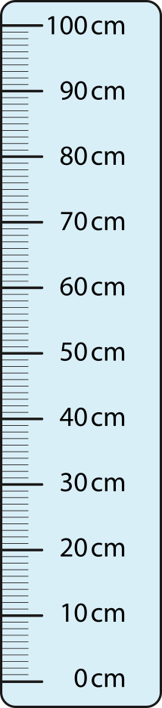
2.1 Counting and unitising Step 2:6

Slide 46
2.1 Counting and unitising Step 3:1
0
5
10
15
20
25
30
35
40
45
50

Slide 47
2.1 Counting and unitising Step 3:1

Slide 48
2.1 Counting and unitising Step 3:1

Slide 49




2.1 Counting and unitising Step 3:2
How many fingers (and thumbs) are there?
Count in groups of five.
twenty-five
twenty
fifteen
thirty
five
ten
thirty-five
forty-five
forty
30
25
20
15
10
40
35
45
5

Slide 50
2.1 Counting and unitising Step 3:2
How many fingers (and thumbs) are there?
Count in groups of five.
Notes:
Now ask children to count in fives without on-screen prompts.

Slide 51

2.1 Counting and unitising Step 3:2
How many dots are there?
Count in groups of five.
twenty
fifteen
five
ten
20
15
10
5

Slide 52
2.1 Counting and unitising Step 3:2
How many dots are there?
Count in groups of five.
Notes:
Now ask children to count in fives without on-screen prompts.

Slide 53

2.1 Counting and unitising Step 3:2
How many hedgehogs are there?
Count in groups of five.
twenty-five
twenty
fifteen
thirty
five
ten
30
25
20
15
10
5

Slide 54
2.1 Counting and unitising Step 3:2
How many hedgehogs are there?
Count in groups of five.
Notes:
Now ask children to count in fives without on-screen prompts.

Slide 55


2.1 Counting and unitising Step 3:3
How many counters are there?

Slide 56






2.1 Counting and unitising Step 3:4
How many stars are there?

Slide 57
2.1 Counting and unitising Step 3:5
‘Four groups of five.’
‘Five groups of five.’
‘Six groups of five.’
‘Seven groups of five.’
‘Eight groups of five.’
‘Nine groups of five.’

Slide 58
2.1 Counting and unitising Step 3:5
Notes:
Now ask children to count in groups of five from this new starting point without on-screen prompts.

Slide 59
2.1 Counting and unitising Step 3:5
‘Three groups of five.’
‘Four groups of five.’
‘Seven groups of five.’
‘Five groups of five.’
‘Six groups of five.’

Slide 60
2.1 Counting and unitising Step 3:5
Notes:
Now ask children to count in groups of five from this new starting point without on-screen prompts.

Slide 61
2.1 Counting and unitising Step 3:5
‘Two groups of five.’
‘Three groups of five.’
‘Four groups of five.’
‘Five groups of five.’
‘Six groups of five.’

Slide 62
2.1 Counting and unitising Step 3:5
Notes:
Now ask children to count in groups of five from this new starting point without on-screen prompts.

Slide 63
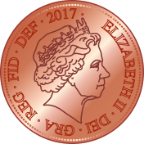

2.1 Counting and unitising Step 4:1
heads
tails

Slide 64

2.1 Counting and unitising Step 4:1

Slide 65
2.1 Counting and unitising Step 4:2
Notes:
There are three one-penny coins; the total value is three p or three pence.

Slide 66
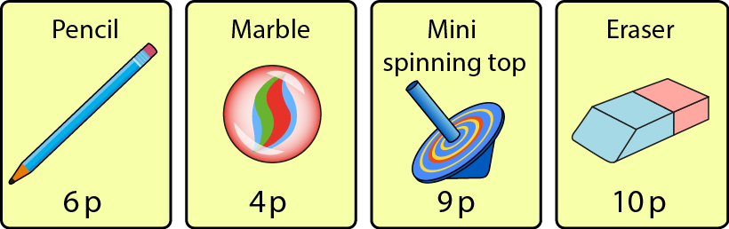
2.1 Counting and unitising Step 4:2
Notes:
How many pennies do you need to buy:
One marble?
One eraser?
One spinning top?
One pencil?

Slide 67
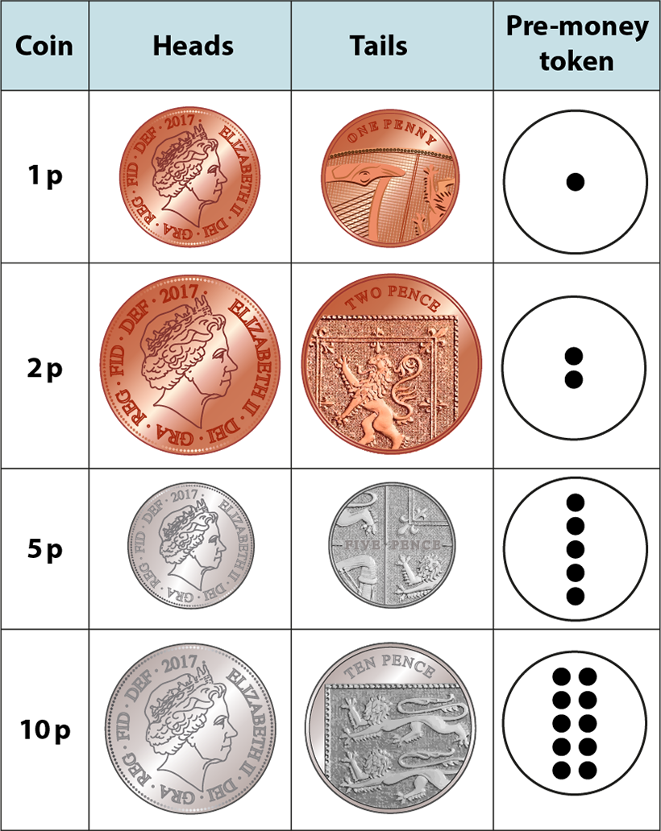
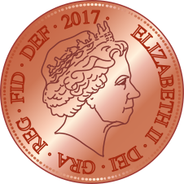
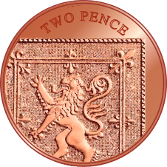

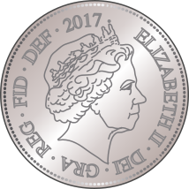
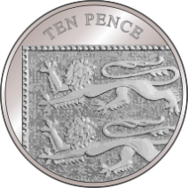

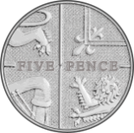
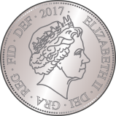

2.1 Counting and unitising Step 4:3
10 p
2 p
5 p
1 p
Notes:
I am thinking of a coin. It is silver. It is about the same size as a penny. Which coin is it?

Slide 68
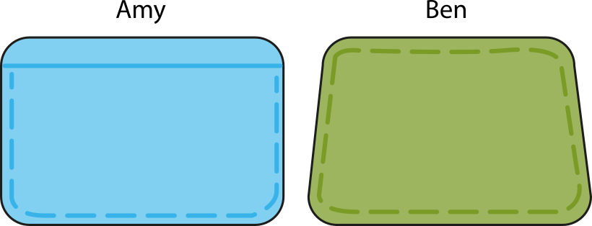



2.1 Counting and unitising Step 4:4
Can Amy buy an eraser?
Can Ben buy an eraser?
Yes ✓
Yes ✓
10 p
10 p
Notes:
For each count, ensure children first identify the skip-counting unit (the coin denomination) before beginning.

Slide 69

2.1 Counting and unitising Step 5:1
eight one-pennies
8 p

Slide 70
2.1 Counting and unitising Step 5:2
nine two-pennies
18 p

Slide 71
2.1 Counting and unitising Step 5:4
seven five-pennies
35 p

Slide 72
2.1 Counting and unitising Step 5:5
nine ten-pennies
90 p

Slide 73
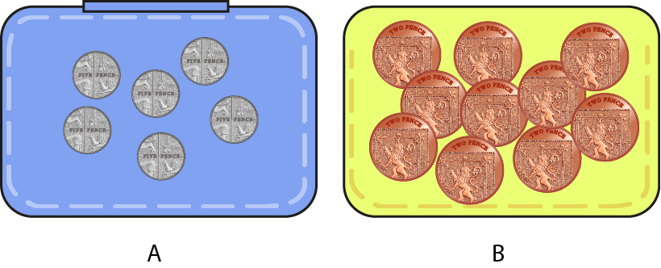

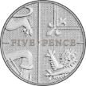
2.1 Counting and unitising Step 5:6
Which purse would you rather have?
30 p
20 p

Slide 74
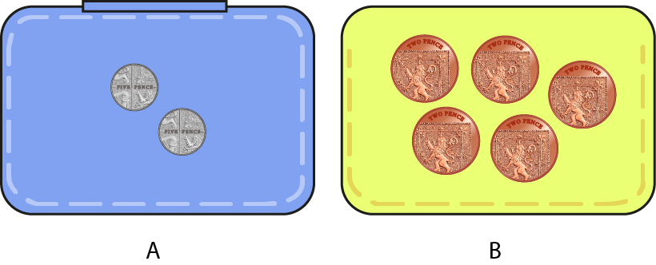
2.1 Counting and unitising Step 5:6
Which purse would you rather have?
10 p
10 p

Slide 75
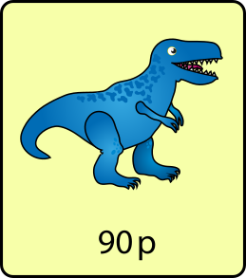
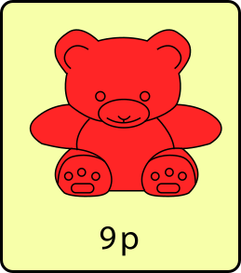
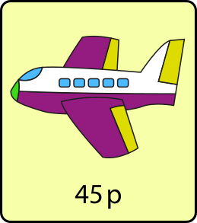
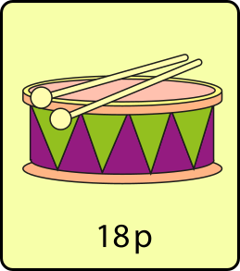
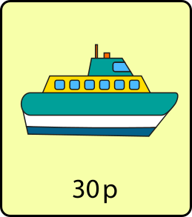
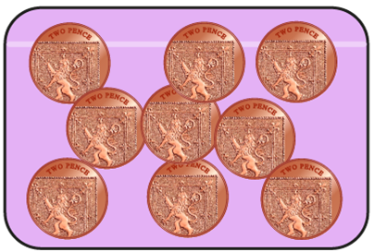
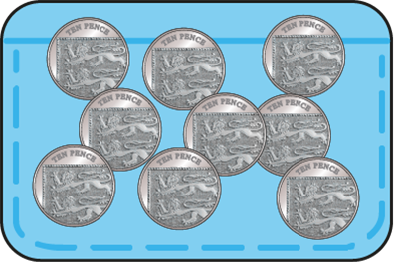
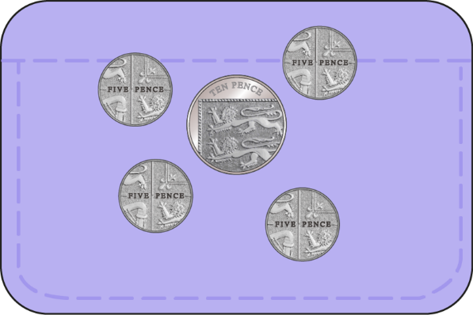
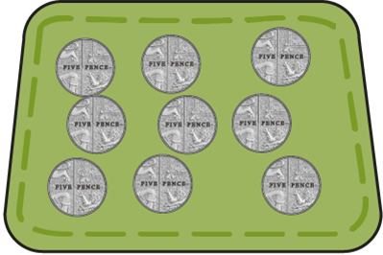
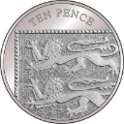
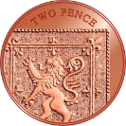

2.1 Counting and unitising Step 5:7
What could you buy with the coins in this purse?
90 p
18 p
45 p
30 p

Slide 76
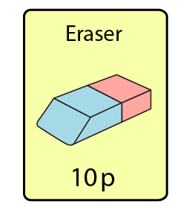
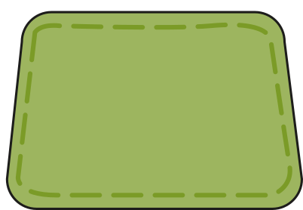
2.1 Counting and unitising Step 6:1
How many pennies would you need to buy this eraser?

Slide 77
2.1 Counting and unitising Step 6:2
How many two-pence coins would you need to buy this eraser?

Slide 78
2.1 Counting and unitising Step 6:3
How many five-pence coins would you need to buy this eraser?

Slide 79
2.1 Counting and unitising Step 6:4
How many ten-pence coins would you need to buy this eraser?

Slide 80
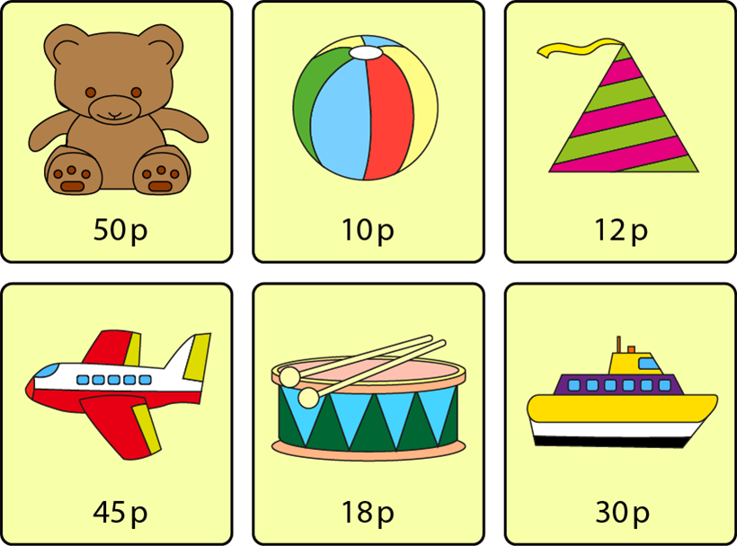
2.1 Counting and unitising Step 6:6

