Slide 1
Year 4, Unit 1
Review of column addition and subtraction

Slide 2
Year 4, Unit 1
These materials heavily reflect the prioritisation approach of the ready-to-progress criteria in the DfE Primary Mathematics Guidance 2020 and on the PPTs that exemplify them on the NCETM website. They also include other relevant National Curriculum content. Related sections of the NCETM Primary Mastery Professional Development Materials provide small-step teaching guidance.
Ready-to-progress criteria addressed by this unit
Teaching of this unit supports the following criteria from the ‘DfE Mathematics Guidance: key stages 1 & 2’ (the 335-page document available as a download)
3AS-2 Page 109
Where a unit offers a focus on a ready-to-progress criterion from a previous year group, this is to allow time to consolidate and secure learning. If the children are already secure, then teachers should move to the next unit.

Slide 3
Contents
The links below take you to the starting slide of each learning outcome.
1 | Pupils identify the addends and the sum in column addition
2 | Pupils use their knowledge of place value to correctly lay out column addition
3 | Pupils add a pair of 2-digit numbers using column addition
4 | Pupils add using column addition
5 | Pupils use their knowledge of column addition to solve problems
6 | Pupils add a pair of 2-digit numbers using column addition with regrouping in the ones column
Click the arrow button to return to this Contents slide.

Slide 4
Contents
The links below take you to the starting slide of each learning outcome.
7 | Pupils add a pair of 2-digit numbers using column addition with regrouping in the tens column
8 | Pupils add using column addition with regrouping
9 | Pupils use known facts and strategies to accurately and efficiently calculate and check column addition
10 | Pupils use their knowledge of column addition to solve problems
11 | Pupils identify the minuend and the subtrahend in column subtraction
12 | Pupils subtract using column subtraction
Click the arrow button to return to this Contents slide.

Slide 5
Contents
The links below take you to the starting slide of each learning outcome.
13 | Pupils subtract from a 2-digit number using column subtraction with exchanging from tens to ones
14 | Pupils subtract from a 3-digit number using column subtraction with exchanging from hundreds to tens (1)
15 | Pupils subtract from a 3-digit number using column subtraction with exchanging from hundreds to tens (2)
16 | Pupils evaluate the efficiency of strategies for subtraction
Click the arrow button to return to this Contents slide.

Slide 6
Year 4, Unit 1, Learning Outcome 1
Learning Outcome 1
Pupils identify the addends and the sum in column addition
The following slides have been collated to support the teaching of this learning outcome.

Slide 7
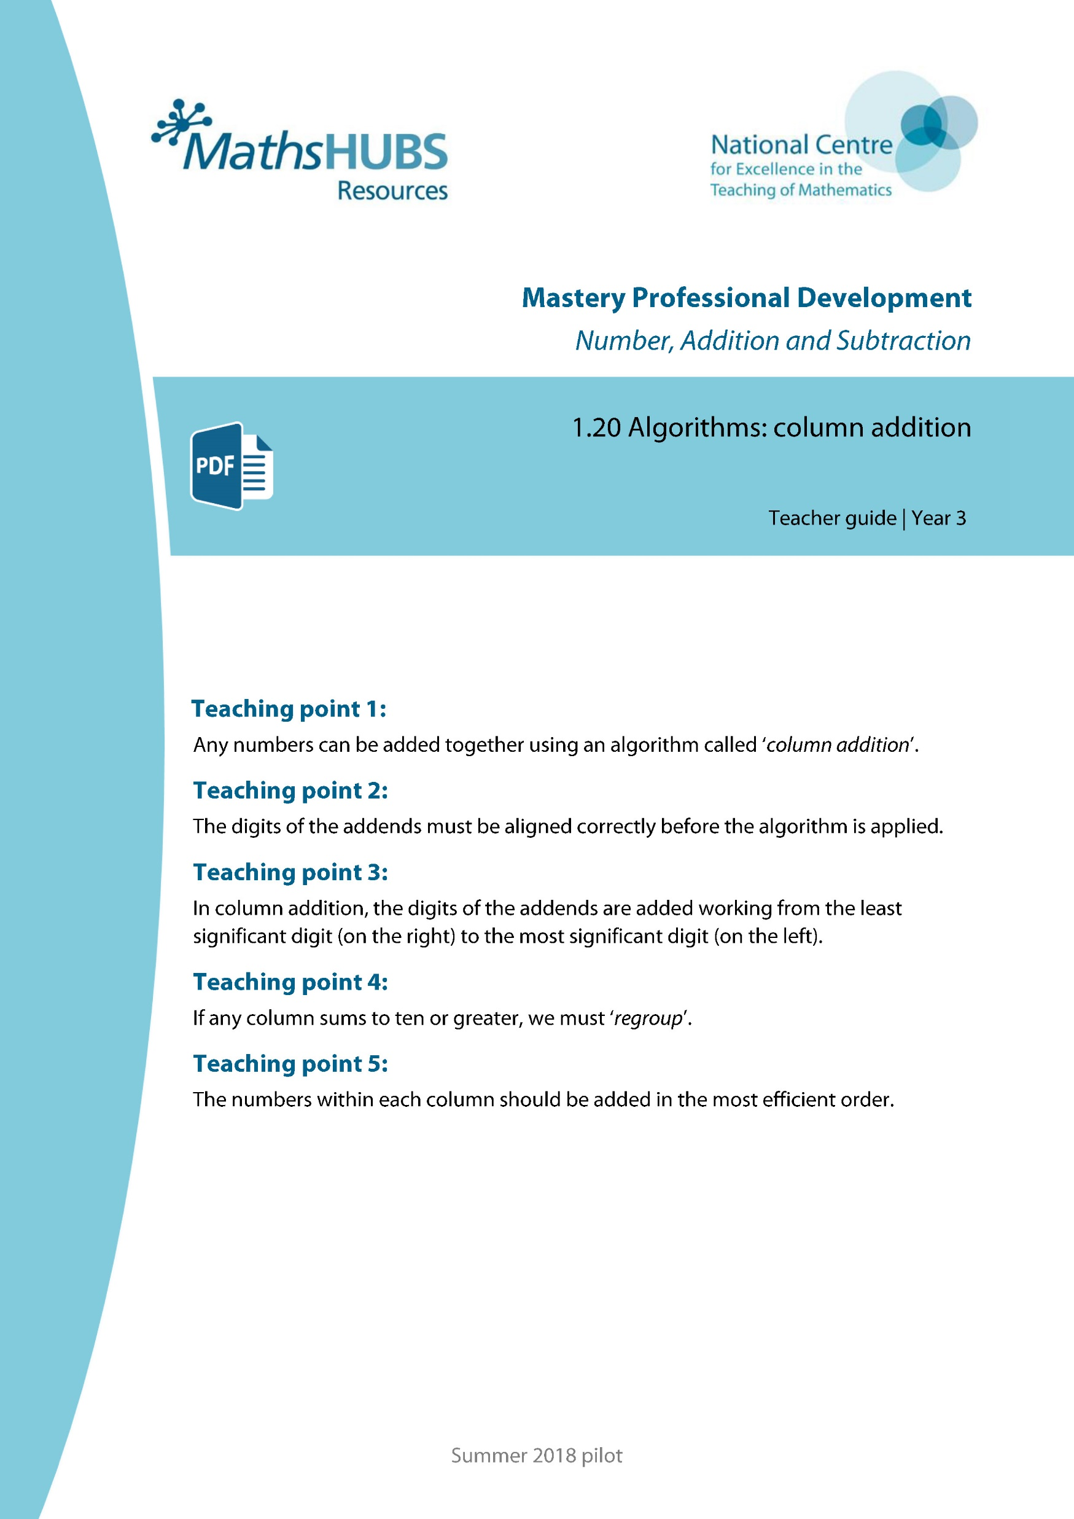
Year 4, Unit 1, Learning Outcome 1
Additional teacher guidance for this outcome should be read first and can be found in this segment of the NCETM Primary Mastery Professional Development Materials:
1.20 Algorithms: column addition
The spine materials are divided into ‘teaching points’ and ‘steps in learning’.
Teaching point | Steps in learning | Pages
1 | 1:1 - 1:3 | 3-4

Slide 8
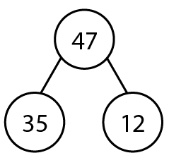



1.20 Column addition – step 1:2
Notes:
Jamal has collected 35 stickers. He gets 12 more for his birthday. He now has 47 stickers.

Slide 9


1.20 Column addition – step 1:2
Notes:
Jamal has collected 35 stickers. He gets 12 more for his birthday. He now has 47 stickers.

Slide 10
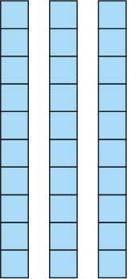
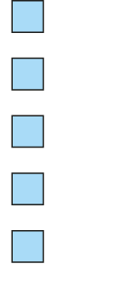



1.20 Column addition – step 1:2
 |  | 4 | 7
 |  | 3 | 5
 | + | 1 | 2
Notes:
Jamal has collected 35 stickers. He gets 12 more for his birthday. He now has 47 stickers.

Slide 11
Year 4, Unit 1, Learning Outcome 2
Learning Outcome 2
Pupils use their knowledge of place value to correctly lay out column addition
The following slides have been collated to support the teaching of this learning outcome.

Slide 12
Year 4, Unit 1, Learning Outcome 2
Additional teacher guidance for this outcome should be read first and can be found in this segment of the NCETM Primary Mastery Professional Development Materials:
1.20 Algorithms: column addition
The spine materials are divided into ‘teaching points’ and ‘steps in learning’.
Teaching point | Steps in learning | Pages
2 | 2:1 – 2:4 | 5-8

Slide 13
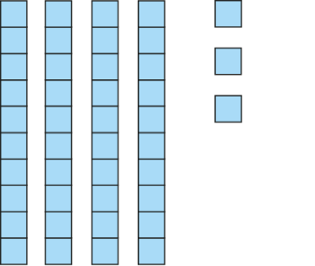
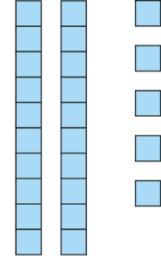


1.20 Column addition – step 2:1

Slide 14




1.20 Column addition – step 2:1
+

Slide 15
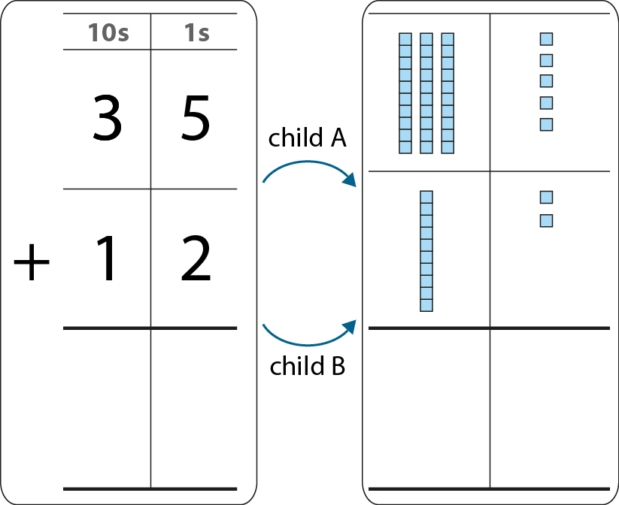
1.20 Column addition – step 2:2

Slide 16

1.20 Column addition – step 2:4
Which place-value chart correctly shows thirty-five plus twelve?
100s | 10s | 1s
1
3
5
1
2
100s | 10s | 1s
3
5
1
2

Slide 17
1.20 Column addition – step 2:4
Which place-value chart correctly shows
three hundred and five plus forty?
100s | 10s | 1s
3
0
5
40
100s | 10s | 1s
3
0
5
4
0

Slide 18
Year 4, Unit 1, Learning Outcome 3
Learning Outcome 3
Pupils add a pair of 2-digit numbers using column addition
The following slides have been collated to support the teaching of this learning outcome.

Slide 19
Year 4, Unit 1, Learning Outcome 3
Additional teacher guidance for this outcome should be read first and can be found in this segment of the NCETM Primary Mastery Professional Development Materials:
1.20 Algorithms: column addition
The spine materials are divided into ‘teaching points’ and ‘steps in learning’.
Teaching point | Steps in learning | Pages
3 | 3:1 – 3:3 | 9-11

Slide 20
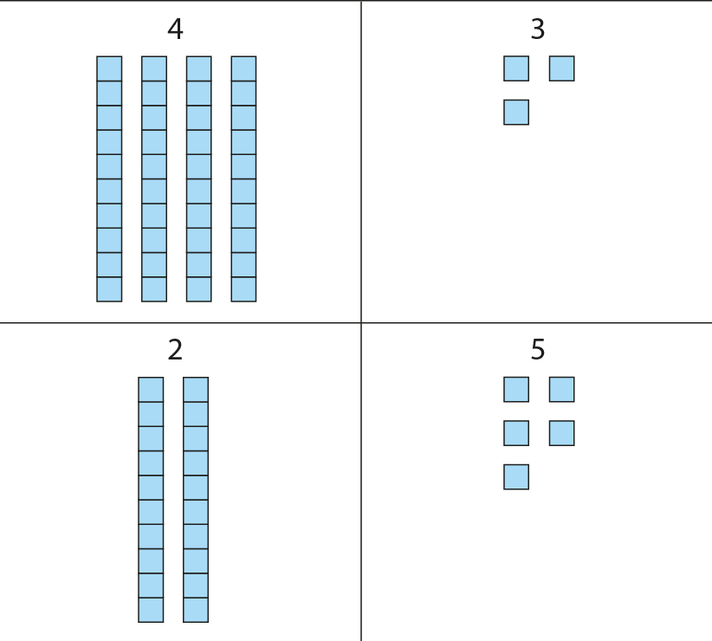


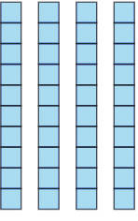

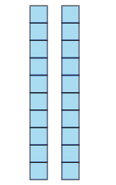

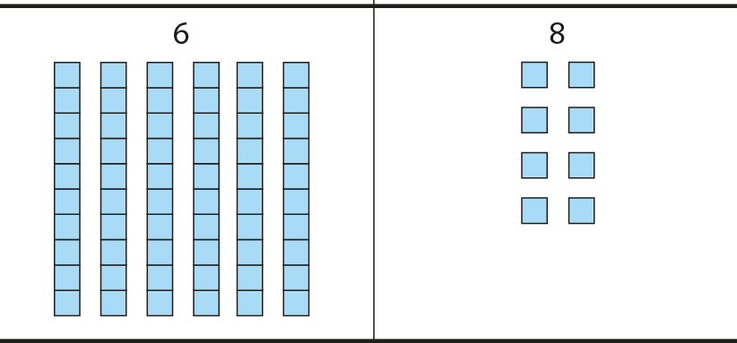
3AS-2 Columnar addition and subtraction
Write the two numbers as shown ready for column addition. Is it important that the 5 ones is written underneath the 3 ones?
We add like values together, so tens with tens and ones with ones.
Use Dienes to model the calculation.
What does the digit 3 represent?
What does the digit 2 represent?
In column addition, we start at the right-hand side.
 |  | 4 | 3
 |  | 6 | 8
 |  | 2 | 5
 |  | 6 | 8
 |  | 4 | 3
 | + | 2 | 5
 |  | 6 | 8
We add the ones.3 ones plus 5 ones is equal to 8 ones.
We add the tens. 4 tens plus 2 tens is equal to 6 tens.

Slide 21
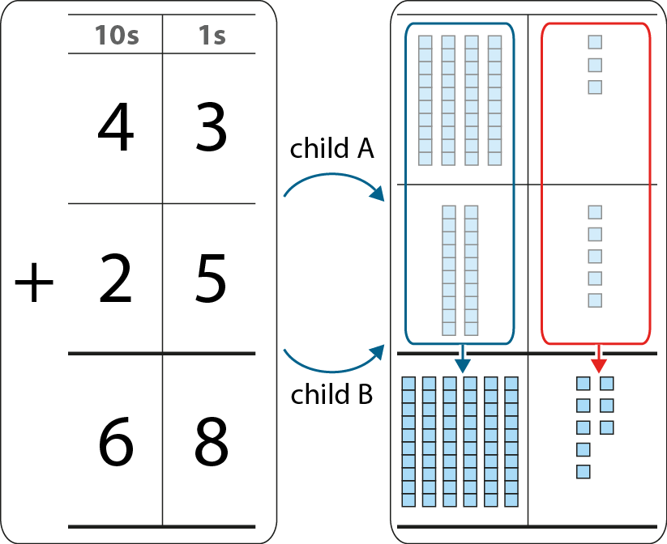
3AS-2 Columnar addition and subtraction
Work in pairs. Child A writes the calculation to solve as column addition. Child B uses Dienes to model the calculation. See if you get the same answer.
Use the language focus box to help you explain what is happening.
Solve the following calculations: 51 + 24; 62 + 27; 72 + 15. Swap over roles each time.
We add the ones. 3 ones plus 5 ones is equal to 8 ones.
We add the tens. 4 tens plus 2 tens is equal to 6 tens.

Slide 22
Year 4, Unit 1, Learning Outcome 4
Learning Outcome 4
Pupils add using column addition
The following slide supports the teaching of this learning outcome.

Slide 23
Year 4, Unit 1, Learning Outcome 4
Additional teacher guidance for this outcome should be read first and can be found in this segment of the NCETM Primary Mastery Professional Development Materials:
1.20 Algorithms: column addition
The spine materials are divided into ‘teaching points’ and ‘steps in learning’.
Teaching point | Steps in learning | Pages
3 | 3.4 | 11

Slide 24
Year 4, Unit 1, Learning Outcome 5
Learning Outcome 5
Pupils use their knowledge of column addition to solve problems
The following slides have been collated to support the teaching of this learning outcome.

Slide 25
Year 4, Unit 1, Learning Outcome 5
Additional teacher guidance for this outcome should be read first and can be found in this segment of the NCETM Primary Mastery Professional Development Materials:
1.20 Algorithms: column addition
The spine materials are divided into ‘teaching points’ and ‘steps in learning’.
Teaching point | Steps in learning | Pages
3 | 3.5 | 11-12

Slide 26
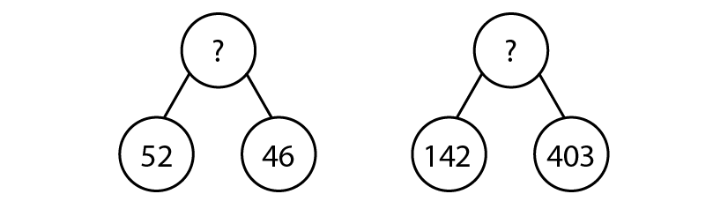
1.20 Column addition – step 3:5
Write these as column addition calculations.
635 + 24
326 + 441 + 210
532 + 43 + 114

Slide 27
Year 4, Unit 1, Learning Outcome 6
Learning Outcome 6
Pupils add a pair of 2-digit numbers using column addition with regrouping in the ones column
The following slides have been collated to support the teaching of this learning outcome.

Slide 28
Year 4, Unit 1, Learning Outcome 6
Additional teacher guidance for this outcome should be read first and can be found in this segment of the NCETM Primary Mastery Professional Development Materials:
1.20 Algorithms: column addition
The spine materials are divided into ‘teaching points’ and ‘steps in learning’.
Teaching point | Steps in learning | Pages
4 | 4:1 – 4:3 and 4:7 | 13-14 and 16

Slide 29

1.20 Column addition – step 4:1

Slide 30
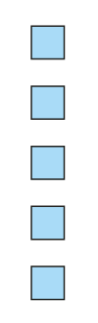
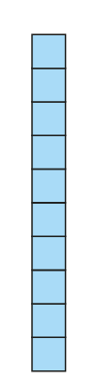


1.20 Column addition – step 4:2
+
7
=
12
=
10
+
5
2

Slide 31
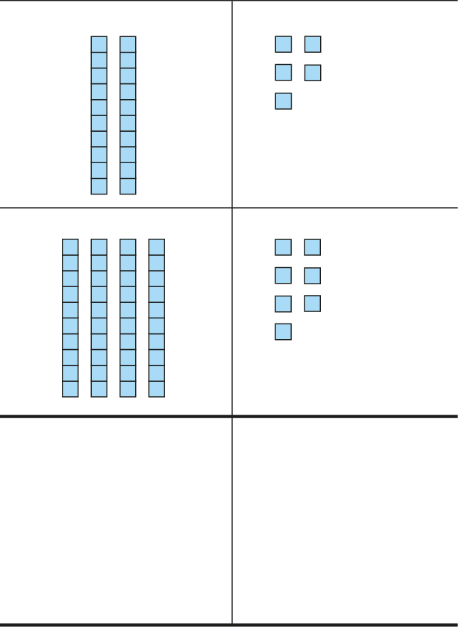



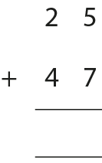















1.20 Column addition – steps 4:3
7
1
2
2
1

Slide 32
3AS-2 Columnar addition and subtraction
Run this slide a few times to secure the idea.
What numbers are represented by the Dienes?
First we need to add the ones.
Can you see where this total of twelve is on each of the representations shown?
Then we add the tens.
5 ones plus 7 ones is equal to 12 ones. I can regroup 12 ones. 12 ones is equal to 1 ten and 2 ones.
7
1
2
2
1
2 tens plus 4 tens is 6 tens. We also need to add 1 ten from the regrouping. There are 7 tens altogether.
If a column group is equal to ten or more we must regroup.
10 ones is equivalent to 1 ten. 10 tens is equivalent to 1 hundred.

Slide 33
Year 4, Unit 1, Learning Outcome 7
Learning Outcome 7
Pupils add a pair of 2-digit numbers using column addition with regrouping in the tens column
The following slide supports the teaching of this learning outcome.

Slide 34
Year 4, Unit 1, Learning Outcome 7
Additional teacher guidance for this outcome should be read first and can be found in this segment of the NCETM Primary Mastery Professional Development Materials:
1.20 Algorithms: column addition
The spine materials are divided into ‘teaching points’ and ‘steps in learning’.
Teaching point | Steps in learning | Pages
4 | 4:4 and 4:7 | 15 and 16

Slide 35
Year 4, Unit 1, Learning Outcome 8
Learning Outcome 8
Pupils add using column addition with regrouping
The following slides have been collated to support the teaching of this learning outcome.

Slide 36
Year 4, Unit 1, Learning Outcome 8
Additional teacher guidance for this outcome should be read first and can be found in this segment of the NCETM Primary Mastery Professional Development Materials:
1.20 Algorithms: column addition
The spine materials are divided into ‘teaching points’ and ‘steps in learning’.
Teaching point | Steps in learning | Pages
4 | 4:5 – 4:7 | 15-16

Slide 37
1.20 Column addition – step 4:6
Which calculations require regrouping?
Which calculations require regrouping only once?
Which calculations require regrouping twice?
 | 1 | 2 | 4
+ | 2 | 3 | 3
 | 6 | 4 | 4
+ | 1 | 7 | 2
 | 3 | 6 | 6
+ | 2 | 7 | 7
 | 5 | 7 | 9
+ | 2 | 2 | 1
 | 7 | 9 | 1
+ | 1 | 6 | 3
 | 5 | 6 | 7
+ | 2 | 3 | 3

Slide 38
3AS-2 Columnar addition and subtraction
SET A
Practise adding the two 2-digit numbers together from Set A. You could work in pairs again. Child A could write the calculation as a column addition and child B could model the calculation using Dienes.
See if you can explain to your partner how you got your answer.
Why do all these calculations involve regrouping the ones?
When you are more confident you won’t need to use the Dienes to see why column addition works.
Now try working out the answers to the expressions in Set B. What do you notice?
45 + 28
37 + 56
79km + 14km
£46 + £35
SET B
345 + 171
537 + 284
472kg + 469kg
£637 + £182

Slide 39
3AS-2 Columnar addition and subtraction
Which calculations require regrouping?
Which require regrouping only once?
Which require regrouping twice?
Can you answer these questions without having to solve the calculations?
 | 1 | 2 | 4
+ | 2 | 3 | 3
 | 6 | 4 | 4
+ | 1 | 7 | 2
 | 3 | 6 | 6
+ | 2 | 7 | 7
 | 5 | 7 | 9
+ | 2 | 2 | 1
 | 7 | 9 | 1
+ | 1 | 6 | 3
 | 5 | 6 | 7
+ | 2 | 3 | 3
If the column sum is equal to ten or more, we must regroup.

Slide 40
Year 4, Unit 1, Learning Outcome 9
Learning Outcome 9
Pupils use known facts and strategies to accurately and efficiently calculate and check column addition
The following slides have been collated to support the teaching of this learning outcome.

Slide 41
Year 4, Unit 1, Learning Outcome 9
Additional teacher guidance for this outcome should be read first and can be found in this segment of the NCETM Primary Mastery Professional Development Materials:
1.20 Algorithms: column addition
The spine materials are divided into ‘teaching points’ and ‘steps in learning’.
Teaching point | Steps in learning | Pages
5 | 5:1 - 5:4 | 17-18

Slide 42
3AS-2 Columnar addition and subtraction
475 + 25
237 + 156
Look at these expressions carefully.
Can you solve any of them without using column addition? Sort them into a table like the one shown.
Explain your thinking.
349 + 84
120 + 130
Use column addition | Use mental strategies

Slide 43
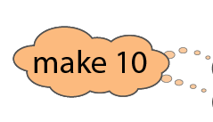






1.20 Column addition – step 5:2
416
+
223
+
184
=
823

Slide 44

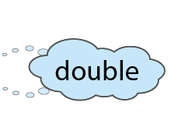



1.20 Column addition – step 5:2
15
+
57
+
27
=
99

Slide 45





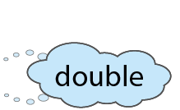


1.20 Column addition – step 5:2
172
+
234
+
54
=
460

Slide 46
3AS-2 Columnar addition and subtraction
We can also use column addition to find the sum of three numbers.
Look carefully at numbers in each column. Look for numbers which are easy to add together.
416
+
223
+
184
=
823

Slide 47
Year 4, Unit 1, Learning Outcome 10
Learning Outcome 10
Pupils use their knowledge of column addition to solve problems
The following slide supports the teaching of this learning outcome.

Slide 48
Year 4, Unit 1, Learning Outcome 10
Additional teacher guidance for this outcome should be read first and can be found in this segment of the NCETM Primary Mastery Professional Development Materials:
1.20 Algorithms: column addition
The spine materials are divided into ‘teaching points’ and ‘steps in learning’.
Teaching point | Steps in learning | Pages
5 | 5.5 | 19

Slide 49
Year 4, Unit 1, Learning Outcome 11
Learning Outcome 11
Pupils identify the minuend and the subtrahend in column subtraction
The following slides have been collated to support the teaching of this learning outcome.

Slide 50
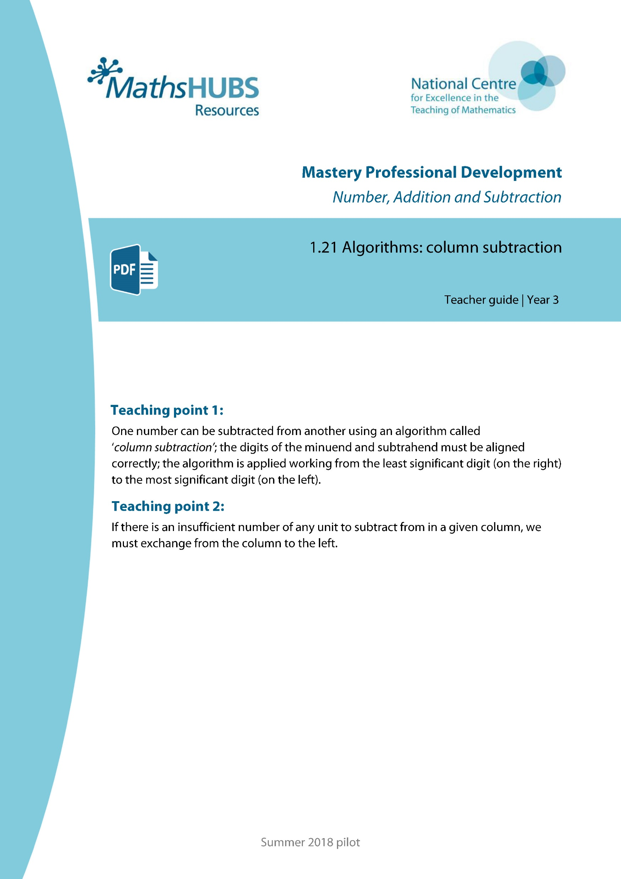
Year 4, Unit 1, Learning Outcome 11
Additional teacher guidance for this outcome should be read first and can be found in this segment of the NCETM Primary Mastery Professional Development Materials:
1.21 Algorithms: column subtraction
The spine materials are divided into ‘teaching points’ and ‘steps in learning’.
Teaching point | Steps in learning | Pages
1 | 1:1 - 1:2 | 3-4

Slide 51
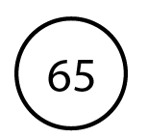


1.21 Algorithms: column subtraction – step 1:2
Notes:
There are 65 books in year 3’s book corner. 23 are fiction. How many are non-fiction?

Slide 52
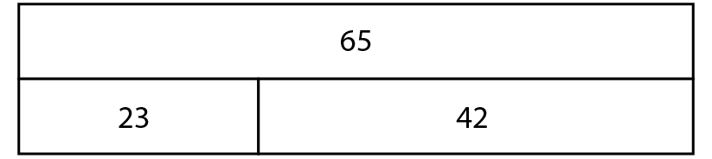
1.21 Algorithms: column subtraction – step 1:2
23
42

Slide 53
Year 4, Unit 1, Learning Outcome 12
Learning Outcome 12
Pupils subtract using column subtraction
The following slides have been collated to support the teaching of this learning outcome.

Slide 54
Year 4, Unit 1, Learning Outcome 12
Additional teacher guidance for this outcome should be read first and can be found in this segment of the NCETM Primary Mastery Professional Development Materials:
1.21 Algorithms: column subtraction
The spine materials are divided into ‘teaching points’ and ‘steps in learning’.
Teaching point | Steps in learning | Pages
1 | 1:3 – 1:6 | 4-7

Slide 55
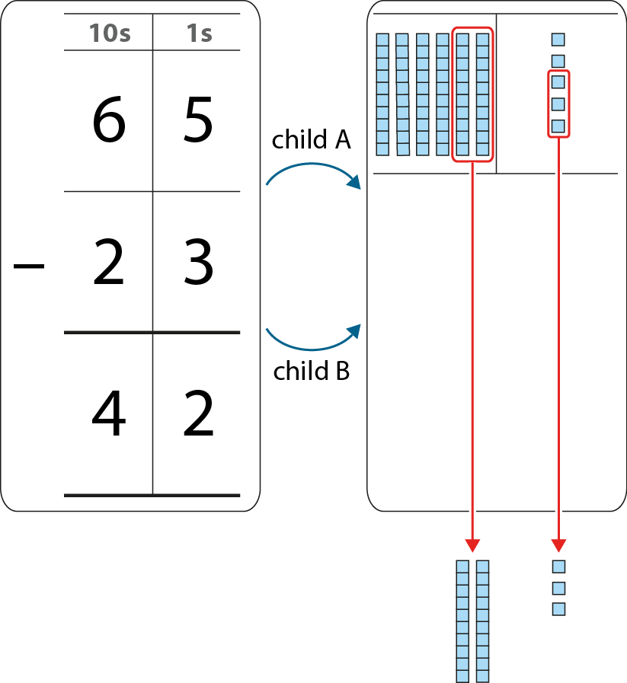
1.21 Algorithms: column subtraction – step 1:4

Slide 56
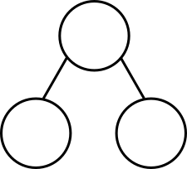
1.21 Algorithms: column subtraction – step 1:6
97
936
52
45
?
511
?
425

Slide 57
1.21 Algorithms: column subtraction – step 1:6
 | 3 |  | 5
− |  | 3
 | 2 | 3 | 4
6
1
1

Slide 58
Year 4, Unit 1, Learning Outcome 13
Learning Outcome 13
Pupils subtract from a 2-digit number using column subtraction with exchanging from tens to ones
The following slides have been collated to support the teaching of this learning outcome.

Slide 59
Year 4, Unit 1, Learning Outcome 13
Additional teacher guidance for this outcome should be read first and can be found in this segment of the NCETM Primary Mastery Professional Development Materials:
1.21 Algorithms: column subtraction
The spine materials are divided into ‘teaching points’ and ‘steps in learning’.
Teaching point | Steps in learning | Pages
2 | 2:1 – 2:3 | 8-10

Slide 60
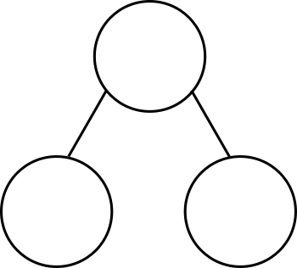
1.21 Algorithms: column subtraction – step 2:1
23
23
2
tens
1
ten
3
ones
13
ones
?
?
?
?

Slide 61

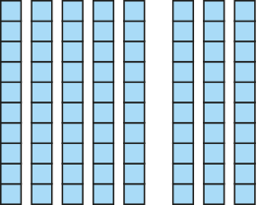

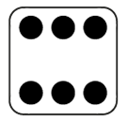
1.21 Algorithms: column subtraction – step 2:2
94
− 6 =
88

Slide 62

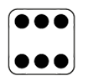
1.21 Algorithms: column subtraction – step 2:3
10s | 1s
9 | 4
 | 6
8
1
−
8
8
94
− 6
= 88

Slide 63
Year 4, Unit 1, Learning Outcome 14
Learning Outcome 14
Pupils subtract from a 3-digit number using column subtraction with exchanging from hundreds to tens (1)
The following slides have been collated to support the teaching of this learning outcome.

Slide 64
Year 4, Unit 1, Learning Outcome 14
Additional teacher guidance for this outcome should be read first and can be found in this segment of the NCETM Primary Mastery Professional Development Materials:
1.21 Algorithms: column subtraction
The spine materials are divided into ‘teaching points’ and ‘steps in learning’.
Teaching point | Steps in learning | Pages
2 | 2:4 – 2:6 | 10-12

Slide 65
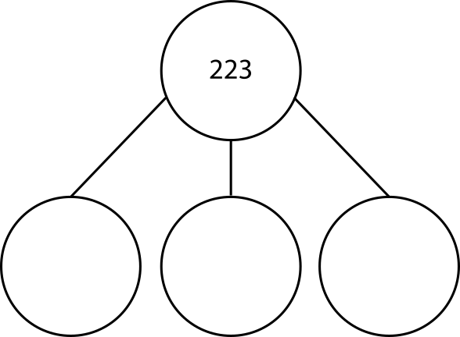

1.21 Algorithms: column subtraction – step 2:4
223 =
200
100
100
+
+
+
20
120
110
+
+
+
3
3
13

Slide 66

1.21 Algorithms: column subtraction – step 2:5
223 − 142
= 81

Slide 67
1.21 Algorithms: column subtraction – step 2:6
100s | 10s | 1s
2 | 2 | 3
1 | 4 | 2
1
1
−
0
8
1

Slide 68
Year 4, Unit 1, Learning Outcome 15
Learning Outcome 15
Pupils subtract from a 3-digit number using column subtraction with exchanging from hundreds to tens (2)
The following slides have been collated to support the teaching of this learning outcome.

Slide 69
Year 4, Unit 1, Learning Outcome 15
Additional teacher guidance for this outcome should be read first and can be found in this segment of the NCETM Primary Mastery Professional Development Materials:
1.21 Algorithms: column subtraction
The spine materials are divided into ‘teaching points’ and ‘steps in learning’.
Teaching point | Steps in learning | Pages
2 | 2:7 – 2:8 | 13

Slide 70

1.21 Algorithms: column subtraction – step 2:7
100s | 10s | 1s
4 | 0 | 4
2 | 5 | 7
3
1
9
1
−
1
4
7

Slide 71
1.21 Algorithms: column subtraction – step 2:8
Which calculations require exchange?
 | 5 | 6 | 3
− | 2 | 1 | 3
 | 4 | 8 | 2
− | 1 | 9 | 7
 | 8 | 2 | 4
− | 3 | 1 | 9
 | 4 | 0 | 5
− | 1 | 2 | 3
 | 3 | 1 | 6
− | 1 | 0 | 3
 | 9 | 0 | 3
− | 1 | 2 | 4

Slide 72
1.21 Algorithms: column subtraction – step 2:8
Which calculations require exchange only once?
 | 5 | 6 | 3
− | 2 | 1 | 3
 | 4 | 8 | 2
− | 1 | 9 | 7
 | 8 | 2 | 4
− | 3 | 1 | 9
 | 4 | 0 | 5
− | 1 | 2 | 3
 | 3 | 1 | 6
− | 1 | 0 | 3
 | 9 | 0 | 3
− | 1 | 2 | 4

Slide 73
1.21 Algorithms: column subtraction – step 2:8
Which calculations require exchange twice?
 | 5 | 6 | 3
− | 2 | 1 | 3
 | 4 | 8 | 2
− | 1 | 9 | 7
 | 8 | 2 | 4
− | 3 | 1 | 9
 | 4 | 0 | 5
− | 1 | 2 | 3
 | 3 | 1 | 6
− | 1 | 0 | 3
 | 9 | 0 | 3
− | 1 | 2 | 4

Slide 74
1.21 Algorithms: column subtraction – step 2:8
Which calculations require exchange through a zero?
 | 5 | 6 | 3
− | 2 | 1 | 3
 | 4 | 8 | 2
− | 1 | 9 | 7
 | 8 | 2 | 4
− | 3 | 1 | 9
 | 4 | 0 | 5
− | 1 | 2 | 3
 | 3 | 1 | 6
− | 1 | 0 | 3
 | 9 | 0 | 3
− | 1 | 2 | 4

Slide 75
3AS-2 Columnar addition and subtraction
Which calculations require exchange?
Which require exchange only once?
Which require exchange twice?
Which require exchange through a zero?
Can you answer these questions without having to solve the calculations?
 | 5 | 6 | 3
− | 2 | 1 | 3
 | 4 | 8 | 2
− | 1 | 9 | 7
 | 8 | 2 | 4
− | 3 | 1 | 9
 | 4 | 0 | 5
− | 1 | 2 | 3
 | 3 | 1 | 6
− | 1 | 0 | 3
 | 9 | 0 | 3
− | 1 | 2 | 4

Slide 76
Year 4, Unit 1, Learning Outcome 16
Learning Outcome 16
Pupils evaluate the efficiency of strategies for subtraction
The following slides have been collated to support the teaching of this learning outcome.

Slide 77
Year 4, Unit 1, Learning Outcome 16
Additional teacher guidance for this outcome should be read first and can be found in this segment of the NCETM Primary Mastery Professional Development Materials:
1.21 Algorithms: column subtraction
The spine materials are divided into ‘teaching points’ and ‘steps in learning’.
Teaching point | Steps in learning | Pages
2 | 2:9 – 2:10 | 14-15

Slide 78
1.21 Algorithms: column subtraction – step 2:9
 | 5 |  | 7
− |  | 8
 | 3 | 5 | 4
3
1
3

Slide 79
3AS-2 Columnar addition and subtraction
475 − 358
170 − 140
Look at these expressions carefully.
Can you solve any of them without using column subtraction? Sort them into a table like the one shown.
Explain your thinking.
349 − 101
201 − 198
Use column subtraction | Use mental strategies

