Slide 1
1.4 Composition of numbers: 6–10
Representations | Year 1
Number, Addition and Subtraction

Slide 2
How to use this presentation
You can find the teacher guide 1.4 Composition of numbers: 6–10 by following the link below.

Slide 3
1.4 Composition: 6–10 – step 1:1
Images © 2017 Alphablocks Ltd. All Rights Reserved.

Slide 4
1.4 Composition: 6–10 – step 1:1
1
2
3
4
5
6
7
8
9
10

Slide 5
1.4 Composition: 6–10 – step 1:1

Slide 6
1.4 Composition: 6–10 – step 1:2

Slide 7
1.4 Composition: 6–10 – step 1:2
8
eight

Slide 8
1.4 Composition: 6–10 – step 1:2
6
six

Slide 9
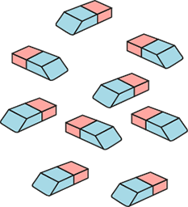
1.4 Composition: 6–10 – step 1:2
9
nine

Slide 10
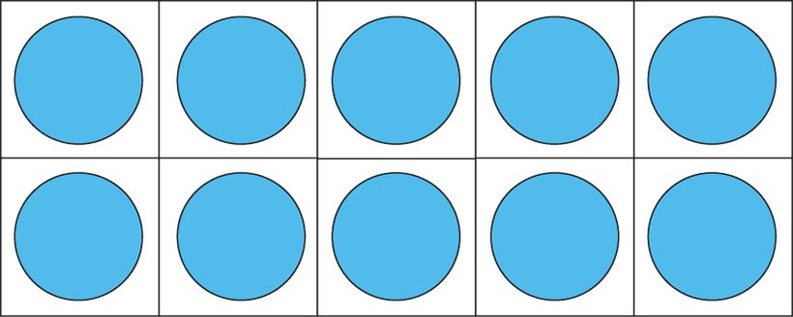
1.4 Composition: 6–10 – step 1:3
6

Slide 11
1.4 Composition: 6–10 – step 1:3
7

Slide 12
1.4 Composition: 6–10 – step 1:3
8

Slide 13
1.4 Composition: 6–10 – step 1:3
9

Slide 14
1.4 Composition: 6–10 – step 1:3
10

Slide 15
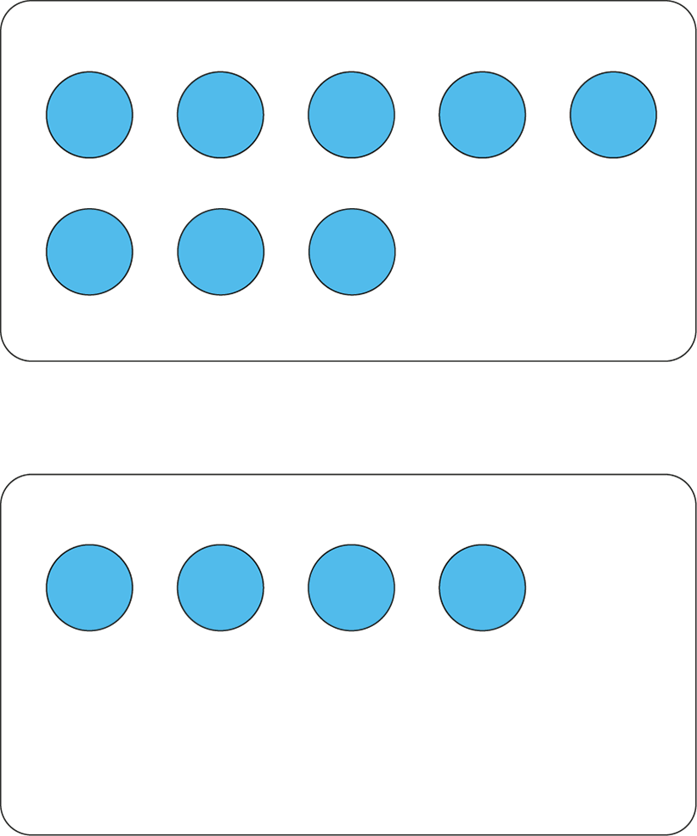
1.4 Composition: 6–10 – step 1:4

Slide 16
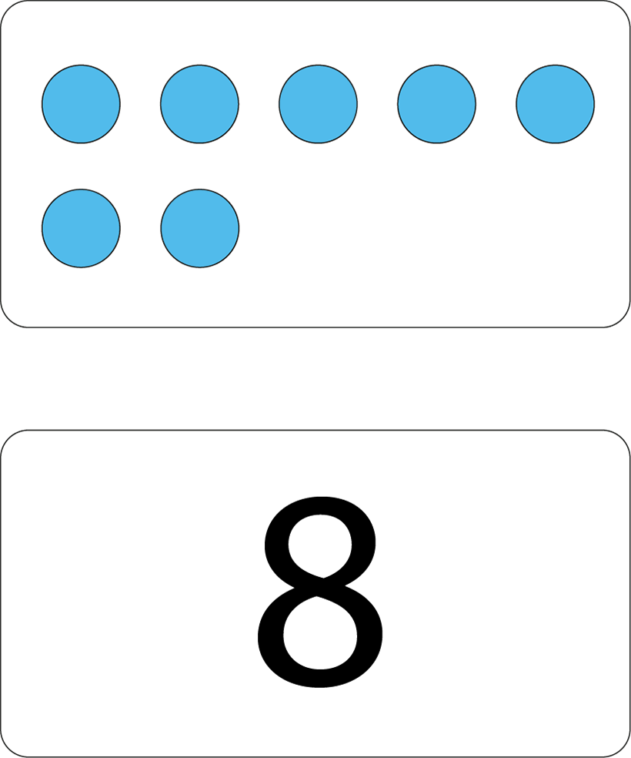
1.4 Composition: 6–10 – step 1:4

Slide 17
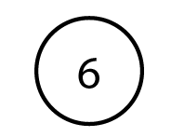
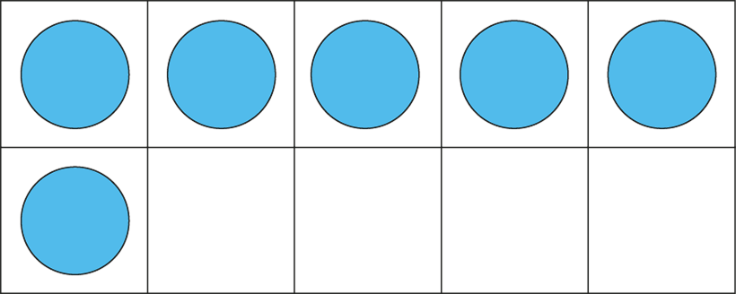
1.4 Composition: 6–10 – step 1:5

Slide 18
1.4 Composition: 6–10 – step 1:6

Slide 19
1.4 Composition: 6–10 – step 1:6

Slide 20
1.4 Composition: 6–10 – step 1:6

Slide 21
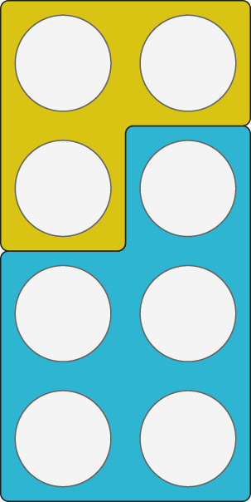
1.4 Composition: 6–10 – step 1:8

Slide 22
1.4 Composition: 6–10 – step 1:8

Slide 23
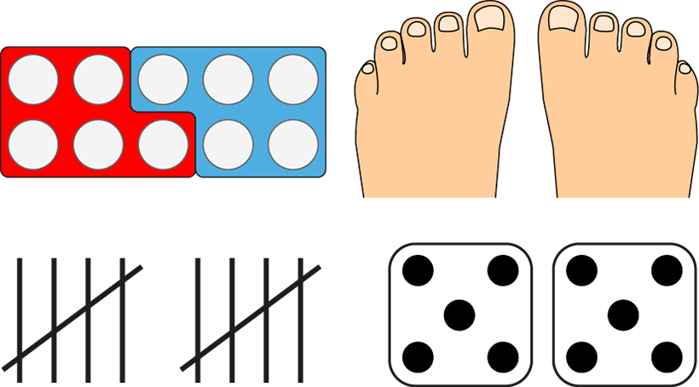
1.4 Composition: 6–10 – step 1:8

Slide 24
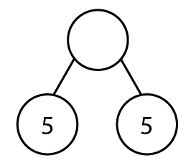
1.4 Composition: 6–10 – step 1:9
?
10
5
5

Slide 25
1.4 Composition: 6–10 – step 1:9
6
5
?
1

Slide 26
1.4 Composition: 6–10 – step 1:9
9
4
5
?

Slide 27
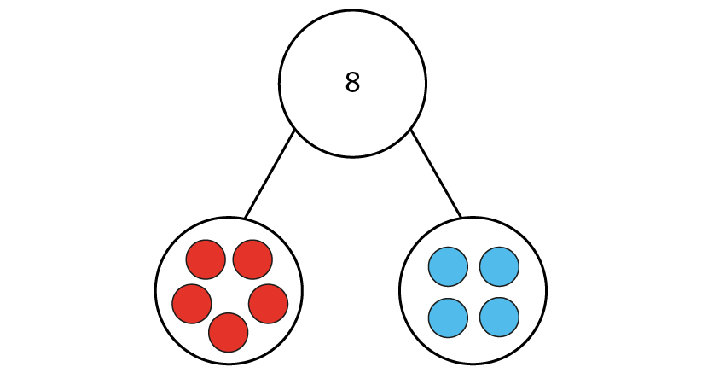
1.4 Composition: 6–10 – step 1:10
8
✓
✗

Slide 28
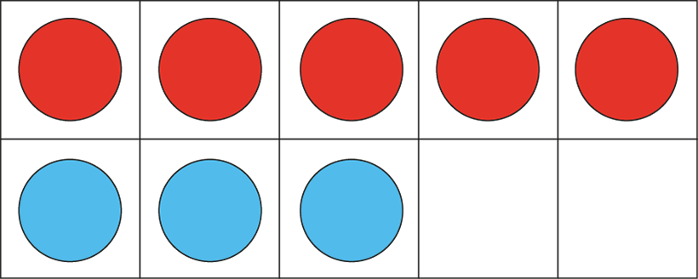
1.4 Composition: 6–10 – step 1:10
7
8
✗
✓
5
3

Slide 29
1.4 Composition: 6–10 – step 2:2
?

Slide 30
1.4 Composition: 6–10 – step 2:3

Slide 31
1.4 Composition: 6–10 – step 2:3
1
2
4
6
8
9

Slide 32
1.4 Composition: 6–10 – step 2:3
1
3
4
5
7
8

Slide 33
1.4 Composition: 6–10 – step 2:4
1
2
4
5
6
8

Slide 34
1.4 Composition: 6–10 – step 2:4
1
3
5
7
8
9

Slide 35
1.4 Composition: 6–10 – step 2:6
1
2
3
5
6
7
8
9

Slide 36
1.4 Composition: 6–10 – step 3:1

Slide 37
1.4 Composition: 6–10 – step 3:1

Slide 38
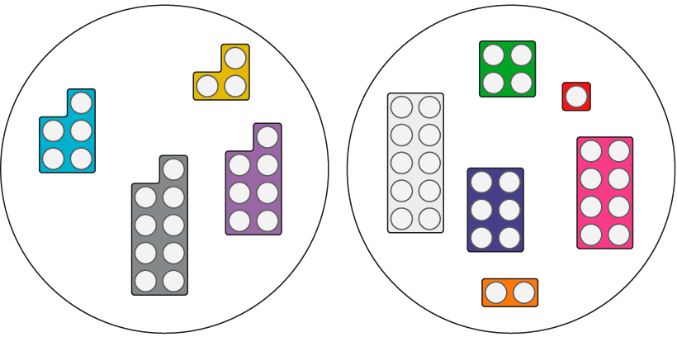
1.4 Composition: 6–10 – step 3:2
odd
even
✓
✗

Slide 39
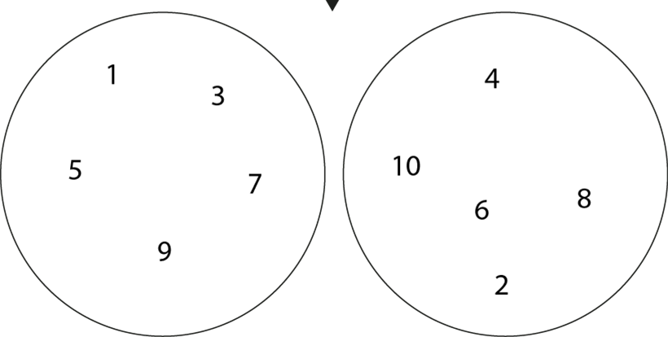
1.4 Composition: 6–10 – step 3:3
odd
even
1
4
3
5
10
7
6
8
9
2

Slide 40
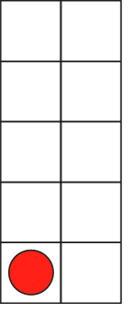
1.4 Composition: 6–10 – step 3:3
1
2
3
10
4
5
6
7
8
9

Slide 41
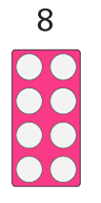
1.4 Composition: 6–10 – step 3:4

Slide 42
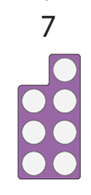
1.4 Composition: 6–10 – step 3:4

Slide 43
1.4 Composition: 6–10 – step 3:4

Slide 44
1.4 Composition: 6–10 – step 3:4

Slide 45
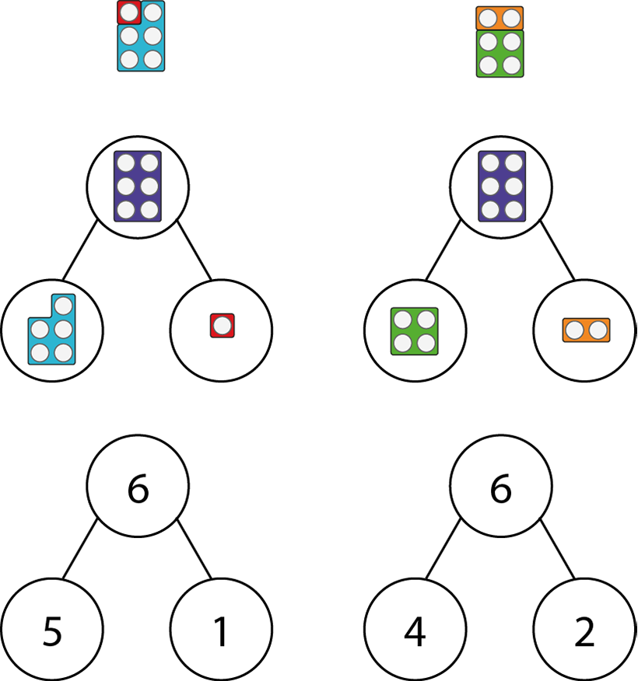
1.4 Composition: 6–10 – step 3:6

Slide 46
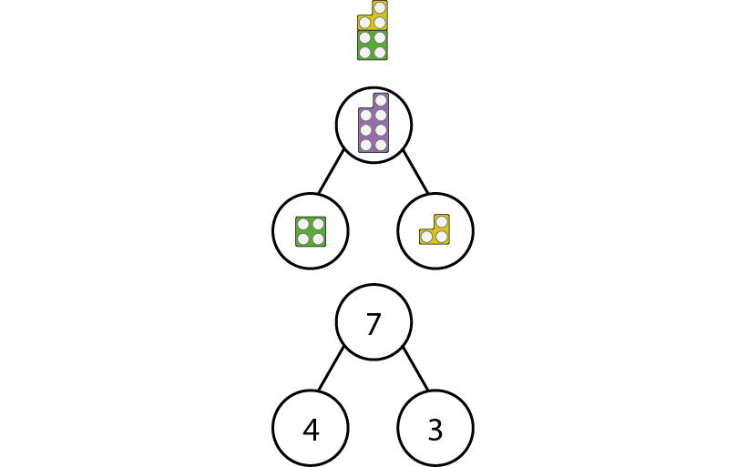
1.4 Composition: 6–10 – step 3:7

Slide 47
1.4 Composition: 6–10 – step 4:1

Slide 48
1.4 Composition: 6–10 – step 4:1

Slide 49
1.4 Composition: 6–10 – step 4:1

Slide 50
1.4 Composition: 6–10 – step 4:1

Slide 51
1.4 Composition: 6–10 – step 4:1

Slide 52
1.4 Composition: 6–10 – step 4:1

Slide 53
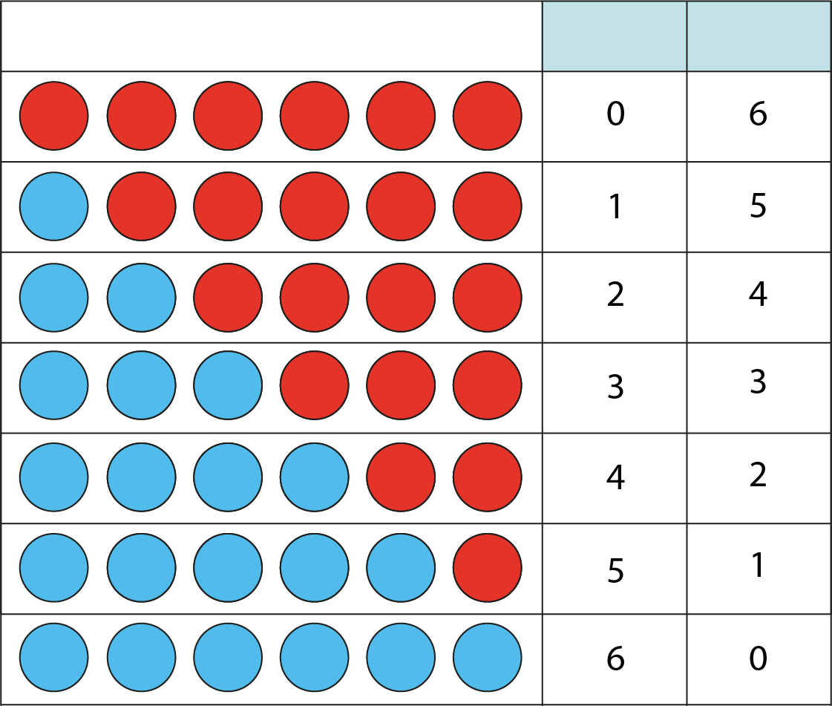
1.4 Composition: 6–10 – step 4:2
0
6
1
5
2
4
3
3
4
2
5
1
6
0

Slide 54
1.4 Composition: 6–10 – step 5:1

Slide 55
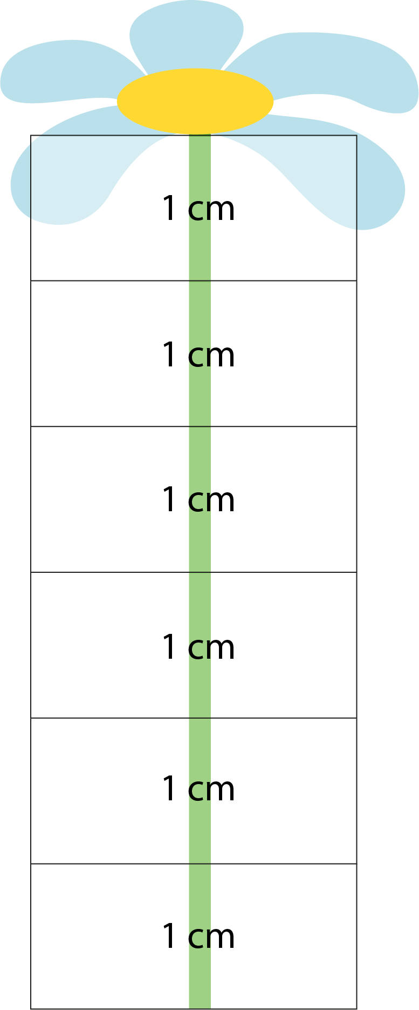
1.4 Composition: 6–10 – step 5:1
3 cm

