Slide 1
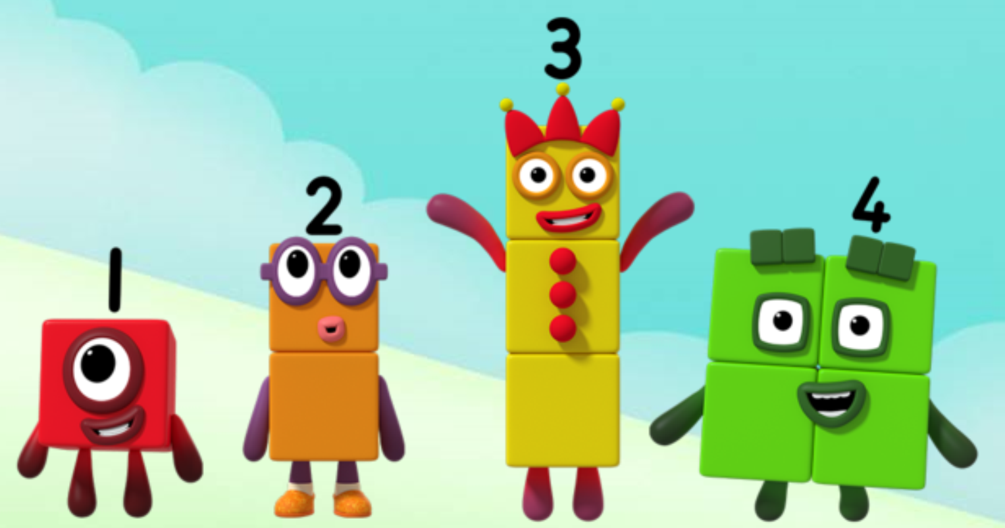
Series 2 Episode 3
Eight

Slide 2
Maths in the Episode
To watch this episode, please go to BBC iPlayer – Numberblocks. Look for Series 2: Eight.
Saying the counting numbers to 8
In this episode children can join in with Octoblock counting to 8 many times. As Octoblock counts, we can see his blocks light up or his ‘arms’ appear. This helps children understand that the last number in the count shows us how many objects (blocks/arms) there are.
Eight is made of seven and one more
At the start of the episode, children can see Eight being made when One jumps on Seven, showing that eight can be made of seven and one.

Slide 3
Talk and discuss together
Watch the episode together.
Ask your child what they noticed and be interested in anything they have to say.
Use the following pictures and activities to explore and talk about the maths involved.

Slide 4
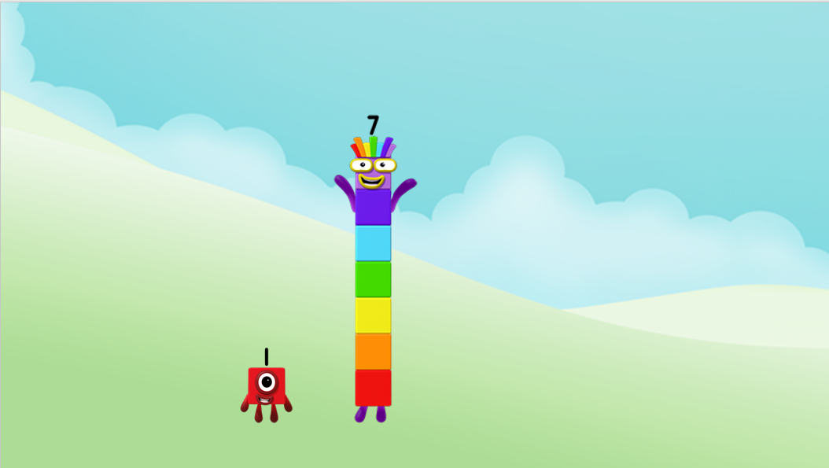
Can you jump on me?
What will happen?
Images © 2017 Alphablocks Ltd. All Rights Reserved.

Slide 5
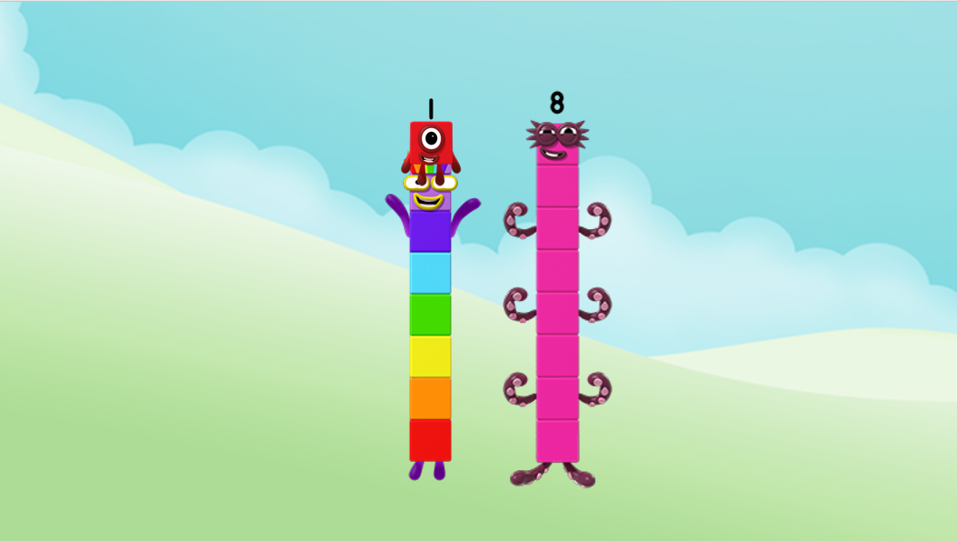
You made me! I am Eight but you can call me Octoblock!
Images © 2017 Alphablocks Ltd. All Rights Reserved.

Slide 6
What if I jump on you, One?
What will happen?
Images © 2017 Alphablocks Ltd. All Rights Reserved.

Slide 7
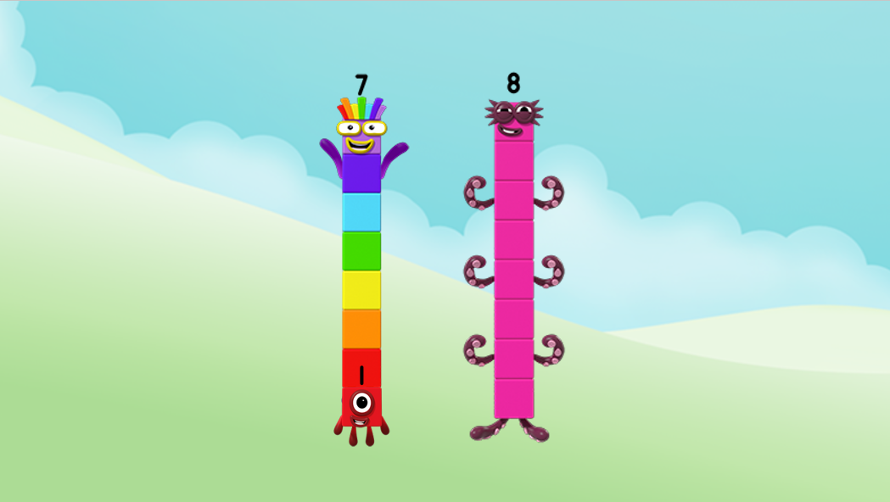
You made me again!
You can do it both ways!
Images © 2017 Alphablocks Ltd. All Rights Reserved.

Slide 8
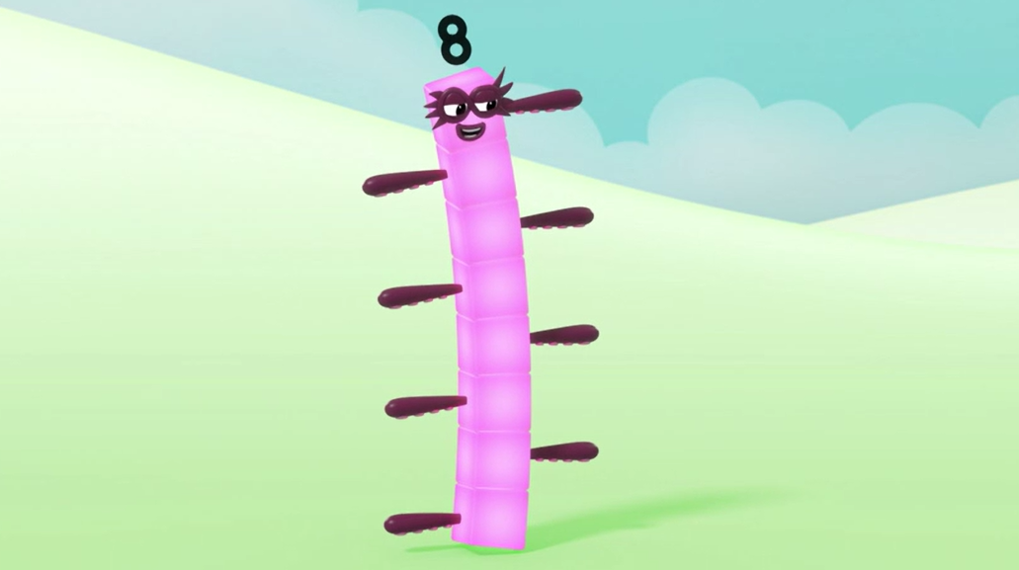
Count my blocks!
1, 2, 3, 4, 5, 6, 7, 8!
Eight blocks!
Images © 2017 Alphablocks Ltd. All Rights Reserved.

Slide 9
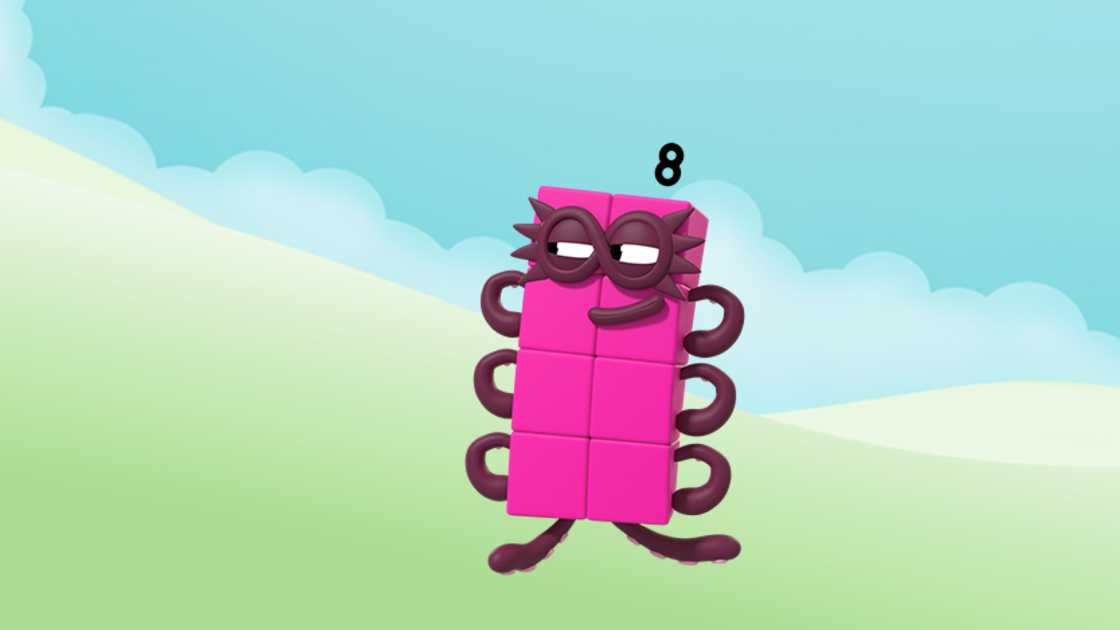
Count my arms!
1, 2, 3, 4, 5, 6, 7, 8!
Eight arms! Or are they legs?
Images © 2017 Alphablocks Ltd. All Rights Reserved.

Slide 10
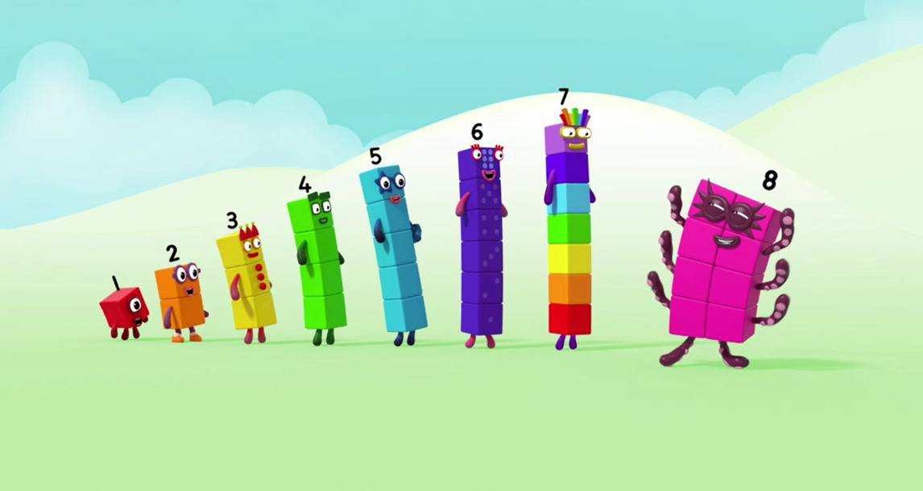
I can stand next to Seven!
Images © 2017 Alphablocks Ltd. All Rights Reserved.

Slide 11
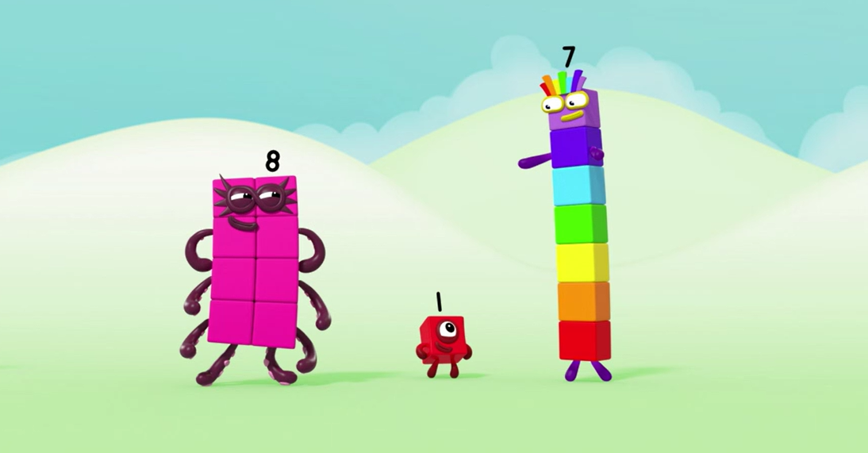
If you take a block off me, you can make Seven and One again!
Images © 2017 Alphablocks Ltd. All Rights Reserved.

Slide 12
Around the home
Say the counting numbers to eight as you go upstairs. Which stair will you be on after counting up eight stairs?
Put some small objects in a bowl, for example, small pieces of pasta or beads. Using both hands, can you grab 8? Count out the objects you have grabbed and see if you have 8. Win a point if you do.
Make Octoblock with eight squares cut out from a cereal box. Can you make him tall? Can you make him wide? Can you make him into a different shape?
Draw a picture of Octoblock swimming or climbing up a wall. Make sure you can see all eight blocks and eight arms/legs!
Make an octopus with part of a cardboard roll and some string or wool. Stick on eight pieces of string/wool around the roll for the tentacles.
If you have building blocks, make a tower of seven with one colour. Put a different colour block on the top – can you see the seven and one in eight?

Slide 13
General tips that can make a difference in maths
Provide lots of opportunities to say how many things you can see (up to 5) without counting.
Whenever you talk about a small set of objects, say the number. For example, please pick up those 3 teddies or look at those 2 dogs.
Count up (starting from one) when walking upstairs and count back when walking downstairs.
Count lots of different objects, big and small, and ask ‘How many are there?’ Your child should be able to tell you without going back and re-counting. If they can’t, then tell them: ‘There are 6 altogether’.
Play with fingers, firstly practise counting fingers.
Ask your child to put their fingers down and then say or hold up a number such as 3. Can they do it without counting? Can they do it using different fingers? Can they do it using fingers from two hands?
Play board games with your child which involve moving along numbered tracks, such as ‘Snakes and Ladders’. Check that your child counts along the track correctly, moving one square for each number counted.
Regular use of these simple ideas, whenever the opportunity arises, will improve your child’s maths.

Slide 14
General tips that can make a difference in maths
Notice when there are two amounts and one is more than the other, or they are the same. For example, I have 2 eyes and 2 ears, or I have more chips than peas.
Talk about and describe shapes you can see outside or around your home. For example, count corners, talk about straight/curved edges, flat/curved surfaces. If you have building blocks then talk about and describe the things that are built.
In the bath or at the sink, play with containers, pouring water, counting how many small pots are needed to fill the big container.
Encourage your child to draw a picture of their number work and explain their mark-making to you, for example, how many leaves they find on a walk. This doesn’t necessarily mean writing the numerals (1, 2, 3, 4… etc.).
Sing counting songs and rhymes. You can find some on the internet, but children love it if you join in with them!
Make a deliberate maths mistake from time to time and ask your child to explain why you are wrong. For example, say that 4 is bigger than 5.
Regular use of these simple ideas, whenever the opportunity arises, will improve your child’s maths.

