Slide 1
Year 3, Unit 7
Column subtraction

Slide 2
Year 3, Unit 7
These materials heavily reflect the prioritisation approach of the ready-to-progress criteria in the DfE Primary Mathematics Guidance 2020 and on the PPTs that exemplify them on the NCETM website. They also include other relevant National Curriculum content. Related sections of the NCETM Primary Mastery Professional Development Materials provide small-step teaching guidance.
Ready-to-progress criteria addressed by this unit
Teaching of this unit supports the following criteria from the ‘DfE Mathematics Guidance: key stages 1 & 2’ (the 335-page document available as a download)
3AS-2 Page 109
Prior learning
There are no specific ready-to-progress criteria supporting the prior learning for this unit.

Slide 3
Contents
The links below take you to the starting slide of each learning outcome.
1 | Pupils identify the minuend and the subtrahend in column subtraction
2 | Pupils explain the column subtraction algorithm
3 | Pupils subtract from a 2-digit number using column subtraction with exchanging from tens to ones
4 | Pupils subtract from a 3-digit number using column subtraction with exchanging from hundreds to tens (1)
5 | Pupils subtract from a 3-digit number using column subtraction with exchanging from hundreds to tens (2)
6 | Pupils evaluate the efficiency of strategies for subtraction
Click the arrow button to return to this Contents slide.

Slide 4
Year 3, Unit 7, Learning Outcome 1
Learning Outcome 1
Pupils identify the minuend and the subtrahend in column subtraction
The following slides have been collated to support the teaching of this learning outcome.

Slide 5
Year 3, Unit 7, Learning Outcome 1
Additional teacher guidance for this outcome should be read first and can be found in this segment of the NCETM Primary Mastery Professional Development Materials:
1.21 Algorithms: column subtraction
The spine materials are divided into ‘teaching points’ and ‘steps in learning’.
Teaching point | Steps in learning | Pages
1 | 1:1-1:2 | 3-4

Slide 6
1.21 Algorithms: column subtraction – step 1:2
Notes:
There are 65 books in year 3’s book corner. 23 are fiction. How many are non-fiction?

Slide 7
1.21 Algorithms: column subtraction – step 1:2
23
42

Slide 8
Year 3, Unit 7, Learning Outcome 2
Learning Outcome 2
Pupils explain the column subtraction algorithm
The following slides have been collated to support the teaching of this learning outcome.

Slide 9
Year 3, Unit 7, Learning Outcome 2
Additional teacher guidance for this outcome should be read first and can be found in this segment of the NCETM Primary Mastery Professional Development Materials:
1.21 Algorithms: column subtraction
The spine materials are divided into ‘teaching points’ and ‘steps in learning’.
Teaching point | Steps in learning | Pages
1 | 1:3-1:6 | 4-7

Slide 10
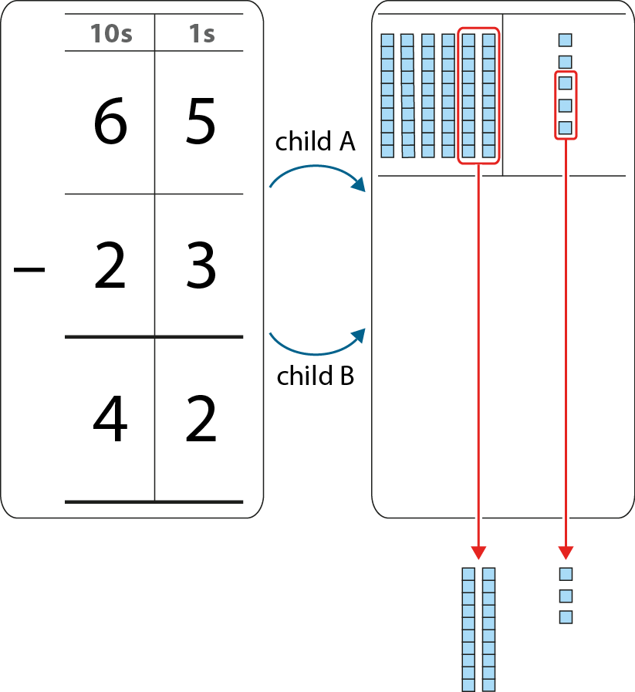
1.21 Algorithms: column subtraction – step 1:4

Slide 11
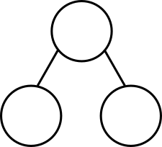
1.21 Algorithms: column subtraction – step 1:6
97
936
52
45
?
511
?
425

Slide 12
1.21 Algorithms: column subtraction – step 1:6
 | 3 |  | 5
− |  | 3
 | 2 | 3 | 4
6
1
1

Slide 13
Year 3, Unit 7, Learning Outcome 3
Learning Outcome 3
Pupils subtract from a 2-digit number using column subtraction with exchanging from tens to ones
The following slides have been collated to support the teaching of this learning outcome.

Slide 14
Year 3, Unit 7, Learning Outcome 3
Additional teacher guidance for this outcome should be read first and can be found in this segment of the NCETM Primary Mastery Professional Development Materials:
1.21 Algorithms: column subtraction
The spine materials are divided into ‘teaching points’ and ‘steps in learning’.
Teaching point | Steps in learning | Pages
2 | 2:1-2:3 | 8-10

Slide 15
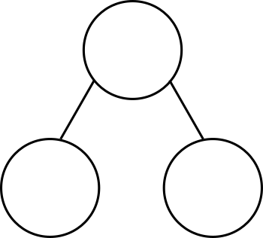
1.21 Algorithms: column subtraction – step 2:1
23
23
2
tens
1
ten
3
ones
13
ones
?
?
?
?

Slide 16
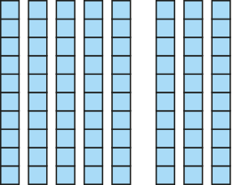
1.21 Algorithms: column subtraction – step 2:2
94
− 6 =
88

Slide 17
1.21 Algorithms: column subtraction – step 2:3
10s | 1s
9 | 4
 | 6
8
1
−
8
8
94
− 6
= 88

Slide 18
Year 3, Unit 7, Learning Outcome 4
Learning Outcome 4
Pupils subtract from a 3-digit number using column subtraction with exchanging from hundreds to tens (1)
The following slides have been collated to support the teaching of this learning outcome.

Slide 19
Year 3, Unit 7, Learning Outcome 4
Additional teacher guidance for this outcome should be read first and can be found in this segment of the NCETM Primary Mastery Professional Development Materials:
1.21 Algorithms: column subtraction
The spine materials are divided into ‘teaching points’ and ‘steps in learning’.
Teaching point | Steps in learning | Pages
2 | 2:4-2:6 | 10-12

Slide 20
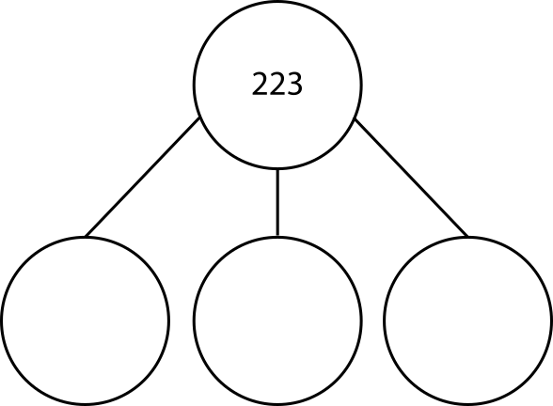
1.21 Algorithms: column subtraction – step 2:4
223 =
200
100
100
+
+
+
20
120
110
+
+
+
3
3
13

Slide 21
1.21 Algorithms: column subtraction – step 2:5
223 − 142
= 81

Slide 22
1.21 Algorithms: column subtraction – step 2:6
100s | 10s | 1s
2 | 2 | 3
1 | 4 | 2
1
1
−
0
8
1

Slide 23
Year 3, Unit 7, Learning Outcome 5
Learning Outcome 5
Pupils subtract from a 3-digit number using column subtraction with exchanging from hundreds to tens (2)
The following slides have been collated to support the teaching of this learning outcome.

Slide 24
Year 3, Unit 7, Learning Outcome 5
Additional teacher guidance for this outcome should be read first and can be found in this segment of the NCETM Primary Mastery Professional Development Materials:
1.21 Algorithms: column subtraction
The spine materials are divided into ‘teaching points’ and ‘steps in learning’.
Teaching point | Steps in learning | Pages
2 | 2:7-2:8 | 13

Slide 25
1.21 Algorithms: column subtraction – step 2:7
100s | 10s | 1s
4 | 0 | 4
2 | 5 | 7
3
1
9
1
−
1
4
7

Slide 26
1.21 Algorithms: column subtraction – step 2:8
Which calculations require exchange?
 | 5 | 6 | 3
− | 2 | 1 | 3
 | 4 | 8 | 2
− | 1 | 9 | 7
 | 8 | 2 | 4
− | 3 | 1 | 9
 | 4 | 0 | 5
− | 1 | 2 | 3
 | 3 | 1 | 6
− | 1 | 0 | 3
 | 9 | 0 | 3
− | 1 | 2 | 4

Slide 27
1.21 Algorithms: column subtraction – step 2:8
Which calculations require exchange only once?
 | 5 | 6 | 3
− | 2 | 1 | 3
 | 4 | 8 | 2
− | 1 | 9 | 7
 | 8 | 2 | 4
− | 3 | 1 | 9
 | 4 | 0 | 5
− | 1 | 2 | 3
 | 3 | 1 | 6
− | 1 | 0 | 3
 | 9 | 0 | 3
− | 1 | 2 | 4

Slide 28
1.21 Algorithms: column subtraction – step 2:8
Which calculations require exchange twice?
 | 5 | 6 | 3
− | 2 | 1 | 3
 | 4 | 8 | 2
− | 1 | 9 | 7
 | 8 | 2 | 4
− | 3 | 1 | 9
 | 4 | 0 | 5
− | 1 | 2 | 3
 | 3 | 1 | 6
− | 1 | 0 | 3
 | 9 | 0 | 3
− | 1 | 2 | 4

Slide 29
1.21 Algorithms: column subtraction – step 2:8
Which calculations require exchange through a zero?
 | 5 | 6 | 3
− | 2 | 1 | 3
 | 4 | 8 | 2
− | 1 | 9 | 7
 | 8 | 2 | 4
− | 3 | 1 | 9
 | 4 | 0 | 5
− | 1 | 2 | 3
 | 3 | 1 | 6
− | 1 | 0 | 3
 | 9 | 0 | 3
− | 1 | 2 | 4

Slide 30
3AS-2 Columnar addition and subtraction
Which calculations require exchange?
Which require exchange only once?
Which require exchange twice?
Which require exchange through a zero?
Can you answer these questions without having to solve the calculations?
 | 5 | 6 | 3
− | 2 | 1 | 3
 | 4 | 8 | 2
− | 1 | 9 | 7
 | 8 | 2 | 4
− | 3 | 1 | 9
 | 4 | 0 | 5
− | 1 | 2 | 3
 | 3 | 1 | 6
− | 1 | 0 | 3
 | 9 | 0 | 3
− | 1 | 2 | 4

Slide 31
Year 3, Unit 7, Learning Outcome 6
Learning Outcome 6
Pupils evaluate the efficiency of strategies for subtraction
The following slides have been collated to support the teaching of this learning outcome.

Slide 32
Year 3, Unit 7, Learning Outcome 6
Additional teacher guidance for this outcome should be read first and can be found in this segment of the NCETM Primary Mastery Professional Development Materials:
1.21 Algorithms: column subtraction
The spine materials are divided into ‘teaching points’ and ‘steps in learning’.
Teaching point | Steps in learning | Pages
2 | 2:9-2:10 | 14-15

Slide 33
1.21 Algorithms: column subtraction – step 2:9
 | 5 |  | 7
− |  | 8
 | 3 | 5 | 4
3
1
3

Slide 34
3AS-2 Columnar addition and subtraction
475 − 358
170 − 140
Look at these expressions carefully.
Can you solve any of them without using column subtraction? Sort them into a table like the one shown.
Explain your thinking.
349 − 101
201 − 198
Use column subtraction | Use mental strategies

