Slide 1
Algebra Key Stage 2
Video 2.2
Extending reasoning about equations

Slide 2
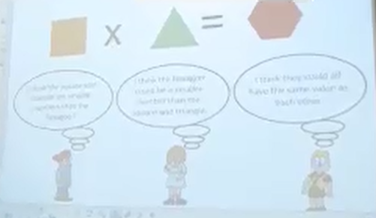
2.2 Extending reasoning about equations
How effective is the teacher’s use of the three different statements in promoting reasoning and discussion?
How does the second statement prompt children to think about numbers other than whole numbers?

