Slide 1
Understanding how to multiply fractions
KS3 Mastery PD Materials: Exemplified Key Ideas
Materials for use in the classroom or to support professional development discussions
(from 2.1 Arithmetic procedures)
Summer 2021

Slide 2
About this resource
These slides are designed to complement the 2.1 Arithmetic procedures Core Concept document and its associated Theme Overview document 2 Operating on number, both found in the Secondary Mastery Professional Development pages.
These slides re-present the key examples from the Core Concept document so that the examples can be used either directly in the classroom or with a group of teachers. There are prompt questions alongside the examples, and further clarification in the notes.
These slides do not fully replicate the Core Concept document, so should be used alongside it. Reference to specific page numbers, and to other useful NCETM resources, can be found in the notes for each slide.
This slide deck is not designed to be a complete PD session, rather it is a selection of resources that you can adapt and use as needed when planning a session with a group of teachers.

Slide 3


About this resource
The slides are structured as follows:
  The big picture:
    Where does this fit in?
    What do students need to understand?
    Why is this key idea important?
  Prior learning
  Misconceptions
  Exemplified key ideas
  Reflection questions
  Appendices:
    Key vocabulary
    Representations and structure
    Previous and Future learning
    Useful links
The exemplified key idea slides have the following symbols to indicate how they have been designed to be used:
Into the classroom
The examples are presented on these slides so that they could be used in PD, but also directly in the classroom. The notes feature suggested questions and things teachers might consider when using with students.
PD discussion prompts
These slides look at the examples in more detail, with question prompts to promote discussion among maths teachers. The notes feature reference to further information and guidance within the Core Concepts document.

Slide 4
Where does this fit in?
The NCETM has identified a set of six ‘mathematical themes’ within Key Stage 3 mathematics that bring together a group of ‘core concepts’.
The second of these themes is Operating on number, which covers the following interconnected core concepts:
2.1 Arithmetic procedures
2.2 Solving linear equations
Notes:
Linked on this slide is the Theme Overview document of Operating on number. This document includes why it is important, the key underpinning knowledge and links to prior and future learning. There is also guidance about how the five big ideas of Teaching for Mastery relate specifically to this theme.

Slide 5
Where does this fit in?
Within this core concept, 2.1 Arithmetic Procedures, there are five statements of knowledge, skills and understanding.
These, in turn, are broken down into twenty one key ideas. The highlighted key idea is exemplified in this slide deck.
Notes:
For key ideas marked with an asterisk, we exemplified the common difficulties and misconceptions that students might have and included elements of what teaching for mastery may look like. We have provided examples of possible student tasks and teaching approaches.
Within these slides are ‘classroom-ready’ versions of the examples for the key idea that has been highlighted. There are also slides that may be useful for discussion in a professional development session

Slide 6
What do students need to understand?
2.1.4.2 Understand how to multiply unit, non-unit and improper fractions
Appreciate that non-unit fractions are integer multiples of unit fractions and that, by considering the commutative and associative laws, the multiplication of non-unit fractions can be derived.
  What prior knowledge might your students already have?
  What language might they use to describe this key idea?
  What questions might you want to ask to assess their prior learning?

Slide 7
Why is this key idea important?
The ability to calculate is a fundamental skill in mathematics and this, of course, includes the requirement that students know and use standard methods of calculation.
However, students who know these methods solely as a set of memorised steps, without any understanding of why they work and the laws of arithmetic on which they are based, may quickly forget them.
There is a danger that students see the mathematics curriculum as a set of separate topics, each with its own set of rules and techniques. This unconnected view of the curriculum can result in an entirely instrumental and procedural approach to mathematics, with no sense of conceptual coherence.
It is, therefore, important that students see fractions or rational numbers as a part of a unified number system and that the operations on such numbers are related and connected to previously taught and learnt concepts for integers.
Notes:
A more detailed overview of the core concept of arithmetic procedures can be found on page 2 of the 2.1 Core Concept document.
The background to each key idea is also explored in more detail on the following pages:
2.1.1 Understand and use the structures that underpin addition and subtraction strategies – page 10
2.1.2 Understand and use the structures that underpin multiplication and division strategies – pages 10 and 11
2.1.3 Know, understand and use fluently a range of calculation strategies for addition and subtraction of fractions – page 11
2.1.4 Know, understand and use fluently a range of calculation strategies for multiplication and division of fractions – pages 11 and 12
2.1.5 Use the laws and conventions of arithmetic to calculate efficiently – pages 12 and 13

Slide 8
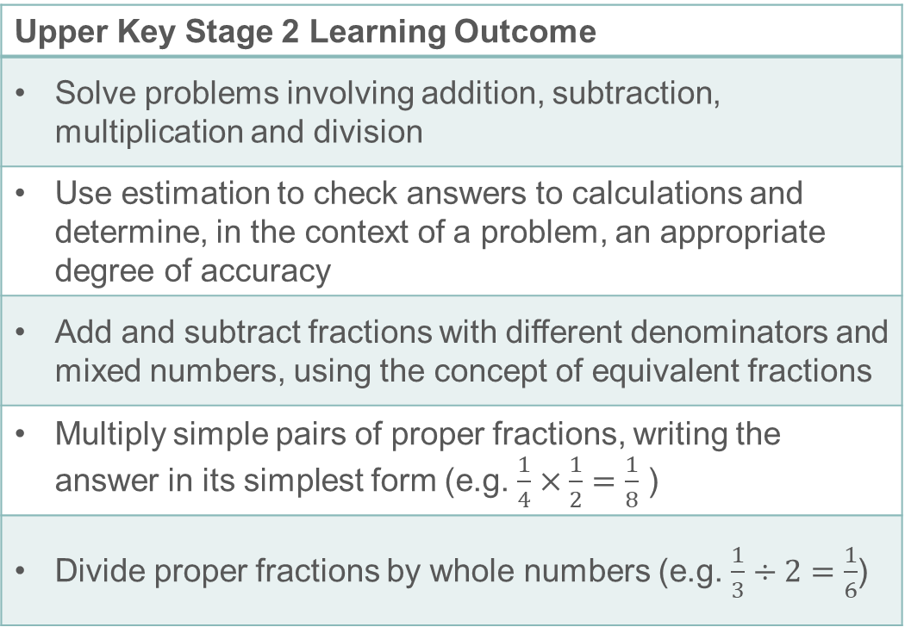
Prior learning
Upper Key Stage 2 Learning Outcome
Solve problems involving addition, subtraction, multiplication and division
Use estimation to check answers to calculations and determine, in the context of a problem, an appropriate degree of accuracy
Add and subtract fractions with different denominators and mixed numbers, using the concept of equivalent fractions
Multiply simple pairs of proper fractions, writing the answer in its simplest form (e.g. $\frac{1}{4}×\frac{1}{2}=\frac{1}{8}$ )
Divide proper fractions by whole numbers (e.g. $\frac{1}{3}÷2=\frac{1}{6}$)
  What prior knowledge might your students already have?
  What language might they use to describe this key idea?
  What questions might you want to ask to assess their prior learning?
Notes:
You may find it useful to speak to your partner schools to see how the above has been covered and the language used.
The prior learning is covered in a number of the segments from Spines 1, 2 and 3 of the NCETM primary mastery professional development materials (linked on final slide).
Within the Operating on Number Theme Overview document, you can also find a broader description of students’ potential previous learning (page 6), alongside further information about key underpinning knowledge (page 2).

Slide 9
Checking prior learning
The following slides contain questions for checking prior learning.
  What representations might students use to support their understanding of these questions?
  What variation might you put in place for these questions to fully assess students’ understanding of the concept?
  How might changing the language of each question change the difficulty?
  Why are these such crucial pre-requisites for this key idea?

Slide 10
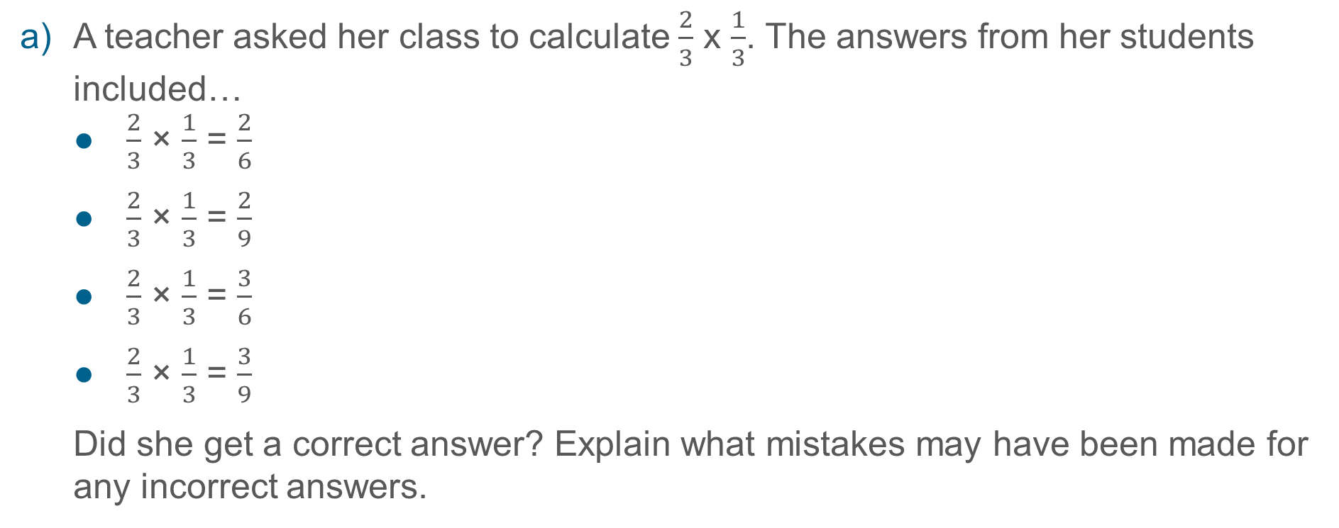
Checking prior learning
A teacher asked her class to calculate $\frac{2}{3}$ x $\frac{1}{3}$. The answers from her students included…
  $\frac{2}{3}$ × $\frac{1}{3}$ = $\frac{2}{6}$
  $\frac{2}{3}$ × $\frac{1}{3}$ = $\frac{2}{9}$
  $\frac{2}{3}$ × $\frac{1}{3}$ = $\frac{3}{6}$
  $\frac{2}{3}$ × $\frac{1}{3}$ = $\frac{3}{9}$
  Did she get a correct answer? Explain what mistakes may have been made for any incorrect answers.
Notes:
References to the questions (links on final slide):
a) NCETM Secondary assessment materials, page 10

Slide 11
Common difficulties and misconceptions
What aspects of this key idea might students find challenging?
What misconceptions might students have?
When teaching this topic, you may find students encounter difficulties with…
Applying the rule without understanding
Using inefficient methods
More information, and some suggestions for overcoming these challenges, can be found on the following slides

Slide 12
Common difficulties and misconceptions (1)
One common difficulty with multiplication of fractions is that the rule for doing this is very simple (multiply the numerators and multiply the denominators) and students often apply this rule without any understanding.
It will be important to use representations (for example, the area model) alongside the symbolic calculation in order to get a sense of what is happening when two fractions are multiplied together. In this way, students can make sense of the rule rather than just learning it without justification.
Examples 1 and 2 use students’ understanding of commutativity and rewriting products to explore the rule for multiplying fractions more deeply.
Notes:
These can be found on page 40 of the 2.1 Core Concept document.

Slide 13
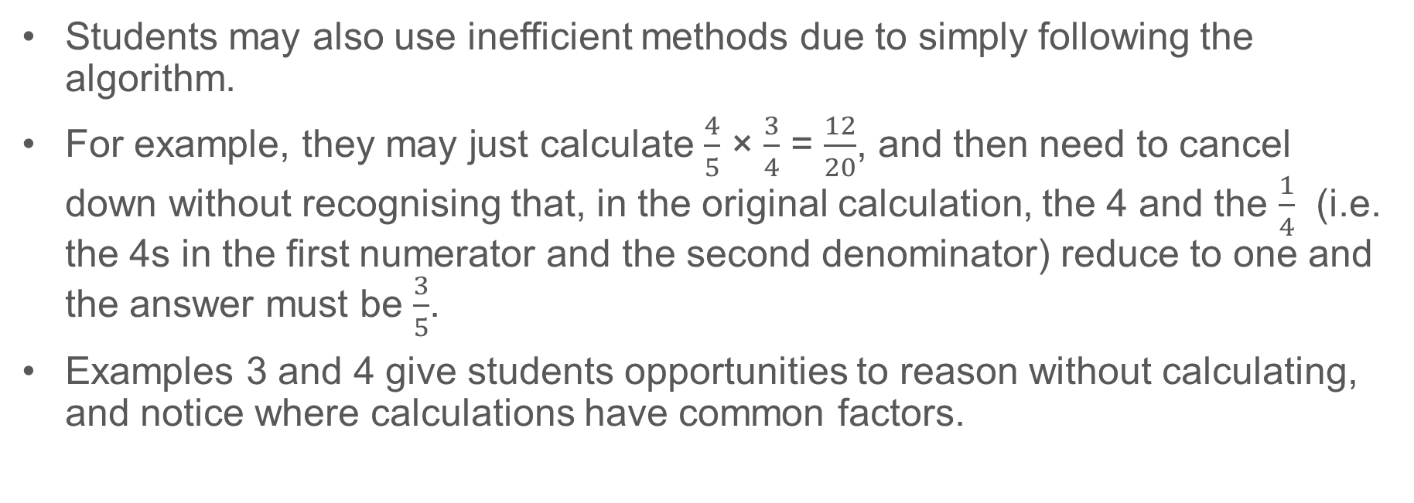
Common difficulties and misconceptions (2)
Students may also use inefficient methods due to simply following the algorithm.
For example, they may just calculate $\frac{4}{5}$ × $\frac{3}{4}$ = $\frac{12}{20}$, and then need to cancel down without recognising that, in the original calculation, the 4 and the $\frac{1}{4}$ (i.e. the 4s in the first numerator and the second denominator) reduce to one and the answer must be $\frac{3}{5}$.
Examples 3 and 4 give students opportunities to reason without calculating, and notice where calculations have common factors.
Notes:
These can be found on page 40 of the 2.1 Core Concept document.

Slide 14
Planning to teach
The following slides feature four examples, each presented two ways:
  An ‘into the classroom’ slide for use directly with students
  A ‘PD discussion prompts’ slide for use in PD sessions or departmental time
The notes section of the ‘into the classroom slides’ contains suggested questions and prompts for teachers to think about when planning.
Before using these examples in the classroom, you may wish to look at the video and resources available for ‘Multiplication of Fractions’ here: Planning to teach secondary maths | NCETM.
If you are using these examples in a PD session, you may also wish to look at the departmental workshops on this fractions here: Departmental Workshops | NCETM.

Slide 15
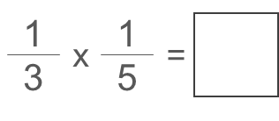
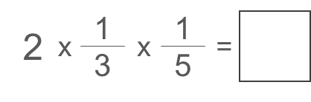
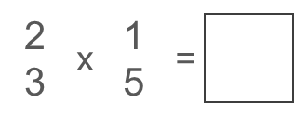
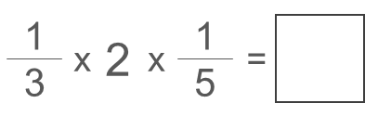
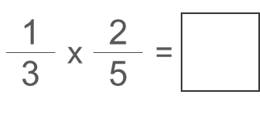



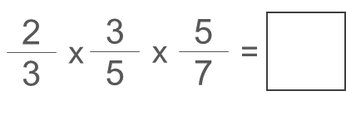
Appreciate that non-unit fractions are integer multiples of unit fractions and that, by considering the commutative and associative laws, the multiplication of non-unit fractions can be derived
Example 1
Complete these calculations.
(These questions are sequenced in rows across the page.)
a)
b)
c)
d)
e)
f)
g)
h)
i)
Notes:
Suggested questioning:
Can you draw a picture to show this?
Can you see this as (e.g.) 1/3 of 1/5 and as 1/5 of 1/3?
Is (e.g.) (1/3 × 2) × 1/5 the same as 2/3 × 1/5?
What other calculations is ___ the same as?
How else can you write (e.g.) 2/3 × 1/5?
In how many ways can you think of this calculation?
What is the same and what is different in these two calculations: 1/3 × 1/5 and 2/3 × 2/5? Why is the answer to the second calculation four times bigger than the answer to the first?
Things for you to think about:
This sequence of questions is designed to help students use their understanding of commutativity to make sense of the ‘multiply the numerators and multiply the denominators’ rule. It will be important to encourage students to reason why this is true, by asking questions that help them recognise where the calculations are equivalent, and to rewrite the calculations in different ways. Your questioning will need to help students to make connections between the calculations that are equivalent and the calculations that are related (i.e. questions a-e). Questions f-i provide an opportunity to practice these ideas, with h-i including some added challenge (i.e. the possibility of cancelling before multiplying). From these exercises and the ensuing discussions, it will be useful for students to articulate (both as a whole class and to themselves) the sentence ‘When multiplying two fractions, multiply the numerators and multiply the denominators.’

Slide 16
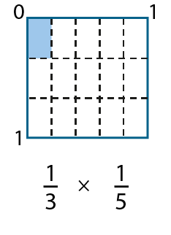
Appreciate that non-unit fractions are integer multiples of unit fractions and that, by considering the commutative and associative laws, the multiplication of non-unit fractions can be derived.
Example 1
How can you modify the unit fraction diagram for question a to represent the calculations in questions b-f?
a)
b)
c)
d)
e)
f)
Notes:
Suggested questioning:
What is the same and what is different about each calculation? How would you modify the diagram each time?
Things for you to think about:
This is an example of how you might encourage students to generalise beyond unit fractions, using Example 1 and their existing experience of the area representation for multiplication.

Slide 17
Appreciate that non-unit fractions are integer multiples of unit fractions and that, by considering the commutative and associative laws, the multiplication of non-unit fractions can be derived.
Example 1
Complete these calculations. (These questions are sequenced in rows across the page.)
a)
13
15
b)
2
13
15
c)
23
15
×
=
×
×
=
×
=
d)
13
2
15
e)
13
25
f)
23
25
×
×
=
×
=
×
=
34
35
34
45
i)
23
35
57
g)
×
=
h)
×
=
×
×
=
  How does the sequencing of these questions use students’ knowledge of commutativity to deepen their understanding of multiplying fractions?
  Which parts of this example will you want to connect in your questioning? What will you want students to take away from the discussion?
Notes:
Due to space constraints, the image on this PD discussion slide is very small. PD Leads might like to use or print the ‘in the classroom’ version of this slide for teachers to access during discussions.
More detail about the sequencing of this example can be found on pages 40-42 of the 2.1 Core Concept document.

Slide 18
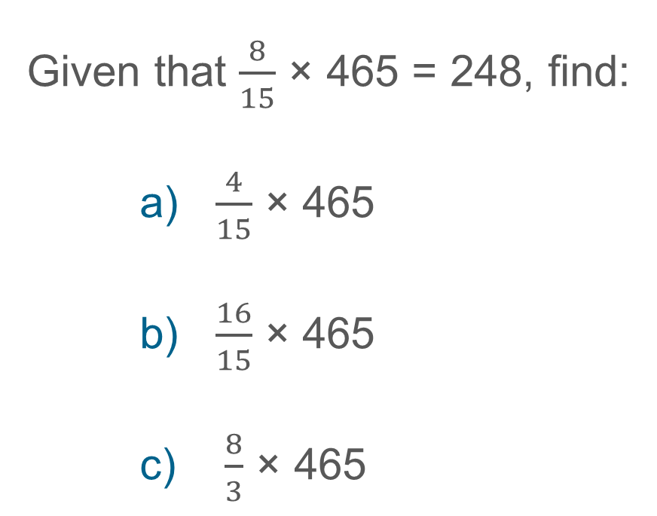
Appreciate that non-unit fractions are integer multiples of unit fractions and that, by considering the commutative and associative laws, the multiplication of non-unit fractions can be derived.
Example 2
Given that $\frac{8}{15}$ × 465 = 248, find:
    a) $\frac{4}{15}$ × 465
    b) $\frac{16}{15}$ × 465
    c) $\frac{8}{3}$ × 465
Notes:
Suggested questioning:
How is each part related to the original calculation? How could you rewrite each part? Could you rewrite each part using 8/15 in your calculation?
What other results could you find given that you know the original product?
Things for you to think about:
In Example 2, students are invited to manipulate a given expression to find the answers to other calculations, further developing their understanding of the use of one fraction (such as a unit fraction) to find the product of two fractions.
On completion of the three given calculations, and having discussed their reasoning, you could then ask students to give some other results that they can find using the original product.

Slide 19
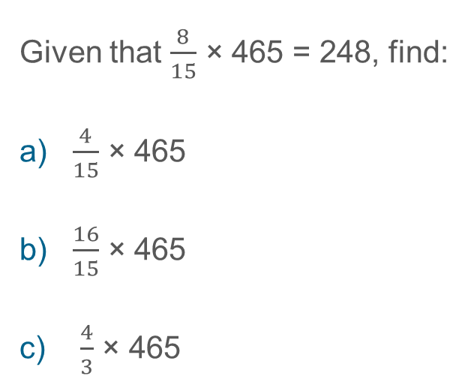
Appreciate that non-unit fractions are integer multiples of unit fractions and that, by considering the commutative and associative laws, the multiplication of non-unit fractions can be derived
Example 2
Given that $\frac{8}{15}$ × 465 = 248, find:
a) $\frac{4}{15}$ × 465
b) $\frac{16}{15}$ × 465
c) $\frac{4}{3}$ × 465
  What is the benefit of asking students to consider related calculations?
  How might you model the relationships between these calculations? Would you expect the same notation or language each time?
Notes:
This example can be found on page 42 of the 2.1 Core Concept document.

Slide 20
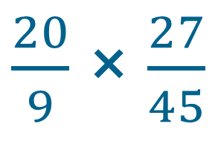
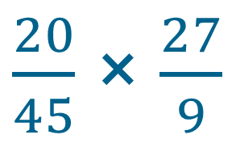
Appreciate that non-unit fractions are integer multiples of unit fractions and that, by considering the commutative and associative laws, the multiplication of non-unit fractions can be derived.
Example 3
Which of these gives the greater product?
or
Explain how you calculated your answer.
$\frac{20}{9}$ × $\frac{27}{45}$
$\frac{20}{45}$ × $\frac{27}{9}$
Notes:
Suggested questioning:
What is the same about these two calculations? What is different?
How many different ways might you approach each calculation to make it simpler?
How could you rewrite each calculation?
Things for you to think about:
Students could consider cancelling fractions in order to simplify multiplication calculations with fractions, but this may not be the most efficient approach. In Example 3, the numbers have been carefully chosen to draw attention to how the commutative law can be used to simplify when multiplying fractions. Initially, students may calculate the product without simplifying, and the numbers used in the first multiplication calculation are chosen to make this reasonably straightforward. Students may be more likely to notice that the second calculation can be simplified before multiplying (by simplifying 27/9 to 3). On finding that the products are equal, students’ attention should be drawn to the common structure of each calculation and the way that the commutative law can be used to simplify.

Slide 21
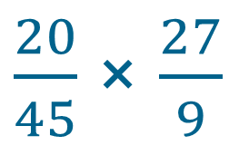
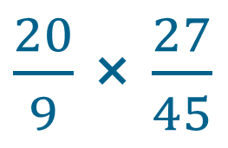
Appreciate that non-unit fractions are integer multiples of unit fractions and that, by considering the commutative and associative laws, the multiplication of non-unit fractions can be derived
Example 3
  How many different ways might your students approach this?
  How will you model the common structure of each calculation, and the way that the commutative law can be used to simplify?
  After this example, what would you want your students to experience next?
Which of these gives the greater product?
or
Explain how you calculated your answer.
$\frac{20}{9}$ × $\frac{27}{45}$
$\frac{20}{45}$ × $\frac{27}{9}$
Notes:
This example can be found on page 42 of the 2.1 Core Concept document.

Slide 22
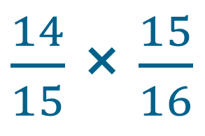
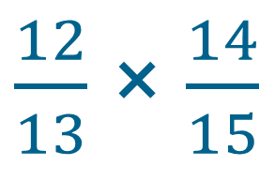
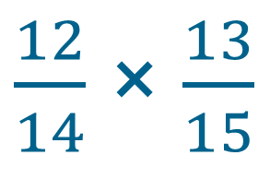
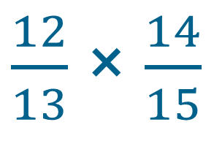
Appreciate that non-unit fractions are integer multiples of unit fractions and that, by considering the commutative and associative laws, the multiplication of non-unit fractions can be derived.
Example 4
a)
Which gives the greater result, calculation A or calculation B?
Explain how you know.
b)
Which gives the greater result, calculation C or calculation D?
Explain how you know.
$\frac{12}{13}$ × $\frac{14}{15}$
$\frac{12}{13}$ × $\frac{14}{15}$
A:
C:
B:
$\frac{14}{15}$ × $\frac{15}{16}$
D:
$\frac{12}{14}$ × $\frac{13}{15}$
Notes:
Suggested questioning:
How could you rewrite each product? How could you rewrite each product so that they share a factor?
Once students have identified the common factor of 14/15: Which is bigger, 12/13 or 15/16? How do you know? (If students are struggling with this, you could reframe the question as ‘which is further from 1?’)
How does this help you to reason about which product is greater?
Will this always be possible with fractions made from consecutive numbers?
Things for you to think about:
A key aspect of fluency with calculations of this type is to look for simplifications before multiplying numerators and denominators. In Examples 4a and b, students should be encouraged to reason about the relative size of the answers by looking at the constituent parts of the product rather than calculating the product.

Slide 23
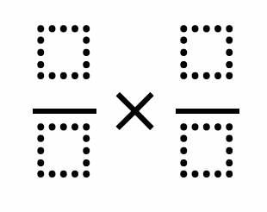
Appreciate that non-unit fractions are integer multiples of unit fractions and that, by considering the commutative and associative laws, the multiplication of non-unit fractions can be derived.
Example 4 (optional extension)
Arrange four consecutive numbers into the four parts of this fraction multiplication.
Which arrangement gives the greatest product?
Which arrangement gives the least product?
Is this the same for all sets of four consecutive numbers?
Notes:
Suggested questioning:
How many ways can you arrange your four consecutive numbers?
Which arrangement gives the greatest/least product?
Is this the same for all sets of four consecutive numbers?
Can you generalise this?
Things for you to think about:
This investigation might be used as an extension of Examples 4a and b, offering students the opportunity to generalise further about the structure of multiplication.

Slide 24



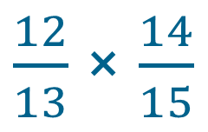
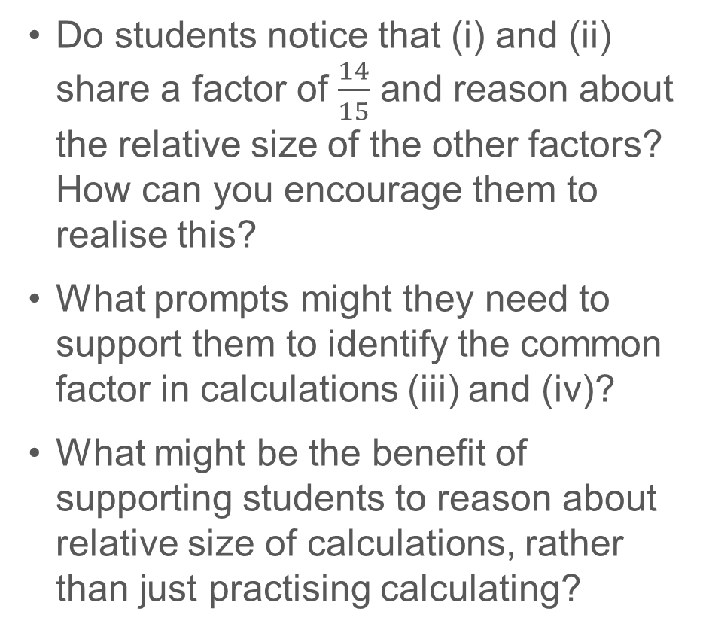
Appreciate that non-unit fractions are integer multiples of unit fractions and that, by considering the commutative and associative laws, the multiplication of non-unit fractions can be derived.
Example 4
  Do students notice that (i) and (ii) share a factor of $\frac{14}{15}$ and reason about the relative size of the other factors? How can you encourage them to realise this?
  What prompts might they need to support them to identify the common factor in calculations (iii) and (iv)?
  What might be the benefit of supporting students to reason about relative size of calculations, rather than just practising calculating?
a)
Which gives the greater result, calculation A or calculation B?
Explain how you know.
i:
$\frac{12}{13}$ × $\frac{14}{15}$
ii:
$\frac{14}{15}$ × $\frac{15}{16}$
b)
Which gives the greater result, calculation C or calculation D?
Explain how you know.
iii:
$\frac{12}{13}$ × $\frac{14}{15}$
iv:
$\frac{12}{14}$ × $\frac{13}{15}$
Notes:
Due to space constraints, the image on this PD discussion slide is very small. PD Leads might like to use or print the ‘in the classroom’ version of this slide for teachers to access during discussions.
This example can be found on pages 42 and 43 of the 2.1 Core Concept document.

Slide 25
Reflection questions
What other mathematical concepts will be supported by students’ stronger understanding of this key idea?
What mathematical language will you continue to use to support pupils to make connections with other areas?
Which representations might you continue to use to further develop students’ understanding?

Slide 27
Appendices
You may choose to use the following slides when planning or delivering a PD session. They cover:
  Key vocabulary
  Representations and structure
  Previous learning
  Future learning
  Library of links

Slide 28
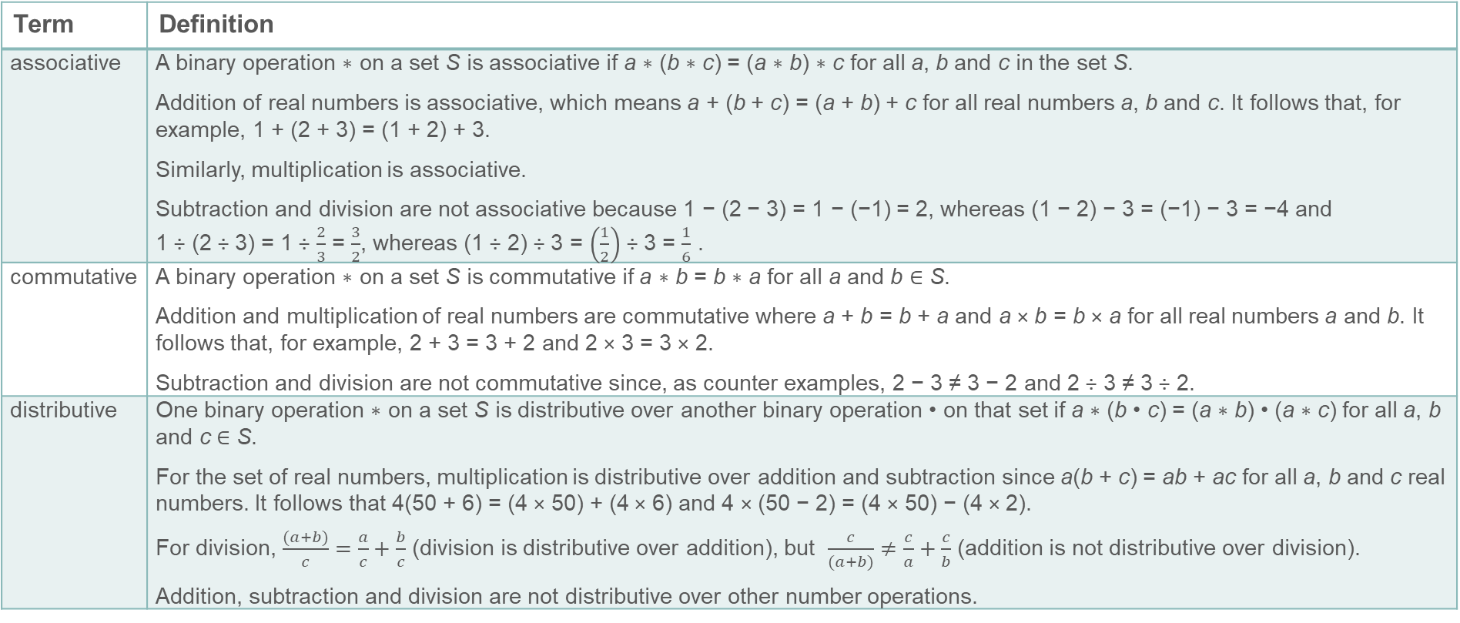
Key vocabulary (1)
Term | Definition
associative | A binary operation ∗ on a set S is associative if a ∗ (b ∗ c) = (a ∗ b) ∗ c for all a, b and c in the set S. Addition of real numbers is associative, which means a + (b + c) = (a + b) + c for all real numbers a, b and c. It follows that, for example, 1 + (2 + 3) = (1 + 2) + 3. Similarly, multiplication is associative. Subtraction and division are not associative because 1 − (2 − 3) = 1 − (−1) = 2, whereas (1 − 2) − 3 = (−1) − 3 = −4 and 1 ÷ (2 ÷ 3) = 1 ÷ $\frac{2}{3}$ = $\frac{3}{2}$, whereas (1 ÷ 2) ÷ 3 = $\left(\frac{1}{2}\right)$ ÷ 3 = $\frac{1}{6}$ .
commutative | A binary operation ∗ on a set S is commutative if a ∗ b = b ∗ a for all a and b ∈ S. Addition and multiplication of real numbers are commutative where a + b = b + a and a × b = b × a for all real numbers a and b. It follows that, for example, 2 + 3 = 3 + 2 and 2 × 3 = 3 × 2. Subtraction and division are not commutative since, as counter examples, 2 − 3 ≠ 3 − 2 and 2 ÷ 3 ≠ 3 ÷ 2.
distributive | One binary operation ∗ on a set S is distributive over another binary operation • on that set if a ∗ (b • c) = (a ∗ b) • (a ∗ c) for all a, b and c ∈ S. For the set of real numbers, multiplication is distributive over addition and subtraction since a(b + c) = ab + ac for all a, b and c real numbers. It follows that 4(50 + 6) = (4 × 50) + (4 × 6) and 4 × (50 − 2) = (4 × 50) − (4 × 2). For division, $\frac{(a+b)}{c}=\frac{a}{c}+\frac{b}{c}$ (division is distributive over addition), but $\frac{c}{(a+b)}≠\frac{c}{a}+\frac{c}{b}$ (addition is not distributive over division). Addition, subtraction and division are not distributive over other number operations.

Slide 29
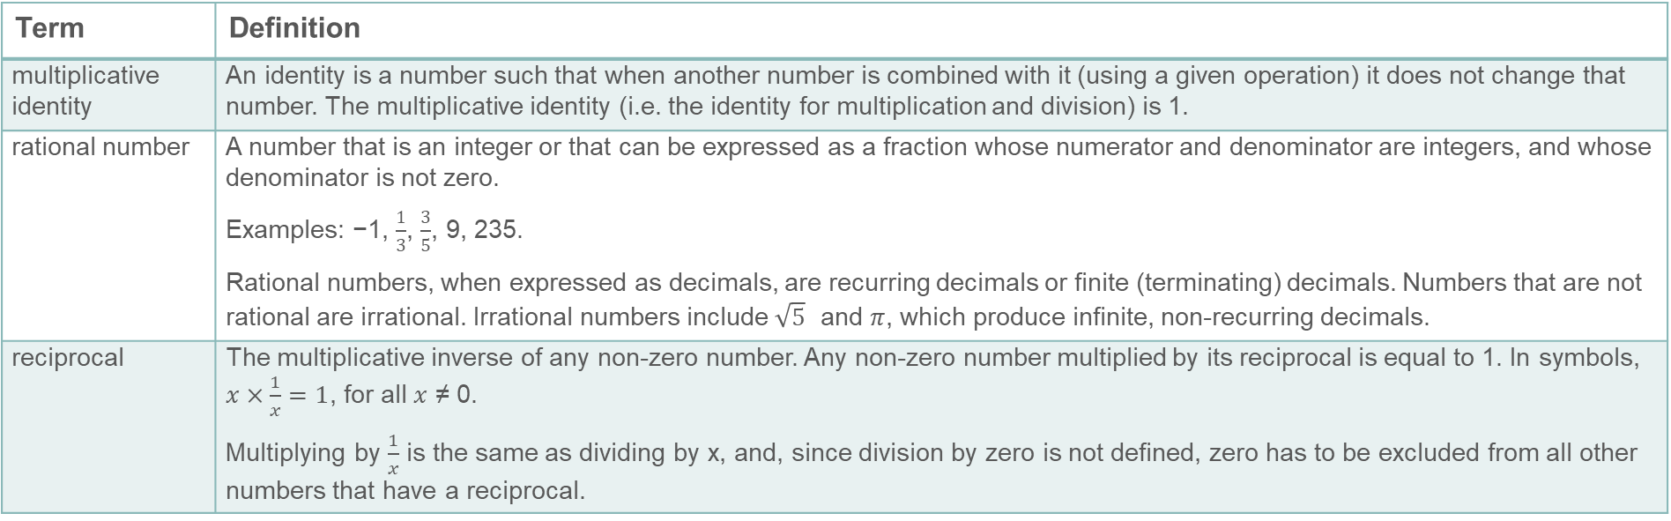
Key vocabulary (2)
Term | Definition
multiplicative identity | An identity is a number such that when another number is combined with it (using a given operation) it does not change that number. The multiplicative identity (i.e. the identity for multiplication and division) is 1.
rational number | A number that is an integer or that can be expressed as a fraction whose numerator and denominator are integers, and whose denominator is not zero. Examples: −1, $\frac{1}{3}$, $\frac{3}{5}$, 9, 235. Rational numbers, when expressed as decimals, are recurring decimals or finite (terminating) decimals. Numbers that are not rational are irrational. Irrational numbers include $\sqrt{5}$ and $π$, which produce infinite, non-recurring decimals.
reciprocal | The multiplicative inverse of any non-zero number. Any non-zero number multiplied by its reciprocal is equal to 1. In symbols, $x×\frac{1}{x}=1$, for all $x$ ≠ 0. Multiplying by $\frac{1}{x}$ is the same as dividing by x, and, since division by zero is not defined, zero has to be excluded from all other numbers that have a reciprocal.

Slide 30

Representations and structure
There are a number of different representations that you may wish to use to support students’ understanding of this key idea. These might include:
Arrays and area models
  The array is a useful image for revealing the commutative and distributive properties of multiplication. When the rectangle has continuous measures for the dimensions, it becomes a useful way of thinking about the product of any two numbers including decimals and fractions.
Bar models
  Bar models can be very useful to support students in representing (literally, re-presenting) problems to reveal additive and multiplicative structures, including those involving fractions.
Notes:
More information about the representations and structure involved in this key idea can be found:
On page 11 and 12 of the Theme Overview document.
In the ‘Using mathematical representations at KS3’ documents
Links to all of these can be found on the final slide.

Slide 31
Previous learning (1)
From Upper Key Stage 2, students will bring experience of:
multiplying multi-digit numbers up to four digits by a two-digit whole number using the formal written method of long multiplication
dividing numbers up to four digits by a two-digit whole number using the formal written method of long division, and interpreting remainders as whole number remainders, fractions, or by rounding, as appropriate for the context
dividing numbers up to four digits by a two-digit number using the formal written method of short division where appropriate, and interpreting remainders according to the context
performing mental calculations, including with mixed operations and large numbers
using their knowledge of the order of operations to carry out calculations involving the four operations
solving addition and subtraction multi-step problems in contexts, deciding which operations and methods to use and why
Notes:
Theme 2 Operating on number

Slide 32
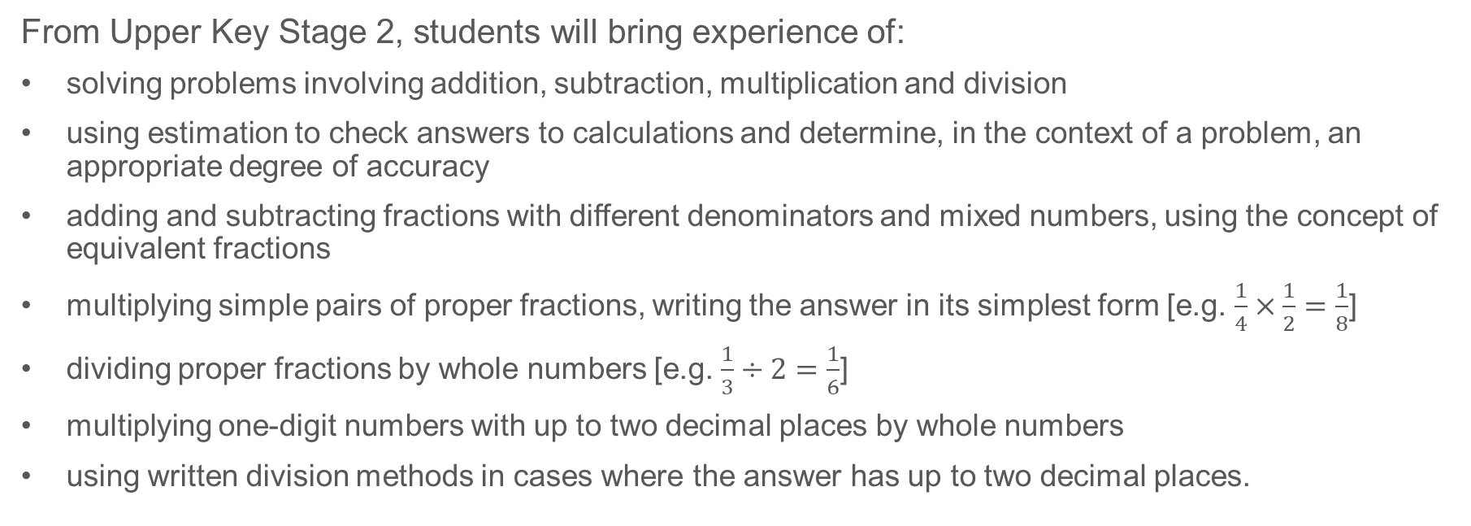
Previous learning (2)
From Upper Key Stage 2, students will bring experience of:
solving problems involving addition, subtraction, multiplication and division
using estimation to check answers to calculations and determine, in the context of a problem, an appropriate degree of accuracy
adding and subtracting fractions with different denominators and mixed numbers, using the concept of equivalent fractions
multiplying simple pairs of proper fractions, writing the answer in its simplest form [e.g. $\frac{1}{4}×\frac{1}{2}=\frac{1}{8}$]
dividing proper fractions by whole numbers [e.g. $\frac{1}{3}÷2=\frac{1}{6}$]
multiplying one-digit numbers with up to two decimal places by whole numbers
using written division methods in cases where the answer has up to two decimal places.
Notes:
Theme 2 Operating on number

Slide 33
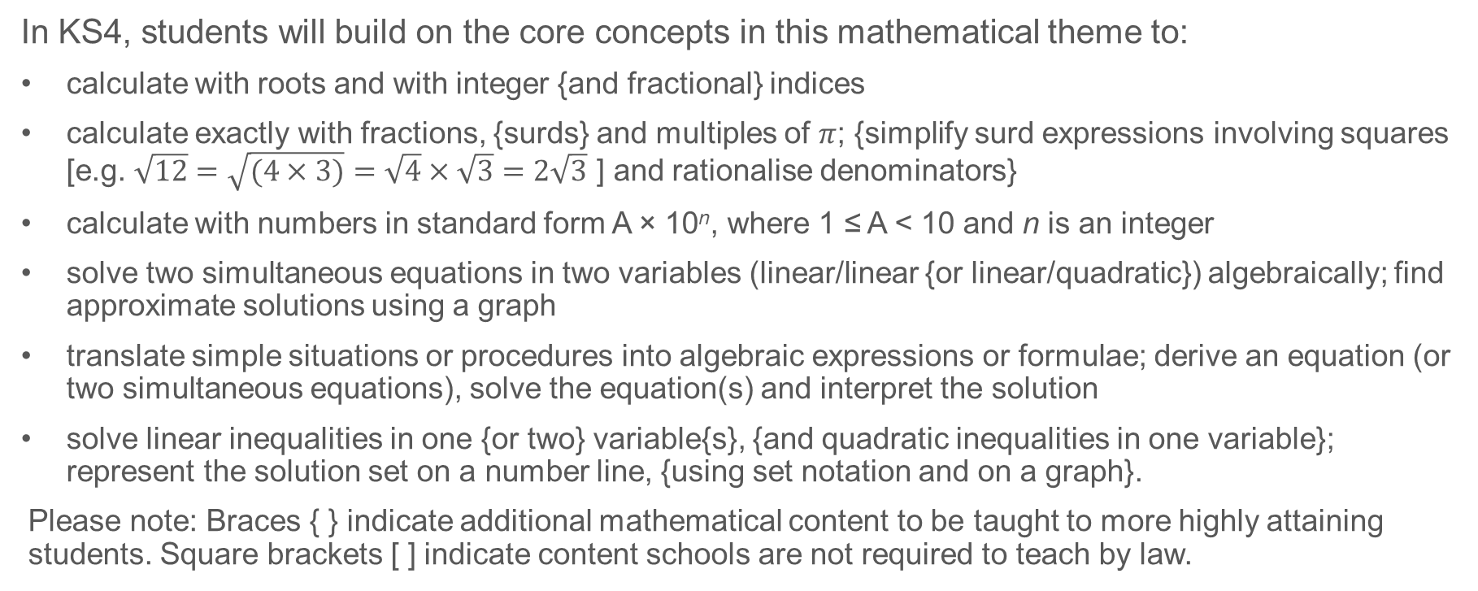
Future learning
In KS4, students will build on the core concepts in this mathematical theme to:
calculate with roots and with integer {and fractional} indices
calculate exactly with fractions, {surds} and multiples of $π$; {simplify surd expressions involving squares [e.g. $\sqrt{12}=\sqrt{(4×3)}=\sqrt{4}×\sqrt{3}=2\sqrt{3}$ ] and rationalise denominators}
calculate with numbers in standard form A × 10^{n}, where 1 ≤ A < 10 and n is an integer
solve two simultaneous equations in two variables (linear/linear {or linear/quadratic}) algebraically; find approximate solutions using a graph
translate simple situations or procedures into algebraic expressions or formulae; derive an equation (or two simultaneous equations), solve the equation(s) and interpret the solution
solve linear inequalities in one {or two} variable{s}, {and quadratic inequalities in one variable}; represent the solution set on a number line, {using set notation and on a graph}.
Please note: Braces { } indicate additional mathematical content to be taught to more highly attaining students. Square brackets [ ] indicate content schools are not required to teach by law.
Notes:
Theme 2 Operating on number

Slide 34
Library of links
The following resources from the NCETM website have been referred to within this slide deck:
  NCETM Secondary Mastery Professional Development
    2 Operating on number Theme Overview Document
    2.1 Arithmetic procedures Core Concept Document
  Using mathematical representations at KS3 | NCETM
  Insights from experienced teachers | NCETM
  NCETM primary mastery professional development materials
  NCETM secondary assessment materials
You may also find the following resources useful:
  Planning to teach secondary maths | NCETM
  Departmental Workshops | NCETM

