Slide 1
1.8 Composition of numbers: multiples of 10 up to 100
Representations | Year 1
Number, Addition and Subtraction

Slide 2
How to use this presentation
You can find the teacher guide 1.8 Composition of numbers: multiples of 10 up to 100 by following the link below.

Slide 3

1.8 Composition: multiples of 10 up to 100 – step 1:1

Slide 4

1.8 Composition: multiples of 10 up to 100 – step 1:1

Slide 5

1.8 Composition: multiples of 10 up to 100 – step 1:1

Slide 6


1.8 Composition: multiples of 10 up to 100 – step 1:1

Slide 7
1.8 Composition: multiples of 10 up to 100 – step 1:1

Slide 8
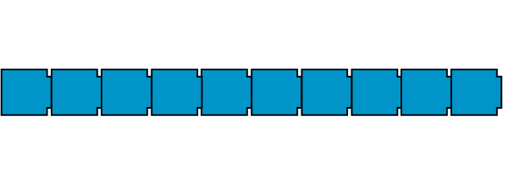
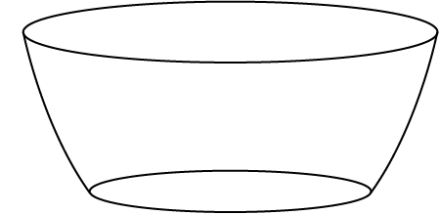

1.8 Composition: multiples of 10 up to 100 – step 1:1

Slide 9
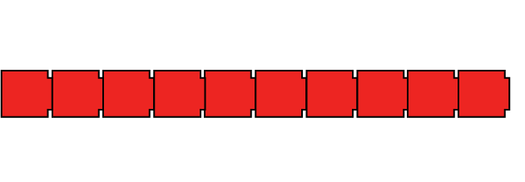
1.8 Composition: multiples of 10 up to 100 – step 1:1

Slide 10
1.8 Composition: multiples of 10 up to 100 – step 1:1

Slide 11
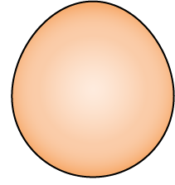
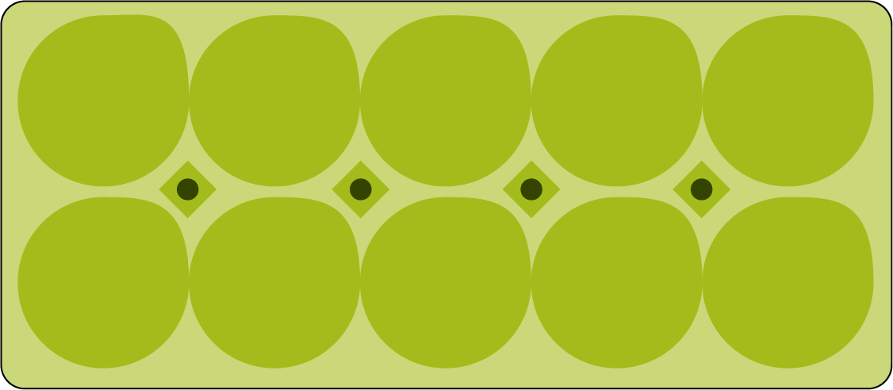
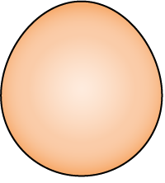
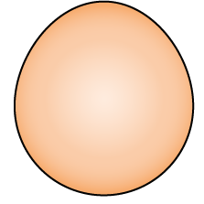
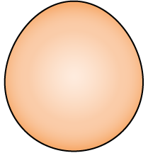
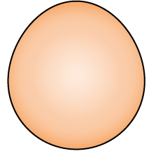
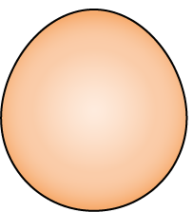
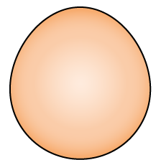
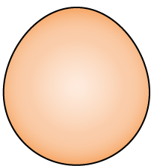
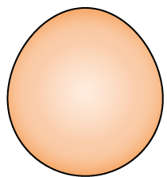
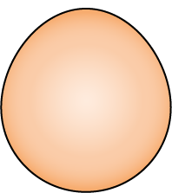
1.8 Composition: multiples of 10 up to 100 – step 1:2

Slide 12


1.8 Composition: multiples of 10 up to 100 – step 1:2

Slide 13

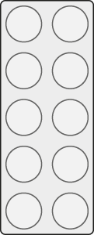
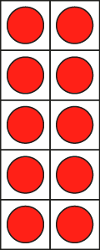
1.8 Composition: multiples of 10 up to 100 – step 1:4

Slide 14
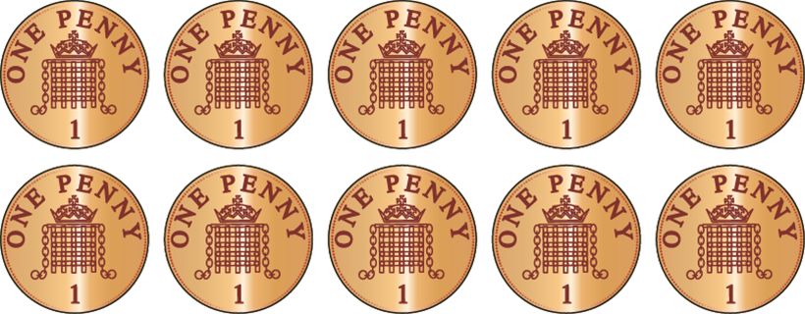
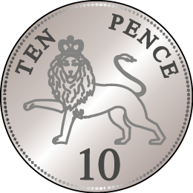
1.8 Composition: multiples of 10 up to 100 – step 1:5

Slide 15
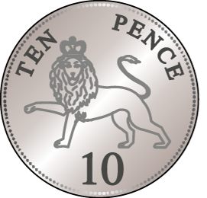
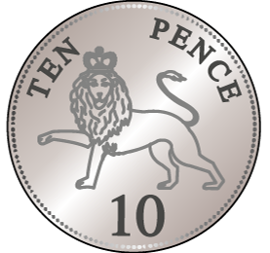
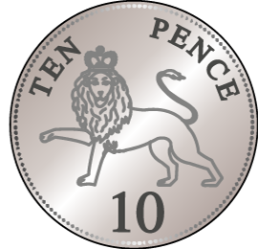
1.8 Composition: multiples of 10 up to 100 – step 2:1

Slide 16
1.8 Composition: multiples of 10 up to 100 – step 2:1

Slide 17













1.8 Composition: multiples of 10 up to 100 – step 2:1

Slide 18
1.8 Composition: multiples of 10 up to 100 – step 2:1

Slide 19
1.8 Composition: multiples of 10 up to 100 – step 2:1

Slide 20
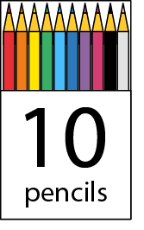
1.8 Composition: multiples of 10 up to 100 – step 2:2
90
70
100
80
20
30
40
50
10
60

Slide 21
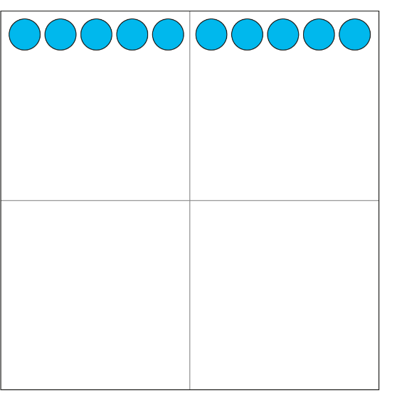




1.8 Composition: multiples of 10 up to 100 – step 2:2
10
20
30
40
50
60
70
80
90
100

Slide 22


1.8 Composition: multiples of 10 up to 100 – step 2:3

Slide 23


1.8 Composition: multiples of 10 up to 100 – step 2:3

Slide 24
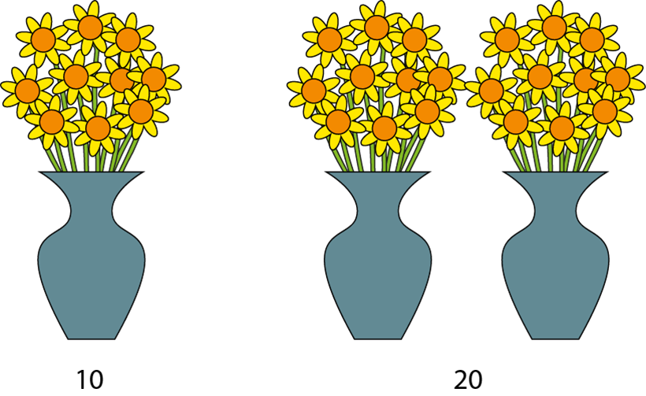
1.8 Composition: multiples of 10 up to 100 – step 2:3

Slide 25
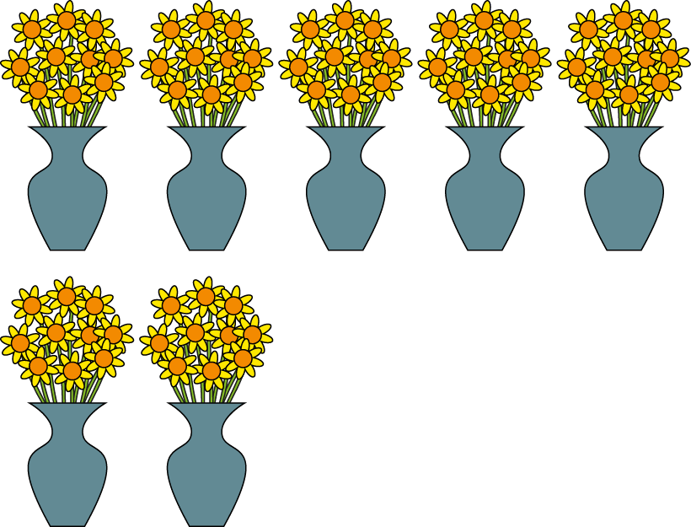
1.8 Composition: multiples of 10 up to 100 – step 2:4
70

Slide 26



1.8 Composition: multiples of 10 up to 100 – step 2:4
10
50
30

Slide 27
1.8 Composition: multiples of 10 up to 100 – step 2:4
10
60
40

Slide 28
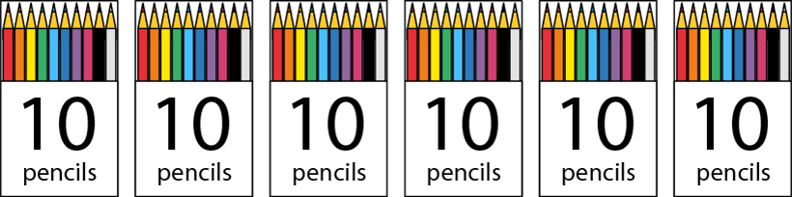




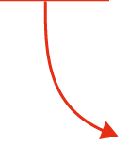


1.8 Composition: multiples of 10 up to 100 – step 2:5

Slide 29
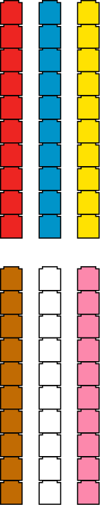
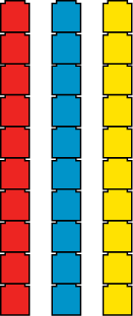
1.8 Composition: multiples of 10 up to 100 – step 2:6
10
30
60

Slide 30




1.8 Composition: multiples of 10 up to 100 – step 2:7
10
+
10
+
10
+
10
+
10
+
10
+
10
=
70

Slide 31
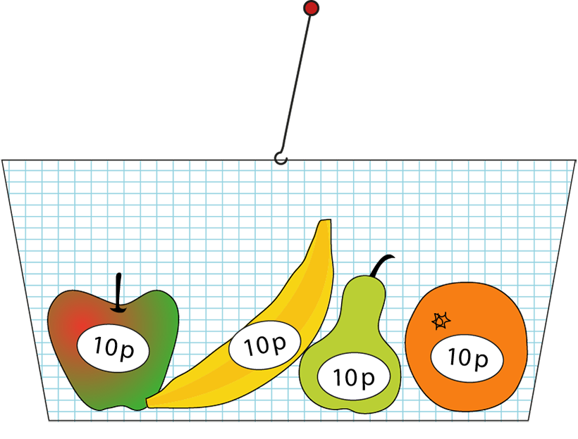
1.8 Composition: multiples of 10 up to 100 – step 2:7
10 p
+
10 p
+
10 p
+
10 p
=
40 p

Slide 32
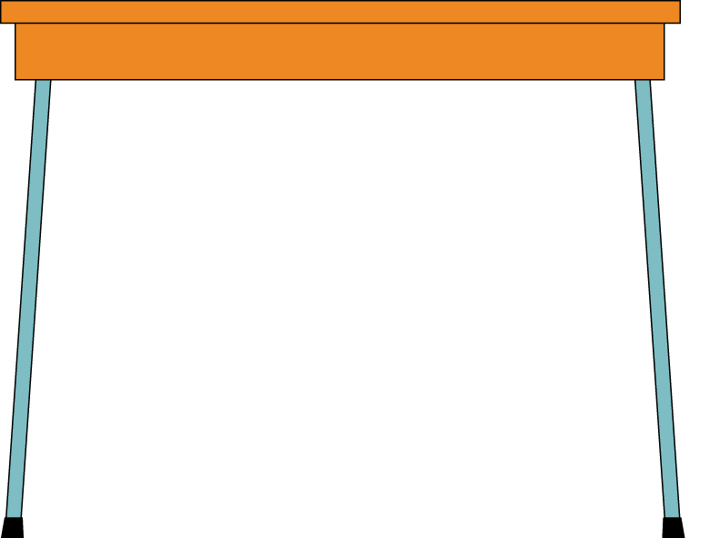



1.8 Composition: multiples of 10 up to 100 – step 3:1

Slide 33
1.8 Composition: multiples of 10 up to 100 – step 3:1

Slide 34
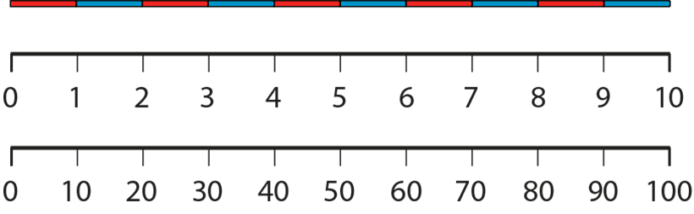
1.8 Composition: multiples of 10 up to 100 – step 3:2

Slide 35









1.8 Composition: multiples of 10 up to 100 – step 3:2

Slide 36
1.8 Composition: multiples of 10 up to 100 – step 3:2
1000 | 2000 | 3000 | 4000 | 5000 | 6000 | 7000 | 8000 | 9000
100 | 200 | 300 | 400 | 500 | 600 | 700 | 800 | 900
1 | 2 | 3 | 4 | 5 | 6 | 7 | 8 | 9
10
20
30
40
50
60
70
80
90

Slide 37
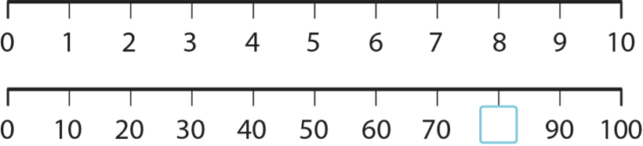

1.8 Composition: multiples of 10 up to 100 – step 3:3

Slide 38
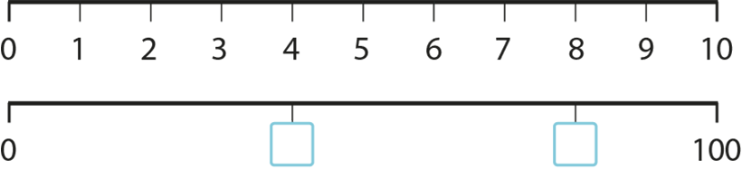

1.8 Composition: multiples of 10 up to 100 – step 3:3

Slide 39
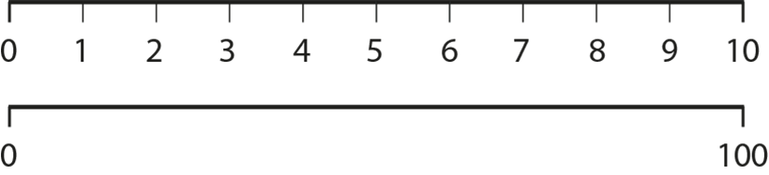


1.8 Composition: multiples of 10 up to 100 – step 3:3

Slide 40





1.8 Composition: multiples of 10 up to 100 – step 3:4

Slide 41







1.8 Composition: multiples of 10 up to 100 – step 3:4

Slide 42


1.8 Composition: multiples of 10 up to 100 – step 3:5

Slide 43
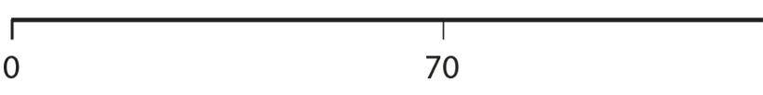

1.8 Composition: multiples of 10 up to 100 – step 3:5

Slide 44
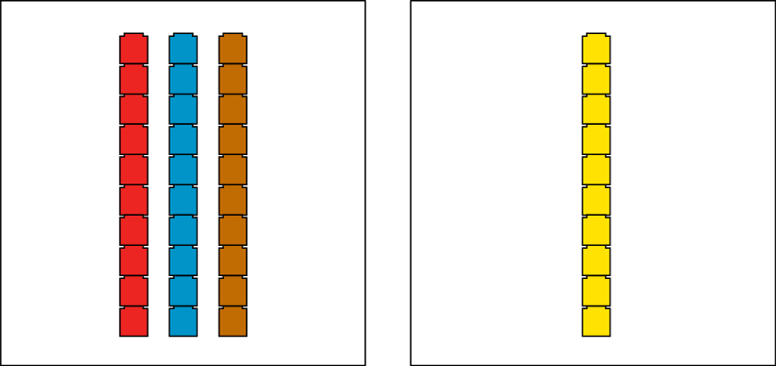
1.8 Composition: multiples of 10 up to 100 – step 3:6

Slide 45

1.8 Composition: multiples of 10 up to 100 – step 3:6
Notes:
Teddy says that forty is less than sixty. Is he right? Convince me.

Slide 46
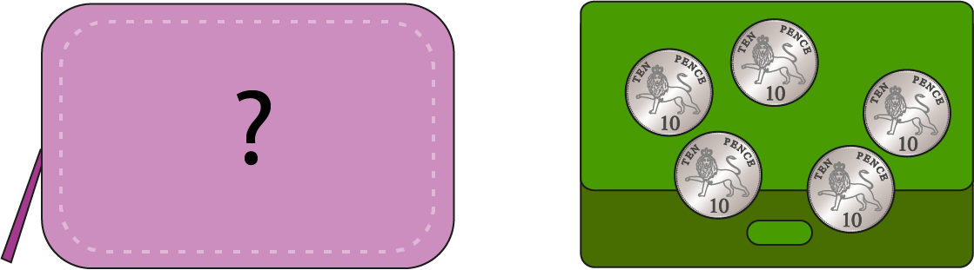
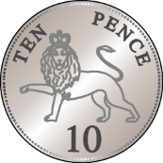
1.8 Composition: multiples of 10 up to 100 – step 3:7
Sarah
Deb
Notes:
Sarah and Deb have some 10 p coins. Sarah has fewer coins than Deb. If Deb has 50 p, how much money might Sarah have?

Slide 47



1.8 Composition: multiples of 10 up to 100 – step 4:1
1
ten
2
tens
3
tens
4
tens
5
tens
6
tens
7
tens
8
tens
9
tens
10
tens

Slide 48
1.8 Composition: multiples of 10 up to 100 – step 4:1
1
ten
2
tens
3
tens
4
tens
5
tens
6
tens
7
tens
8
tens
9
tens
10
tens

Slide 49
1.8 Composition: multiples of 10 up to 100 – step 4:1
ten
10
twenty
20
thirty
30
forty
40
fifty
50
sixty
60
seventy
70
eighty
80
ninety
90
one hundred
100

Slide 50
1.8 Composition: multiples of 10 up to 100 – step 4:1
ten
10
twenty
20
thirty
30
forty
40
fifty
50
sixty
60
seventy
70
eighty
80
ninety
90
one hundred
100

Slide 51
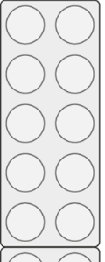
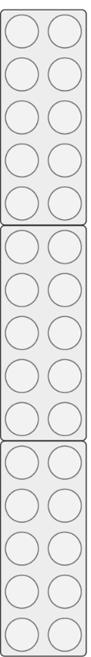
1.8 Composition: multiples of 10 up to 100 – step 4:2
30
40

Slide 52
1.8 Composition: multiples of 10 up to 100 – step 4:2
40
30

Slide 53





1.8 Composition: multiples of 10 up to 100 – step 4:6

Slide 54


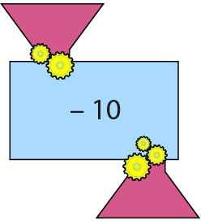




1.8 Composition: multiples of 10 up to 100 – step 4:6

Slide 55





1.8 Composition: multiples of 10 up to 100 – step 4:6

Slide 56


1.8 Composition: multiples of 10 up to 100 – step 4:6

Slide 57
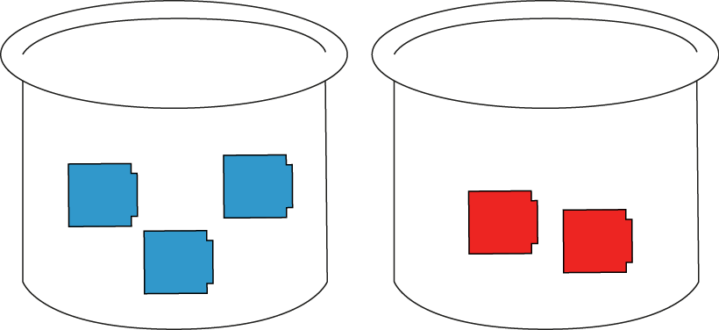
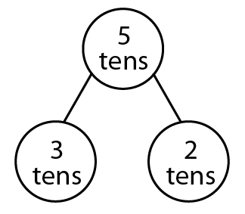

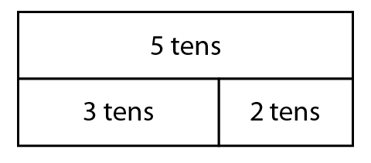

1.8 Composition: multiples of 10 up to 100 – step 5:1

Slide 58
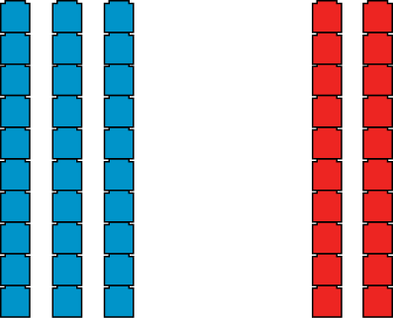
1.8 Composition: multiples of 10 up to 100 – step 5:2

Slide 59
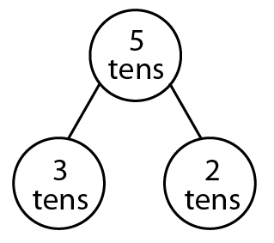
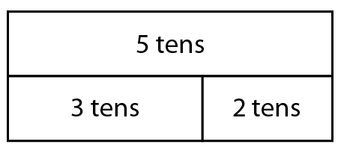
1.8 Composition: multiples of 10 up to 100 – step 5:2

Slide 60


1.8 Composition: multiples of 10 up to 100 – step 5:3

Slide 61
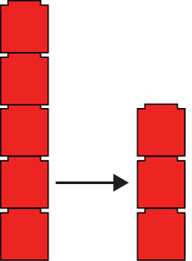

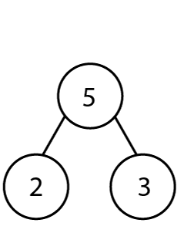

1.8 Composition: multiples of 10 up to 100 – step 5:4
5
− 2
= 3

Slide 62



1.8 Composition: multiples of 10 up to 100 – step 5:4
5 tens
− 2 tens
= 3 tens

Slide 63

1.8 Composition: multiples of 10 up to 100 – step 5:6

Slide 64




1.8 Composition: multiples of 10 up to 100 – step 5:7

Slide 65


1.8 Composition: multiples of 10 up to 100 – step 5:7

Slide 66

1.8 Composition: multiples of 10 up to 100 – step 5:8

Slide 67



1.8 Composition: multiples of 10 up to 100 – step 5:8

Slide 68

1.8 Composition: multiples of 10 up to 100 – step 5:9

