Slide 1
2.28 Combining division with addition and subtraction
Representations | Year 6
Multiplication and Division

Slide 2
How to use this presentation
You can find the teacher guide 2.28 Combining division with addition and subtraction by following the link below.

Slide 3
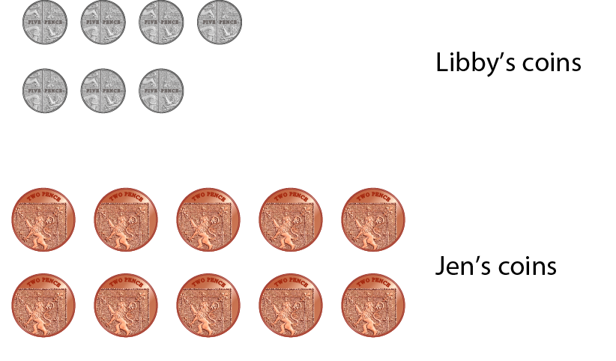
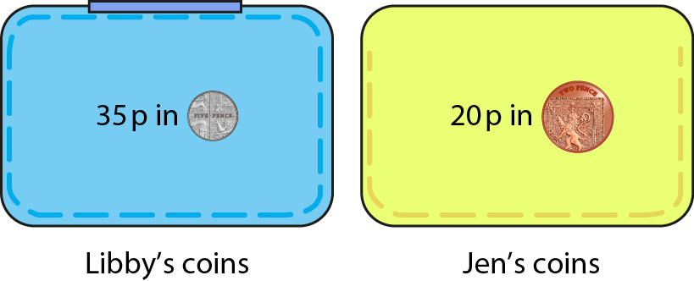
2.28 Combining operations: ÷, + and − Step 1:1
35 p in 5 p coins and 20 p in 2 p coins.
How many coins altogether?
35 p ÷ 5 p + 20 p ÷ 2 p
= 7 + 10
= 17
Notes:
Libby has 35 p in 5 p coins and Jen has 20 p in 2 p coins.
How many coins do they have altogether?

Slide 4
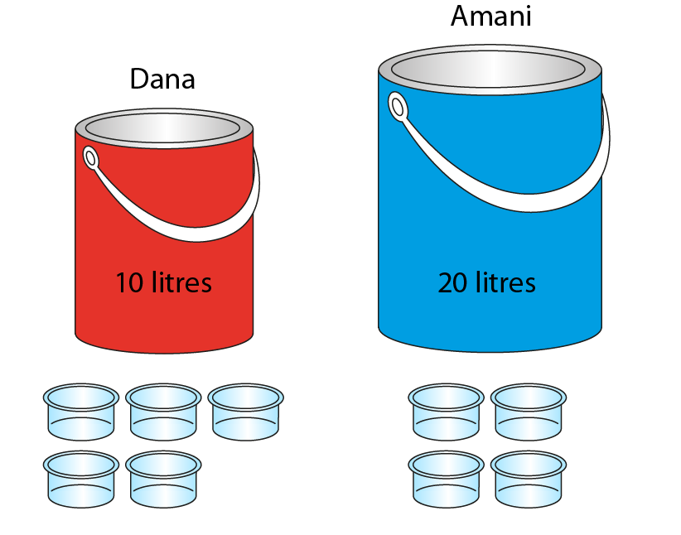
2.28 Combining operations: ÷, + and − Step 1:1
10 litres of red paint, poured into 5 pots;
20 litres of blue paint, poured into 4 pots.
1 pot of red paint and 1 pot of blue paint –
how much paint in total?
10 ÷ 5 + 20 ÷ 4
= 2 + 5
= 7
Notes:
Dana has ten litres of red paint, which she pours into five pots.
Amani has twenty litres of blue paint, which she pours into four pots. They give a pot of red paint and a pot of blue paint to Nathan.
How much paint does Nathan have in total?

Slide 5
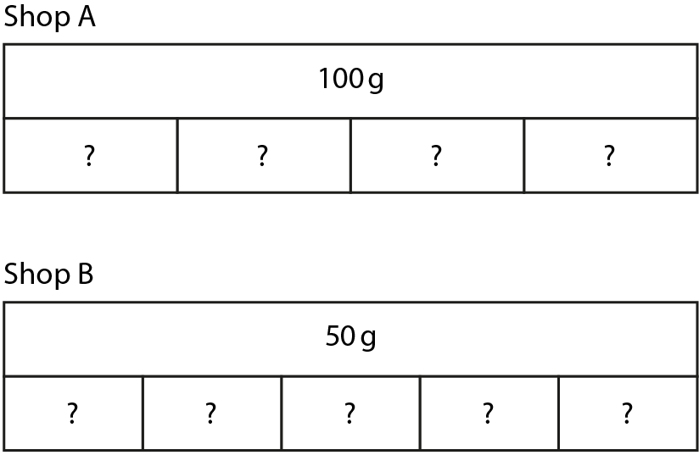
2.28 Combining operations: ÷, + and − Step 1:1
Shop A sells 100 g of cereal shared into 4 packs.
Shop B sells 50 g of cereal shared into 5 packs.
A pack from Shop A and a pack from Shop B –
how much cereal altogether?
Notes:
Shop A sells 100 g of cereal shared into four small packs.
Shop B sells 50 g of cereal shared into five small packs.
If I buy a small pack from Shop A and a small pack from Shop B, how much cereal will I have altogether?

Slide 6

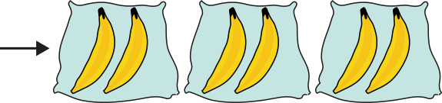

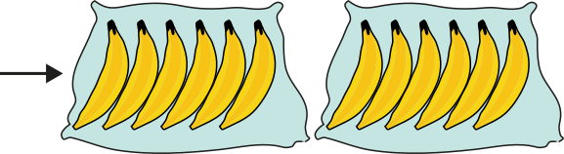
2.28 Combining operations: ÷, + and − Step 1:2
Leila puts 6 bananas into bags of 2.
James puts 12 bananas into bags of 6.
Who has more bags, and by how many?
6 ÷ 2 − 12 ÷ 6
= 3 − 2
= 1

Slide 7
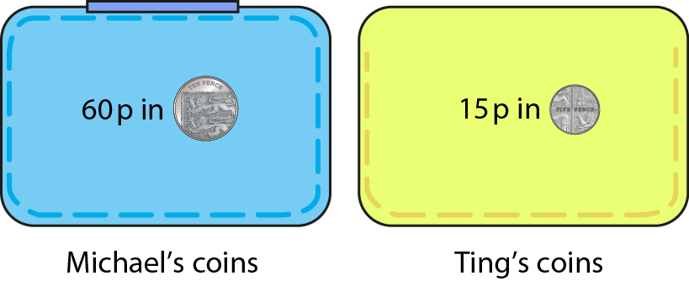
2.28 Combining operations: ÷, + and − Step 1:2
60 p in 10 p coins and 15 p in 5 p coins.
Who has more coins, and by how many?
Notes:
Michael has 60 p in 10 p coins and Ting has 15 p in 5 p coins.
Who has more coins, and by how many?

Slide 8
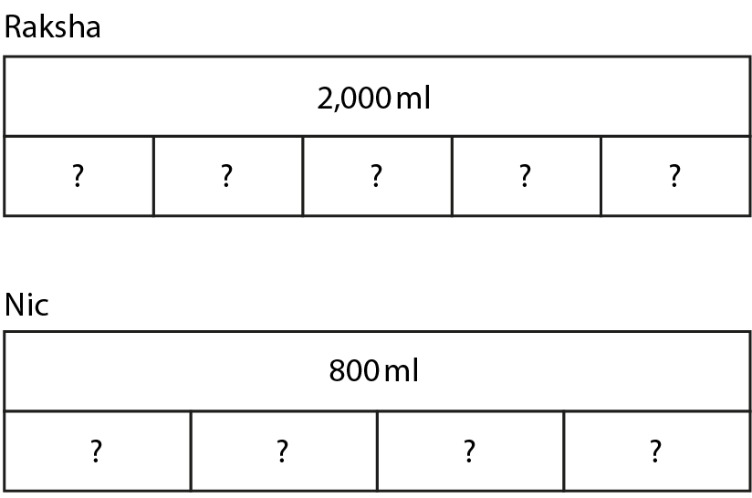
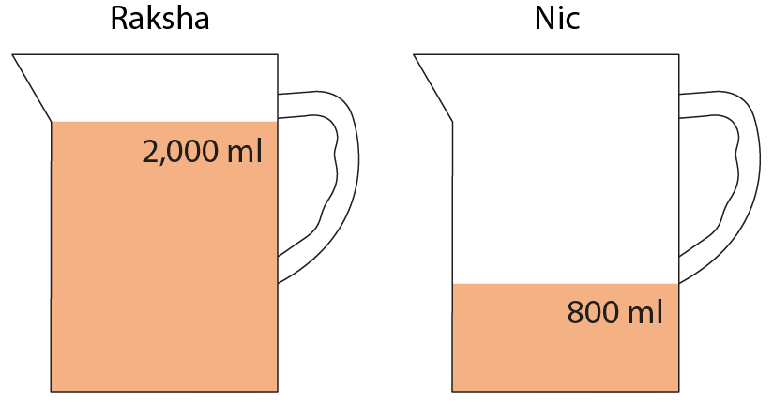
2.28 Combining operations: ÷, + and − Step 1:2
Raksha – 2,000 ml of water, poured into 5 glasses.
Nic – 800 ml of water, poured into 4 glasses.
Who has more water per glass, and by how much?
Notes:
Raksha has 2,000 ml of water, which she pours into five glasses.
Nic has 800 ml of water, which she pours into four glasses.
Who has more water per glass, and by how much?

Slide 9
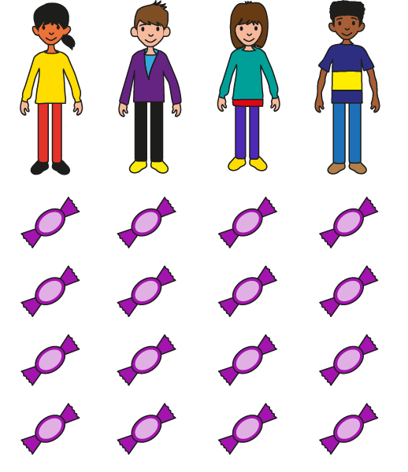
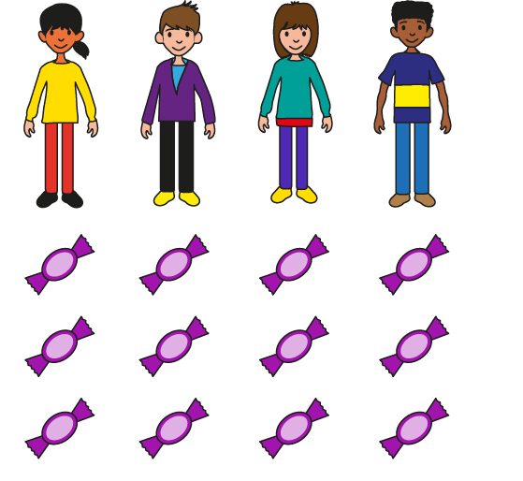
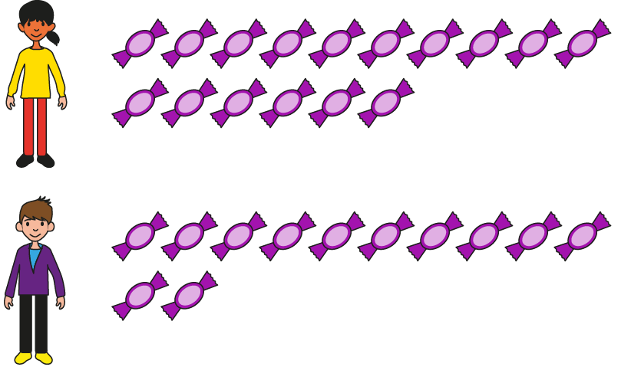
2.28 Combining operations: ÷, + and − Step 2:1
Ann – 16 sweets; Brett – 12 sweets. The sweets are shared between
themselves and two other friends. How many does each person get?
Method 1:
16 ÷ 4
12 ÷ 4
16 ÷ 4 + 12 ÷ 4
= 4 + 3
= 7
Notes:
Ann has sixteen sweets and Brett has twelve sweets.
They share the sweets between themselves and two other friends.
How many does each person get?

Slide 10
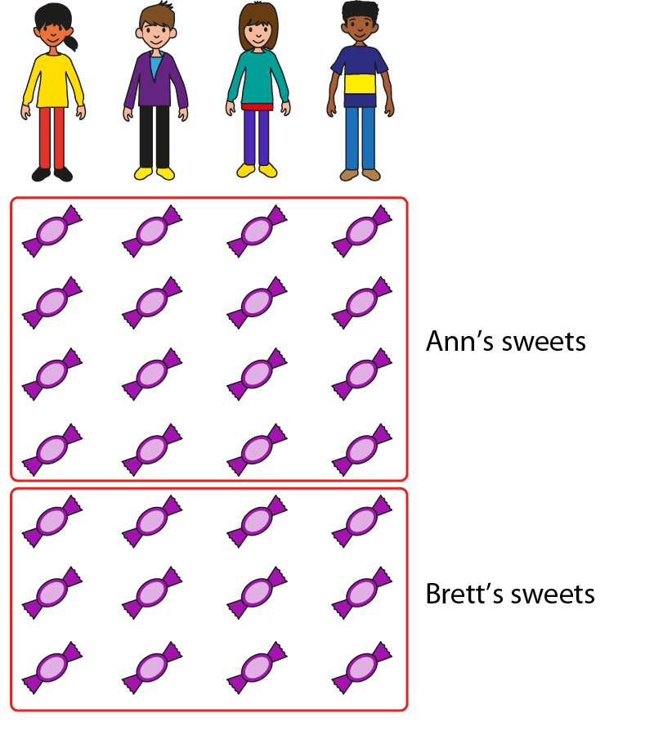
2.28 Combining operations: ÷, + and − Step 2:1
Ann – 16 sweets; Brett – 12 sweets. The sweets are shared between
themselves and two other friends. How many does each person get?
Method 2:
16 ÷ 4
+ 12 ÷ 4
= (16 + 12)
÷
4
= 28
÷
4
= 7
Notes:
Ann has sixteen sweets and Brett has twelve sweets.
They share the sweets between themselves and two other friends.
How many does each person get?

Slide 11
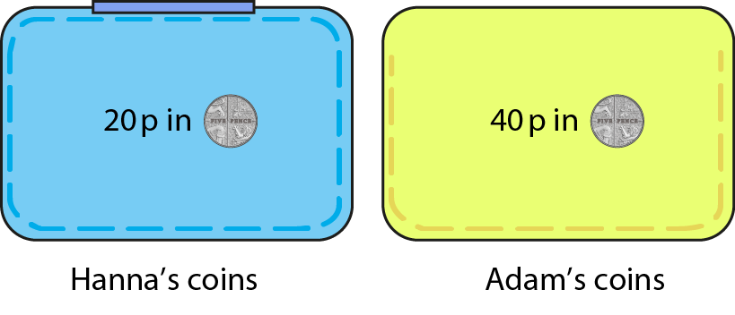
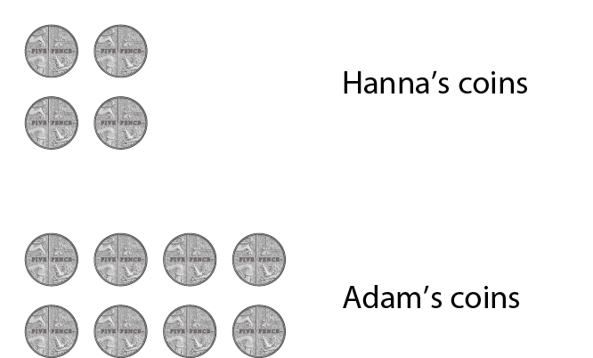
2.28 Combining operations: ÷, + and − Step 2:1
Hanna – 20 p in 5 p coins; Adam – 40 p in 5 p coins.
How many coins altogether?
Method 1:
Method 2:
20 ÷ 5 + 40 ÷ 5
20 ÷ 5 + 40 ÷ 5
= 4 + 8
= (20 + 40) ÷ 5
= 12
= 60 ÷ 5
= 12
Notes:
Hanna has 20 p in 5 p coins and Adam has 40 p in 5 p coins.
How many coins do they have altogether?

Slide 12


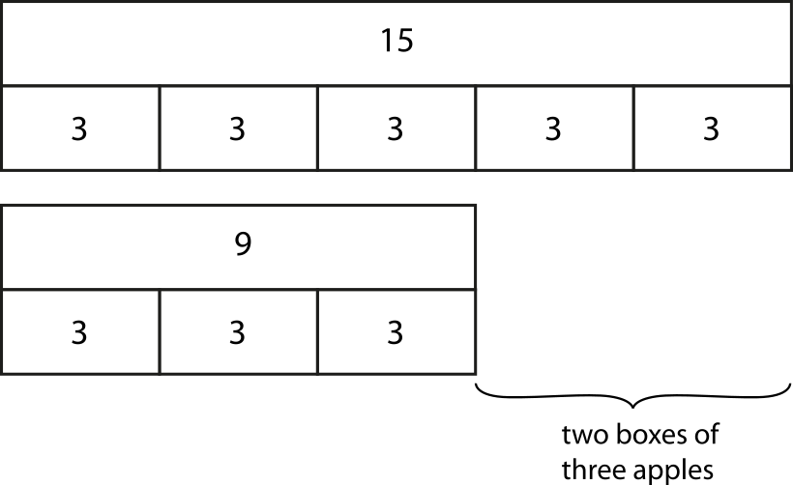

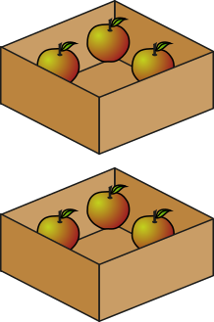
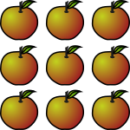

2.28 Combining operations: ÷, + and − Step 2:3
Kish – 15 apples in boxes of 3; Jess – 9 apples in boxes of 3.
Who has more boxes, and by how many?
15 ÷ 3 − 9 ÷ 3
= (15 − 9) ÷ 3
= 6 ÷ 3
= 2
Notes:
Kish puts fifteen apples into boxes of three.
Jess puts nine apples into boxes of three.
Who has more boxes, and by how many?

Slide 13
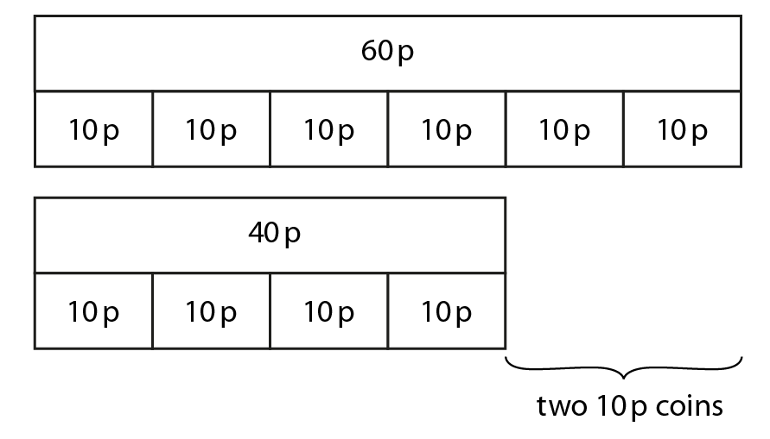
2.28 Combining operations: ÷, + and − Step 2:3
Mr H – 60 p in 10 p coins; Mr J – 40 p in 10 p coins.
Who has more coins, and by how many?
60 ÷ 10 − 40 ÷ 10
= (60 − 40) ÷ 10
= 20 ÷ 10
= 2
Notes:
Mr H has 60 p in 10 p coins. Mr J has 40 p in 10 p coins.
Who has more coins, and by how many?

Slide 14
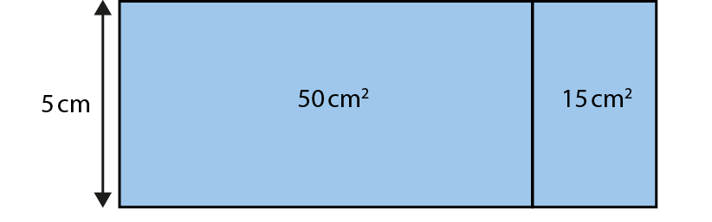
2.28 Combining operations: ÷, + and − Step 2:4
Notes:
A rectangular piece of paper has been cut into two smaller rectangles. One of the smaller pieces of paper has an area of 50 cm² and the other has an area of 15cm².
If the width is 5 cm, what was the length of the piece of paper before it was cut?

